Slide 1
Movement
Markonah : Honey buns, there’s something
I wanted to ask you
Markus : What, sweetie pie?
Markonah : If you will marry me
Markus : (pretending not to hear)
What d’you say, darlin’?
Markonah : Will you marry me?

Slide 2
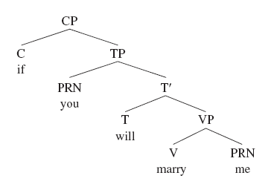
CP

Slide 3
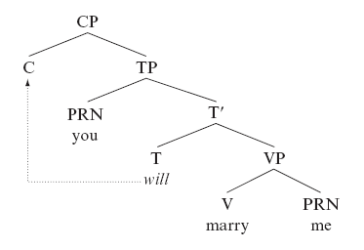

Slide 4
PSRs are not enough for
What did the child draw?
The child draw something. (What was that something?)
The child drew what?
What did the child draw ?

Slide 5
X-Bar limitation
It undergenerates, it does not produce all the possible grammatical sentences in a language.
Chomsky (1957) proposes transformational rules. Transformations take the output of X-bar rules (and other transformations) and change them into different trees.

Slide 6
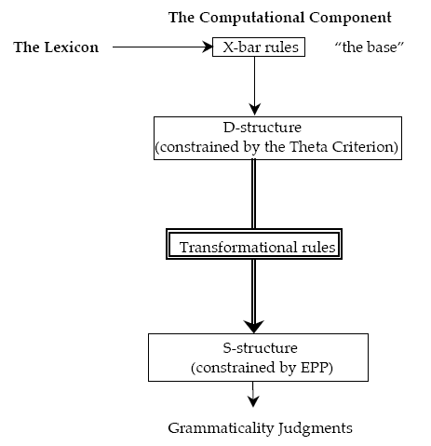
D-structure is then subject to the transformational rules :words around in the sentence.

Slide 7
Therefore:
Movement processes turn out to be a central aspect of grammar in many languages and we will see many instances of it in today’s discussion.
We will see the main theoretical considerations relating to movement processes and which play a role in the description of virtually all English sentences.
We can see that it can be applied to a lot of linguistic phenomena.

Slide 8
Head to Head Movement
In Chomskian grammar, we’ll look at 2 different transformations: Movement rules and Insertion rules.
Movement rules move things around in the sentence. Insertion rules put something new into the sentence.
the rules that move one head into another, called head-to head movement. These transformational rules will allow us to generate sentences like (1) and (2) above. X-bar theory by itself cannot produce these structures. → see p. 241
There are 2 kinds of H to H Movement:

Slide 9
1. Verb Movement (V→T)
V → T movement:
Move the head V to the head T.
Verb raising parameter:
V raise to T or T lowers to V.
Since English is parameterized for affix lowering rather than verb raising, the inverse movement to French applies:

Slide 10
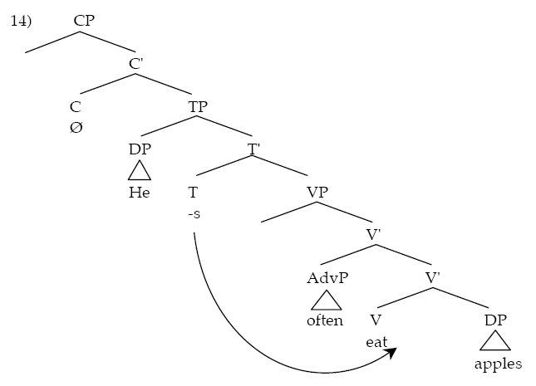
S-Structure Result: He often eats apples

Slide 11
2. T Movement (T → C)
Its often called subject-aux inversion. In yes/no questions in English (questions that can be answered with either a yes or no), auxiliary verbs invert with their subject:
a) You have squeezed the toilet paper.
b) Have you squeezed the toilet paper?
We claimed that subject-aux inversion is a special case of these question complementizers. English doesn’t have an overt (pronounced) question complementizer

Slide 12
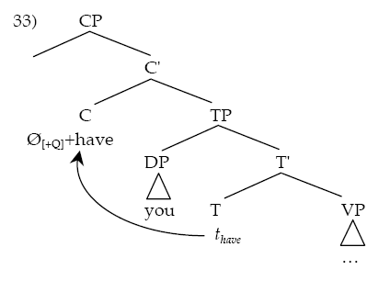
English employs a mechanism (which we now know is a transformation), that gives phonological content to that Ø[+Q] by moving T to it, around the subject:

Slide 13
Proofs:
This kind of analysis is supported by the fact subject-aux inversion (T → C) is in strict complementary distribution with overt question complementizers as seen in the following embedded clauses:
a) I asked,” have you squeezed the toilet paper?”
b) I asked whether you have squeezed the toilet paper.
c) *I asked whether have you squeezed the toilet paper.

Slide 14
Other Movements
the water was wasted
is this the end?
this conclusion, virtually no one has ever come to
the plans were released for the new car park

Slide 15
Passive
Water was wasted (ex no 1). We might claim that in this case the object moves from object position into subject position:

Slide 16
Yes – No Questions
Is this the end? Such questions typically involve subject–auxiliary inversion, in which the auxiliary verb and the subject appear to switch places.

Slide 17
Topicalization
a process which moves an element interpreted as a topic to the front of the sentence. A topic is typically something that has already been mentioned before in a conversation, or can be interpreted as easily accessible in a conversation due to the context.

Slide 18
Extraposition
A kind of movement which appears to split a constituent across the structure. Here, this PP is the complement of the noun; it appears to have been moved out of the subject DP into the final position.

Slide 19
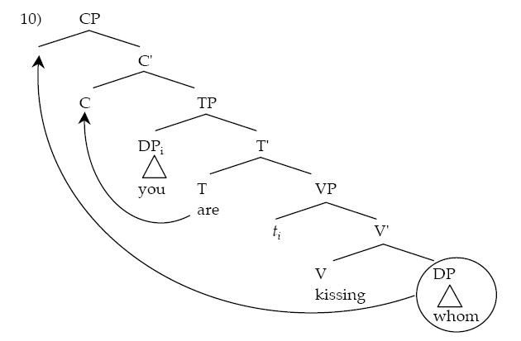
WH- Movement

