Slide 1
Oshima, A. & Hogue, A. (1999) Writing academic English (3rd ed.). White Plains, NY: Longman
ELEMENTS OF A GOOD PARAGRAPH

Slide 2
Proper topic sentence

Slide 5
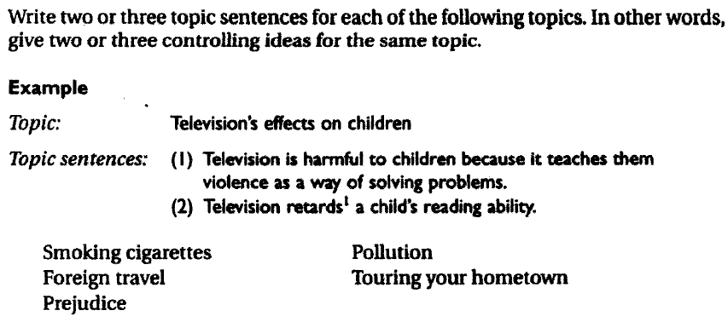

Slide 6
Although most paragraphs should have a topic sentence, there are a few situations when a paragraph might not need a topic sentence. For example, you might be able to omit a topic sentence in a paragraph that narrates a series of events, if a paragraph continues developing an idea that you introduced (with a topic sentence) in the previous paragraph, or if all the sentences and details in a paragraph clearly refer—perhaps indirectly—to a main point. The vast majority of your paragraphs, however, should have a topic sentence.

Slide 7
unity
Unity means that you discuss only one main idea in a paragraph.
The main idea is stated in the topic sentence, and then each and every supporting sentence develops that idea. Do not include any information that does not directly support the topic sentence.
If, for example, you announce in your topic sentence that you are going to discuss two important characteristics of gold, discuss only those. Do not discuss any other ideas, such as the price of gold or gold mining.

Slide 8
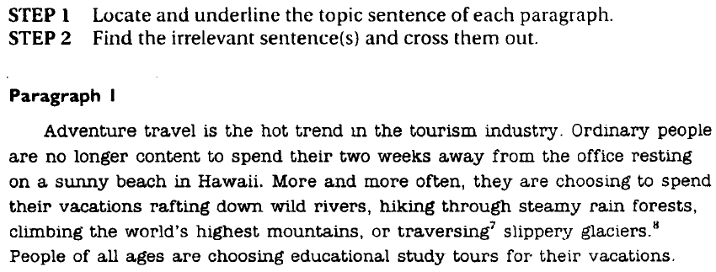

Slide 9
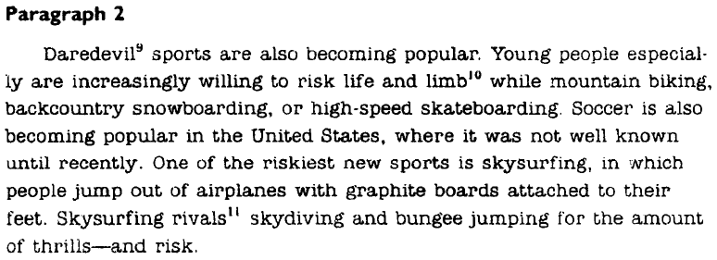

Slide 10
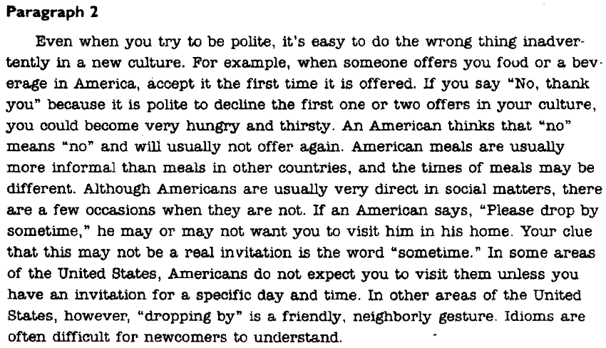
Find out what is wrong with this paragraph and suggest an improvement

Slide 11
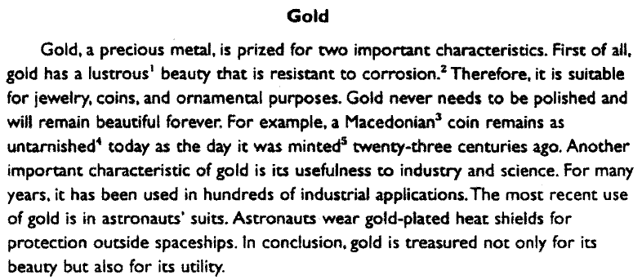

Slide 12
coherence
Coherence means that your paragraph is easy to read and understand because:
your supporting sentences are in some kind of logical order
your ideas are connected by the use of appropriate transition signals.
For example, in the paragraph about gold, there are two supporting ideas: Gold is beautiful, and gold is useful. Each of these supporting ideas is discussed, one after the other, and an example is given for each one. This is one kind of logical order. Furthermore, the relationship between the ideas is clearly shown by using appropriate transition words and phrases such as first of all, for example, another important characteristic, and in conclusion.

Slide 13
Compare these two paragraphs. Which one is more coherent?

