Slide 1
3. MEASUREMENT and DATA COLLECTION
Quantitative Research
© Yosa A. Alzuhdy, M.Hum.
yosa@uny.ac.id
English Language and Literature Study Program
Yogyakarta State University

Slide 2
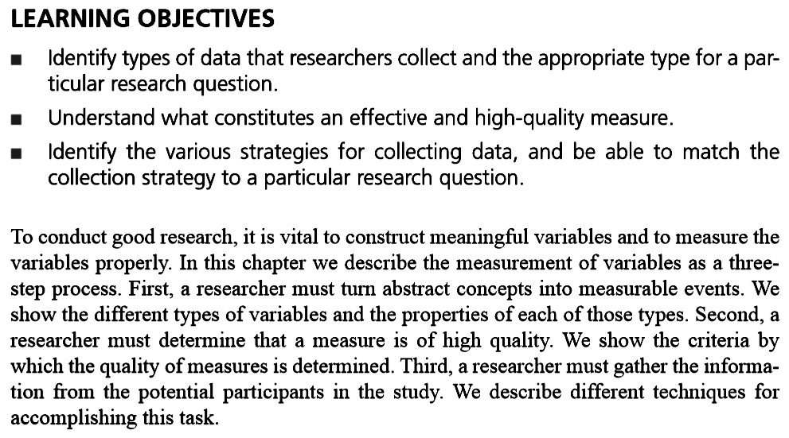
Learning Objectives

Slide 3
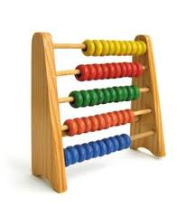
Quantitative research
Quantitative research stands for any systematic empirical investigation of quantitative phenomenon and properties;
Numeric analysis and measurement are the key parts of quantitative research that state the fundamental connection between observation and analytical statement;
Quantitative methods are mostly used to justify the hypotheses and draw a general conclusion on selected hypotheses;
Statistics, tables and graphs, are often used to present the results of these methods.

Slide 4
Measurement
Measurement: turning abstractions into variables.
Variable: a construct that can take on two or more distinct values. It can be anything that can be counted or measured, the result of which will be the data of research.
Data : a collection of variable measurements from a sample, to be analyzed and interpreted.
Operational definition: description of how an abstract concept measured in the research. It defines how a variable will specifically be measured or assessed.

Slide 5
Quantitative Data
The term quantitative data is used to describe a type of information that can be counted or expressed numerically. This type of data is often collected in experiments, manipulated and statistically analyzed. Quantitative data can be represented visually in graphs, histograms, tables and charts.
Some examples of quantitative data include exact counts ('there were 789 students who attended the rally') or other types of measurement ('it was 78 degree Fahrenheit yesterday at 2 PM').

Slide 6
Variable/Data types
Nominal: divide responses into two or more distinct categories in kind, not in degree or amount.
Ordinal: makes further distinction of categories by quantity of response alternatives, with numerical differences.
Interval: reflects increases in quantity with exactly the same quantity between different responses of variables.
Ratio: shows categories of increasing or decreasing quantity with additional property of an absolute zero, corresponding to the absence of the measure.
The measurement of variables can be categorized as categorical (nominal or ordinal scales) or continuous (interval or ratio scales).

Slide 7
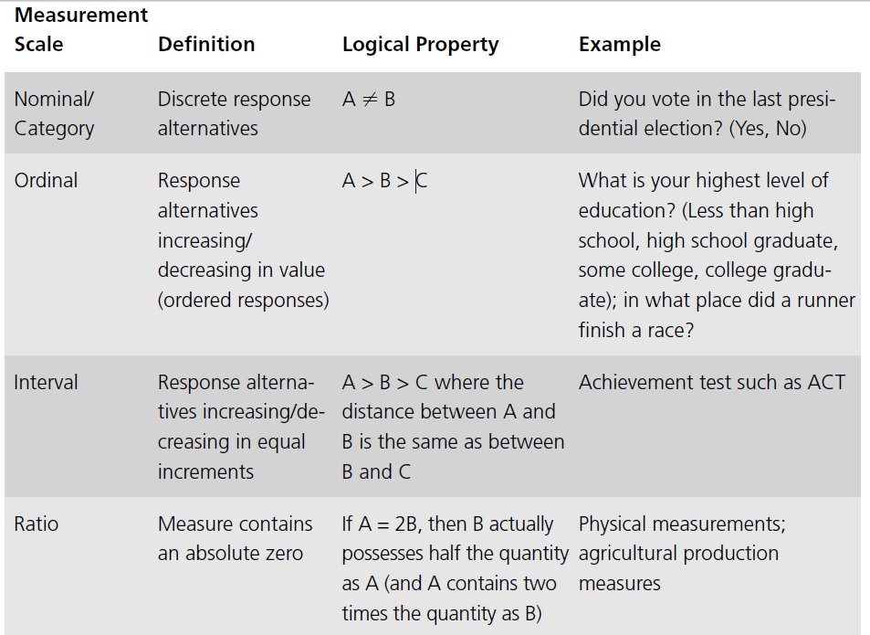
Types of Data
Table 3.1, page 49

Slide 8
NOMINAL DATA
Allows for the classification of objects, individual and responses based on a common characteristic or shared property.
A variable measured on the nominal scale may have one, two or more sub-categories depending on the degree of variation in the coding.
Any number attached to a nominal classification is merely a label, and no ordering is implied: social worker, nurse, electrician, physicist, politician, teacher, plumber, etc.

Slide 10
p.50 Your Turn

Slide 11
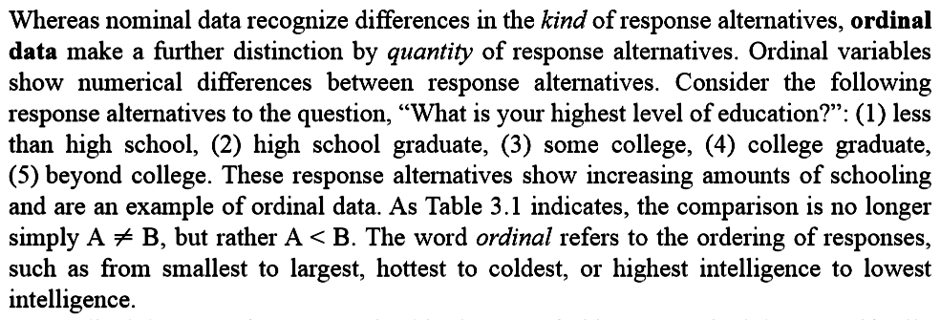
ORDINAL DATA
It does not only categorize objects, individuals and responses into sub-categories on the basis of a common characteristics, but it also ranks them in descending order of magnitude.
Any number attached to an ordinal classification is ordered, but the intervals between may not be constant: Educational background, level of English competence, General English course taken, etc

Slide 13
p.53 Your Turn

Slide 14
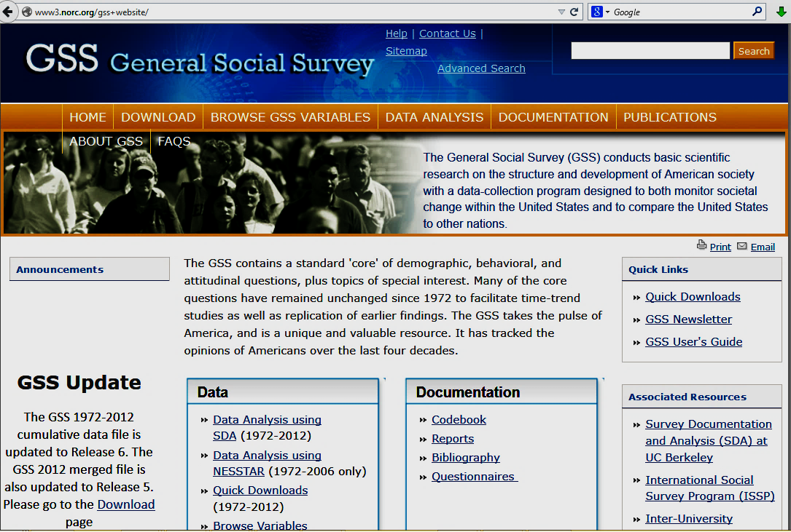

Slide 15
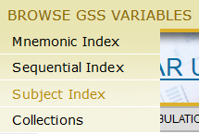
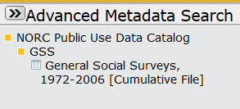

Slide 16
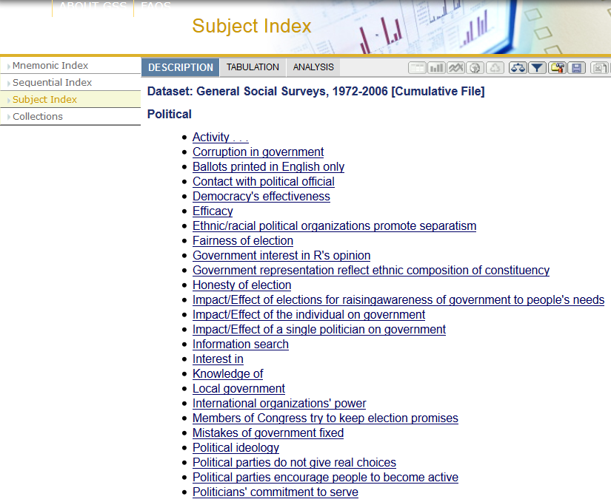
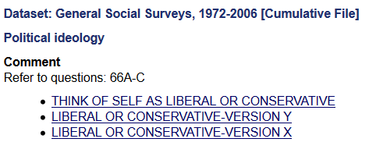
Select Subject Index: P
Select: Political
Select: Political Ideology
Select: THINK OF SELF AS LIBERAL OR CONSERVATIVE

Slide 17
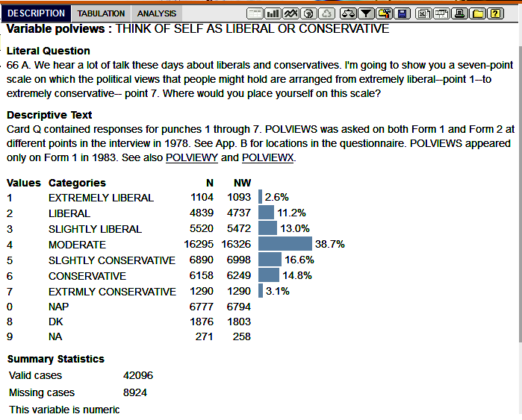

Slide 18
INTERVAL DATA
It has the properties of the ordinal scale and, in addition, has a commencement and termination point, and uses a scale of equally spaced intervals in relation to the range of the variable.
The number of intervals between the commencement and termination points is arbitrary and varies from one scale to another. Zero also has a value: such as the temperature degree.
In measuring an attitude using the Likert scale, the intervals may mean the same up and down the scale of 1 to 5 but multiplication is not meaningful: a rating of ‘4’ is not twice as ‘favorable’ as a rating of ‘2’.

Slide 19
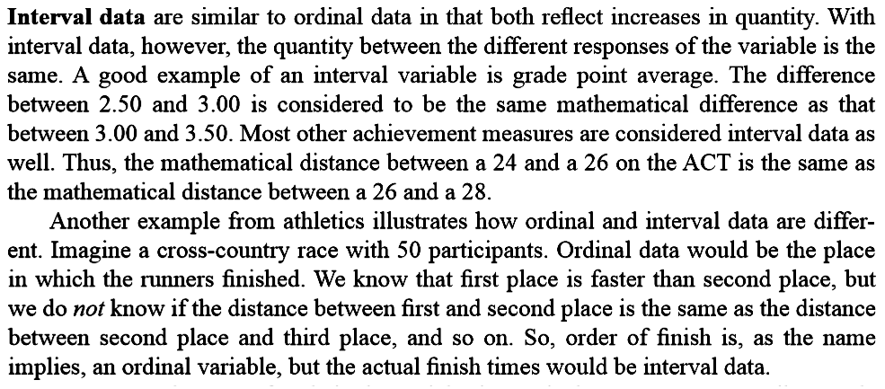
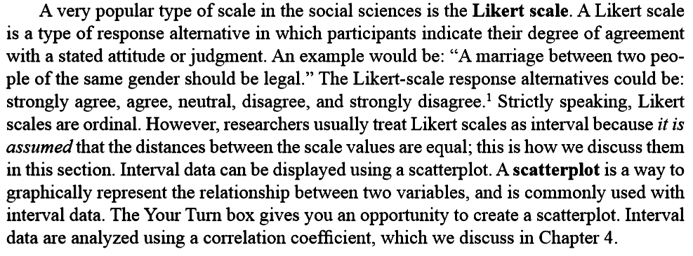

Slide 20
RATIO DATA
In addition to having all the properties of the nominal, ordinal and interval scales, the ratio scale has a zero point.
The ratio scale is an absolute measure allowing multiplication to be meaningful.
The numerical values are ‘real numbers’ with which you can conduct mathematical procedures: a man aged 30 years is half the age of a woman of 60 years.

Slide 21
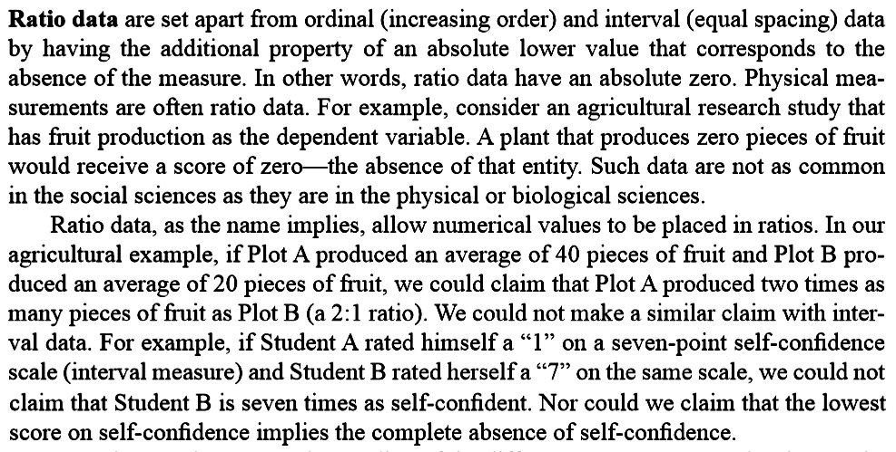

Slide 22
C A T E G O R I C A L
C O N T I N U O U S
Unitary | Dichotomous | Polytomous | Interval or Ratio Scale
Name Occupation Location Site | [1] Yes [0] No [1] Good [0] Bad [1] Female [0] Male [1] Right [0] Wrong [1] Extrovert [0] Introvert [1] Psychotic [0] Neurotic [1] Assertive [0] Passive [1] Present [0] Absent | Attitudes (Likert Scale): [5] . . . strongly agree [4] . . . agree [3] . . . uncertain [2] . . . disagree [1] . . . strongly disagree Age: [4] . . . Old [3] . . . Middle-aged [2] . . . Young [1] . . . Child Income: [3] . . . High [2] . . . Medium [1] . . . Low Socio-Economic Status: [5] . . . A [4] . . . B [3] . . . C1 [2] . . . C2 [1] . . . D [0] . . . E | Income (£000s per annum) Age (in years) Reaction Time (in seconds) Absence (in days) Distance (in kilometres) Length (metres) Number of children (kids) GPA

Slide 23
Another way of classification
Qualitative | Quantitative
Sex (Male/Female) Age (Old/Young) Attitude (Favourable/Unfavourable) Attitude (Likert scale) Achieved Educational Level (High/Low) Style (Autocratic/Participative) Location (Urban/Rural) Performance (Good/Bad) | Age (in years) Attitude (Guttman scale) Attitude (Thurstone & Cheve scale) Performance (errors or faults per minute) Achieved Educational Level (number of years post-secondary school education)

Slide 24
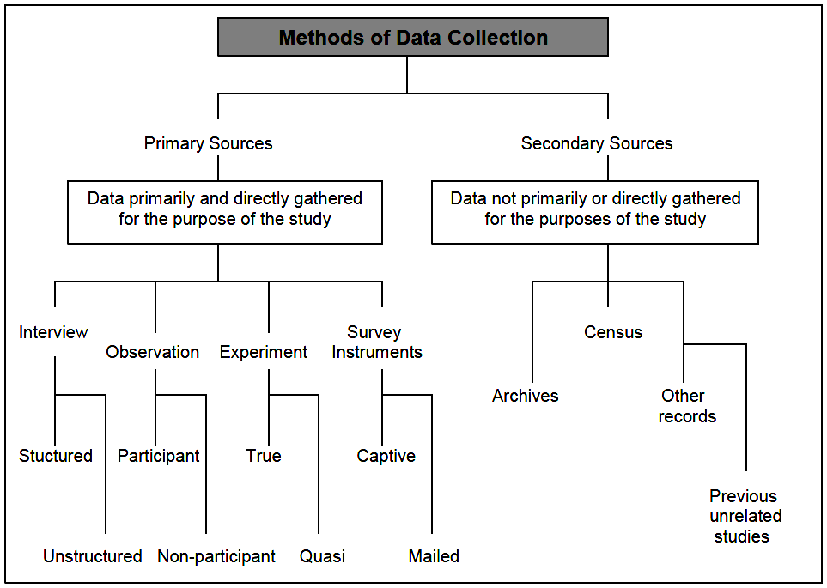

Slide 25
See you next time…

