Slide 1
Tourism Trends

Slide 2
UNWTO (2005) Tourism Highlights 2005 identified the following trends:
(1) rapid development and growth of e-commerce and e-marketing,
(2) fast track travel – the facilitation and speeding up of the travel process, and
(3) everyone is chasing Asian tourists

Slide 4
Trend 1: Travel becomes more activity-interest based rather than destination based
More and more travellers are deciding what activities they want to partake first and then choose the destination that offers them
It is therefore important for the NTOs to associate their destinations with ‘unique’ activities/offerings to induce inbound tourists
Other niche activities to be considered include wellness and medical tourism
Spa tourism
Cruise travel is another growth market
School children have been travelling overseas for the purpose of education
Volunteer tourism is another emerging trend
Development of integrated resorts in the region is gathering pace

Slide 5
Trend 2: Chasing Chinese Tourists
Continuous economic growth in China has generated tremendous volumes of domestic, inbound and outbound tourism activities.
In 2005, China was expected to have 40 million outbound travellers, an increase of 38 percent over 2004.
World Tourism Organization (WTO) predicted that by 2013, China will become the world’s number four tourist-generating country
A booming economy is a result of an influx of foreign direct investment (FDI), which leads to an increase in business travel.
In 2005, China attracted nearly 4 million business travellers and most of them headed to Beijing and Shanghai.
With the 2008 Beijing Olympics and 2010 World Expo on the way, business travel to these two cities is expected to increase steadily

Slide 6
Trend 3: Online travel bookings and demand for information technology keep rising
The increase of online bookings and improvement of information technology will force travel agents to transform themselves into travel consultants
Low-cost carries have helped to speed up this transformation by fueling online bookings
By 2007, all airlines are required by International Air Transport Association (ITA) to issue e-tickets only
Coexistence of online bookings will not replace personal touch and services

Slide 7
Trend 4: Low-cost carriers
Low airfares supposedly encourage more travels
LCCs and rising fuel prices (fuel surcharges discourage long-haul travel) boost intra-regional (short-haul) travel
LCCs’ expansion will shift to north and southwest of the region from South-east Asia
Monitor the trend of exchange rates, as they are reported to be more sensitive to visitors than fuel surcharges when making travel decisions
Open skies and lagging infrastructure development cause the skies to be more crowded, especially in southern China and India

Slide 8
Trend 5: Asia Becomes a convention hub
As Asia continues to be the major recipient of FDI and increase of many multinational corporations in the region, business travel within and to Asia has and will continue to grow at a rapid pace
Asia will also be the most sought after location for conventions
Corporations in mainland China begin to realise the importance of meeting, incentive, convention and exhibition (MICE) market, which will have tremendous growth potential

Slide 9
Trend 6: Competition and cooperation among destinations
China and India are the two major tourists generating countries and other destinations are endeavouring to tap these two markets
Fierce competition also creates more cooperation
e.g., Joint Singapore & Indonesia promotion
Brunei twinned with Singapore
Hong Kong is strengthening its alliance with Thailand, Malaysia and Singapore
Regional consolidation results in coordinated marketing drives
ASEAN countries are promoting their destination as a whole
Countries of the Greater Mekong Sub-region (GMS) are also coordinating their joint effort in tourism infrastructure development
India works with Sri Lanka to boost tourism in South Asia
Middle East equally call for join promotion of the Arabian destination

Slide 10
Trend 7: Tourists’ tastes and spending
At one end are visitors seeking for comfort/luxury travel products, at the other are people looking for thrills/budget travel
Caused by the vaporization of ‘middle class’
Majority of countries/cities in Asia are targeting high-end and high yield markets signifying a shift of focus from quantity to quality

Slide 11
Trend 8: social-environmental awareness and consciousness
One country that needs to pay special attention to this issue is China, where economic development has and continuous to put a heavy burden on its ecological environment
Other regions and countries also need to pay much attention to this issue
Hong Kong (air pollution), Indonesia (haze)
Vietnam (overdevelopment in Camranh Bay and Halong Bay) and Cambodia (commercialization of
Siem Reap)
Indonesia was commended for its success in restoring coral reefs around Pemuteran in north Bali that revived the local communities; and Seoul’s rejuvenation of Cheong Cheon (Stream)
Possible Establishment of an international reference of quality management and environmental management for the tourism industry

Slide 12
Trend 9: Seniors and women will travel more
The empty nesters are becoming the target market for many countries/regions
Japan, Hong Kong, Mainland China, Taiwan, Korea are strong drivers of this market
Thailand, Taiwan are both planning and building nursery villas to attract retirees from Japan and other countries/regions
NTOs and other stakeholders of the tourism industry need to monitor closely the social trends of certain markets
Japan does not encourage long-haul travel for retired couples
Family travel is another important segment that Hong Kong, Brunei, the Philippines, Singapore, Thailand and Australia are eagerly targeting
The Philippines and Singapore are targeting the middle-aged and young professional female travelers
The most favorable activities for women travelers are shopping, visiting natural and scenic attractions, rest and relaxation, gourmet cuisine sampling and visiting historic and cultural attractions

Slide 13
Trend 10: Safety and health concerns
The threat of pandemic outbreaks such as bird flu calls for a coordinated effort among NTOs and other government agencies
Timely and accurate communication is even more important that outbreak itself
Diabetes is another health concern that will have a serious impact on tourism
Action-oriented activities like soft adventure tourism and sport tourism is likely to become more popular

Slide 14
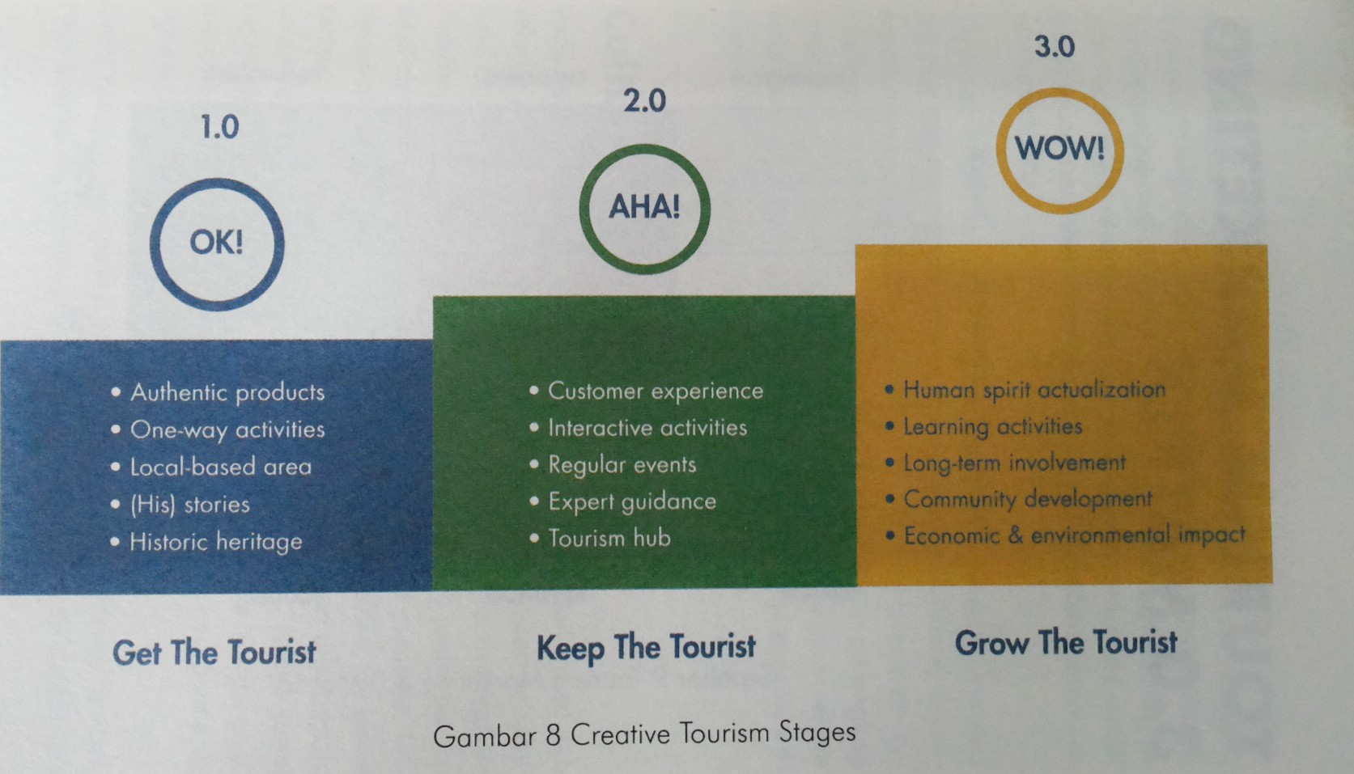

Slide 16
