Slide 1
What we have been through
Culinary role in tourism
Tourism campaigns between countries and cities: Some critics
Tourism impacts
Positive
Negative

Slide 2
Tourists’ motivation
Understanding why tourists travel

Slide 3
Most destinations in Asia
Versi Asia travel
Versi trip advisor
Chiang Mai, Thailand → old cities
Penang, Malaysia → place to relax and to eat the best cuisine in Asia
Singapore
Sabah, Borneo → ecotourism
Siem Riep, Cambodia → world heritage
Beijing, China → world heritage
The Thai islands
Bali, Indonesia
Tokyo, Japan
Goa, India
Siem Riep, Cambodia
Beijing, China
Shanghai, China
Chiang Mai, Thailand
Goa, India
Boracay, Philippines
Hongkong, China
Hanoi, Vietnam
Kyoto, Japan
Tokyo, Japan
Singapore
Ubud, Indonesia
Hoi An, Vietnam
Luang Prabang, Laos
Koh Phi Phi, Thailand
Taipei, Taiwan
Koh Tao, Thailand
Seoul, Korea

Slide 5
Factors affecting tourism
Growing leisure time
Income trends
Demographic
Travel trends: business (MICE), leisure, medical
Mode of transportation

Slide 6
Leiper tourism model

Slide 7
Leiper tourism model - extended

Slide 8
The motivations
Relax → tempting ownself
Escape from daily life
Renewed energy
Sports
Culture appreciation
Explore new things
To be surprised
See something strange

Slide 9
Three elements
As the influence a person’s motivation to visit a specific destination.
Human element/the tourist, with its needs (e.g. relaxation, novelty, adventure),
A nucleus : attributes of the location that make the place considerable as a potential destination (e.g. landscape, culture, food, sea), which can furthermore rank in their importance to the tourist.
A marker or informative element.

Slide 10
A Tourist
Travel from home
Not more than 3 months
For pleasure, business
Stays in hotel or other acommodations

Slide 11
Destination attributes
Sea, sand, sun
Culture
Nature, landscape
Entertainment
Tourism information
World heritage sites
Accessibility
What else???

Slide 12
Destination attributes
Friendly attitudes
Price
Pleasant weather and climate
Service
Safety

Slide 13
Thai

Slide 14
Informations
Tourism board
Travel web: asia tour, trip advisor
Travel agents
Tour operators and reservations network : i.e. Agoda

Slide 15
Indonesian Food Fair by Permitha

Slide 16
Push and pull motivation
For analytical purposes, push factors precede pull factors both logically and temporally, since the decision whether or not to travel is prior to a specific choice of destination.
In practice, however, such decision making may be virtually simultaneous. It follows from the above that the most effective forms of tourism promotion are those which attempt to match the pull factors of the destination with the push factors in the client (matchingsupply and demand, including target marketing).

Slide 17
Push motivations
Related to internal or emotional aspects
the desire for rest and relaxation,
health and fitness,
knowledge or education,
adventure,
social interaction,
family togetherness, and
prestige and
a sense of achievement (“going where friends have not been,” for example).
escape routine: going away from rather than going toward something
search for authentic experiences.”

Slide 18
Pull motivations
Connected to external or situational aspects —those inspired by a destination’s attractiveness:
beaches, recreation facilities, cultural attractions,
entertainment, natural scenery, shopping, and
parks.
Destination attributes also may stimulate and reinforce push motivations.

Slide 19
Implications
For marketers:
Understanding customers’ needs
Create the needs
Encourage buying
Empower resources
Local empowerement

Slide 20
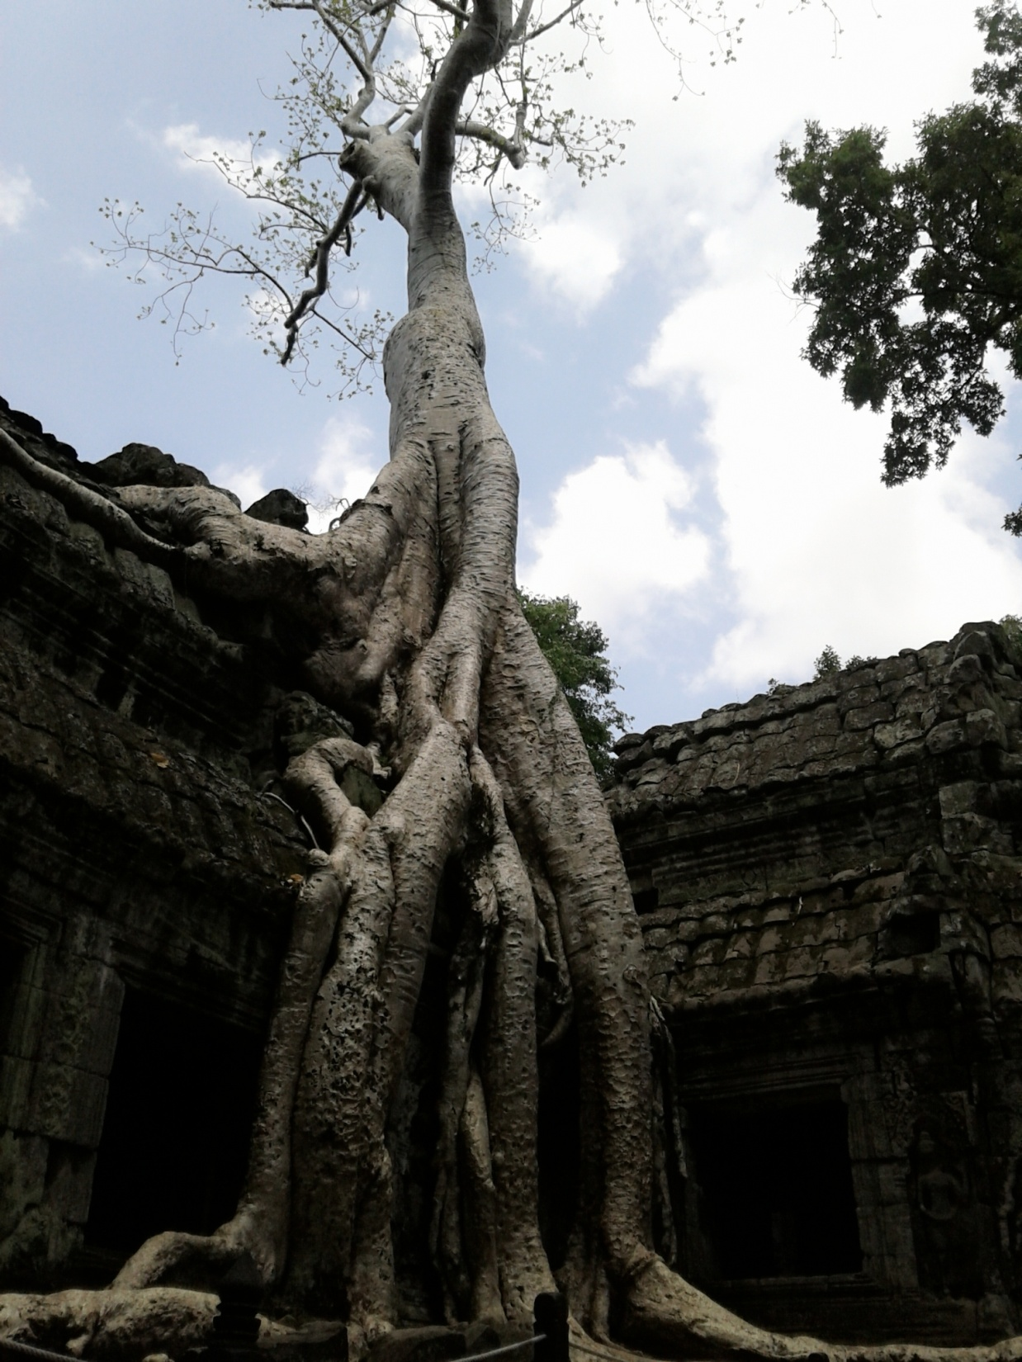
Push or pull?

Slide 21
References
http://hotelmule.com/wiki/Push-pull-factors
Moss,S. (2010). Culture and Heritage Versus Alcohol and Sex in European Urban Destination Development. Retrieved Oct 8, 2012 from http://entplanet.blogspot.com/2010_04_01_archive.html
Uysal, M. (n.d.) Studying tourism push and pull. Retrieved Oct 8, 2012 from http://www.vt.edu/spotlight/achievement/2008-09-22_tourism/2008-09-22_push_pull.pdf

