Slide 1
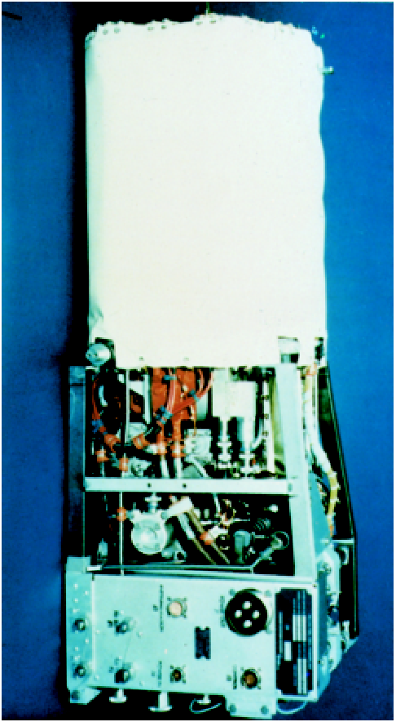
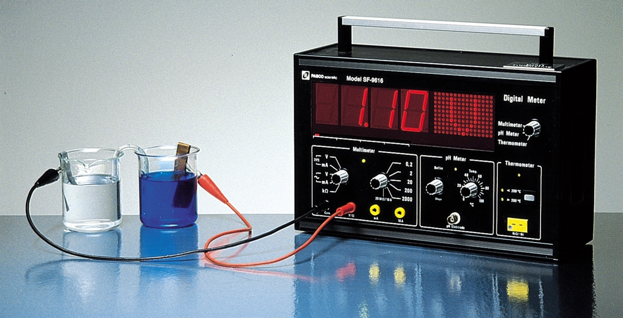
Electrochemistry
Chapter 19
Copyright © The McGraw-Hill Companies, Inc. Permission required for reproduction or display.

Slide 2
Electrochemical processes are oxidation-reduction reactions in which:
the energy released by a spontaneous reaction is converted to electricity or
electrical energy is used to cause a nonspontaneous reaction to occur
0
0
2+
2-
2Mg (s) + O₂ (g) 2MgO (s)
2Mg 2Mg²⁺ + 4e⁻
Oxidation half-reaction (lose e⁻)
O₂ + 4e⁻ 2O²⁻
Reduction half-reaction (gain e⁻)

Slide 3
Oxidation number
The charge the atom would have in a molecule (or an
ionic compound) if electrons were completely transferred.
Free elements (uncombined state) have an oxidation number of zero.
Na, Be, K, Pb, H₂, O₂, P₄ = 0
In monatomic ions, the oxidation number is equal to the charge on the ion.
Li⁺, Li = +1; Fe³⁺, Fe = +3; O²⁻, O = -2
The oxidation number of oxygen is usually –2. In H₂O₂ and O₂²⁻ it is –1.

Slide 4
The oxidation number of hydrogen is +1 except when it is bonded to metals in binary compounds. In these cases, its oxidation number is –1.
Group IA metals are +1, IIA metals are +2 and fluorine is always –1.
6. The sum of the oxidation numbers of all the atoms in a molecule or ion is equal to the charge on the molecule or ion.
HCO₃⁻
Identify the oxidation numbers of all the atoms in HCO₃⁻ ?
O = −2
H = +1
3x(−2) + 1 + ? = −1
C = +4

Slide 5
Balancing Redox Equations
The oxidation of Fe²⁺ to Fe³⁺ by Cr₂O₇²⁻ in acid solution?
Write the unbalanced equation for the reaction ion ionic form.
Fe²⁺ + Cr₂O₇²⁻ Fe³⁺ + Cr³⁺
Separate the equation into two half-reactions.
+2
+3
Oxidation:
Fe²⁺ Fe³⁺
+6
+3
Reduction:
Cr₂O₇²⁻ Cr³⁺
Balance the atoms other than O and H in each half-reaction.
Cr₂O₇²⁻ 2Cr³⁺

Slide 6
Balancing Redox Equations
For reactions in acid, add H₂O to balance O atoms and H⁺ to balance H atoms.
Cr₂O₇²⁻ 2Cr³⁺ + 7H₂O
14H⁺ + Cr₂O₇²⁻ 2Cr³⁺ + 7H₂O
Add electrons to one side of each half-reaction to balance the charges on the half-reaction.
Fe²⁺ Fe³⁺ + 1e⁻
6e⁻ + 14H⁺ + Cr₂O₇²⁻ 2Cr³⁺ + 7H₂O
If necessary, equalize the number of electrons in the two half-reactions by multiplying the half-reactions by appropriate coefficients.
6Fe²⁺ 6Fe³⁺ + 6e⁻
6e⁻ + 14H⁺ + Cr₂O₇²⁻ 2Cr³⁺ + 7H₂O

Slide 7
Balancing Redox Equations
Add the two half-reactions together and balance the final equation by inspection. The number of electrons on both sides must cancel.
Oxidation:
6Fe²⁺ 6Fe³⁺ + 6e⁻
Reduction:
6e⁻ + 14H⁺ + Cr₂O₇²⁻ 2Cr³⁺ + 7H₂O
14H⁺ + Cr₂O₇²⁻ + 6Fe²⁺ 6Fe³⁺ + 2Cr³⁺ + 7H₂O
Verify that the number of atoms and the charges are balanced.
14x1 – 2 + 6 x 2 = 24 = 6 x 3 + 2 x 3
For reactions in basic solutions, add OH⁻ to both sides of the equation for every H⁺ that appears in the final equation.

Slide 8
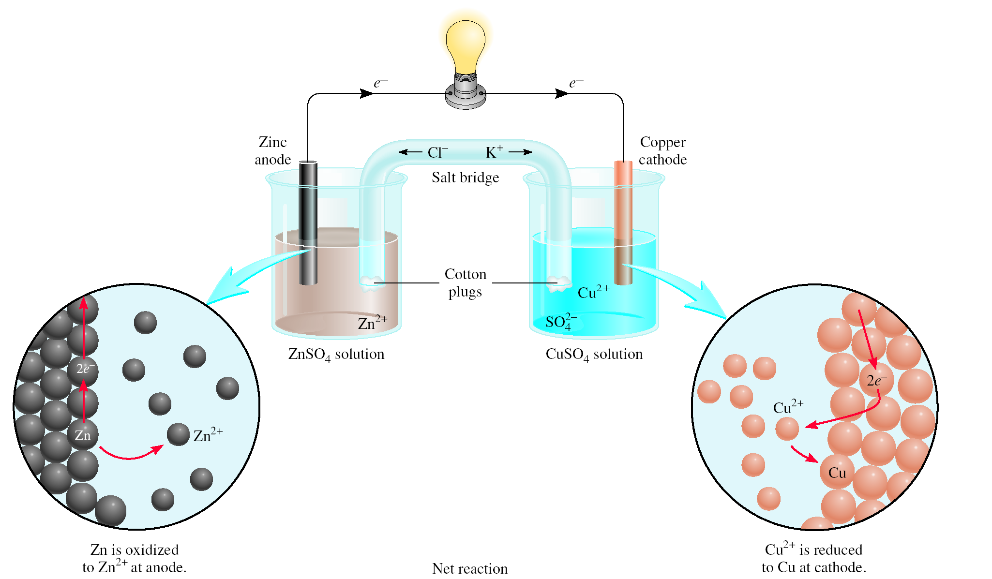
Galvanic Cells
anode
oxidation
cathode
reduction
spontaneous
redox reaction

Slide 9
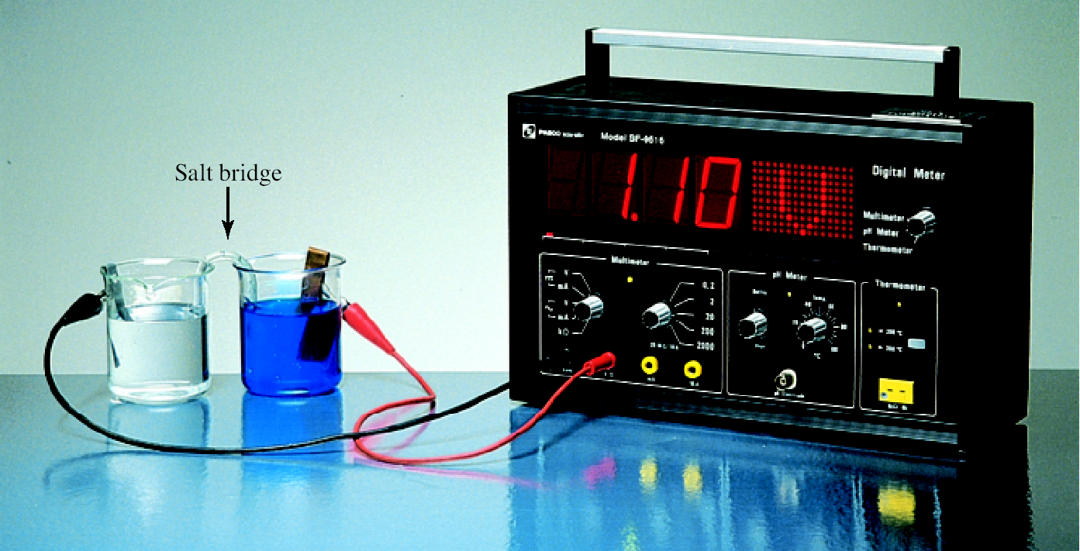
Galvanic Cells
The difference in electrical potential between the anode and cathode is called:
cell voltage
electromotive force (emf)
cell potential
Zn (s) + Cu²⁺ (aq) Cu (s) + Zn²⁺ (aq)
[Cu²⁺] = 1 M and [Zn²⁺] = 1 M
Cell Diagram
phase boundary
Zn (s) | Zn²⁺ (1 M) || Cu²⁺ (1 M) | Cu (s)
anode
salt bridge
cathode

Slide 10
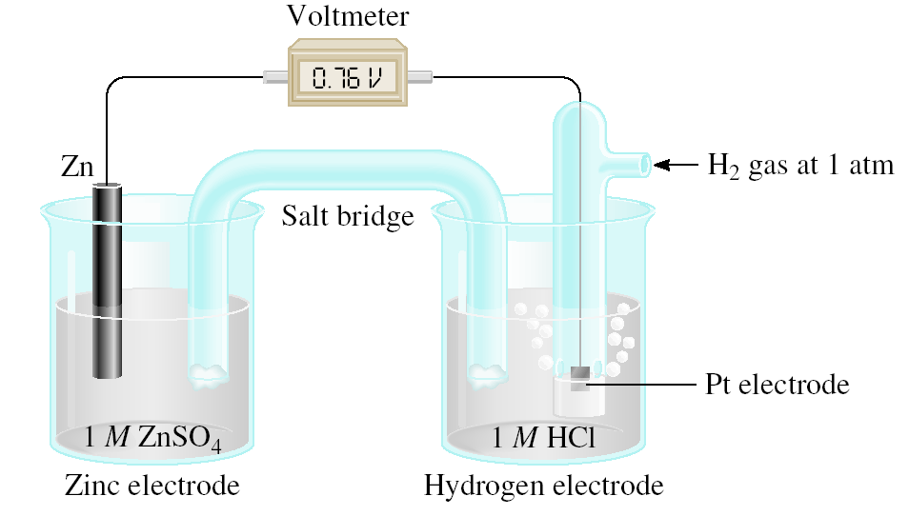
Standard Reduction Potentials
Zn (s) | Zn²⁺ (1 M) || H⁺ (1 M) | H₂ (1 atm) | Pt (s)
Anode (oxidation):
Zn (s) Zn²⁺ (1 M) + 2e⁻
Cathode (reduction):
2e⁻ + 2H⁺ (1 M) H₂ (1 atm)
Zn (s) + 2H⁺ (1 M) Zn²⁺ + H₂ (1 atm)

Slide 11
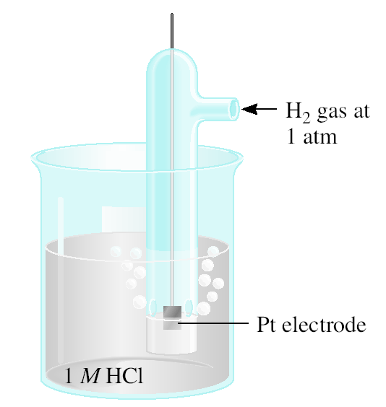
Standard Reduction Potentials
Standard reduction potential (E⁰) is the voltage associated with a reduction reaction at an electrode when all solutes are 1 M and all gases are at 1 atm.
Reduction Reaction
2e⁻ + 2H⁺ (1 M) H₂ (1 atm)
E⁰ = 0 V
Standard hydrogen electrode (SHE)

Slide 12
Standard Reduction Potentials
E⁰ = 0.76 V
cell
Standard emf (E⁰ )
cell
E⁰ = E_{cathode} - E_{anode}
0
0
cell
Zn (s) | Zn²⁺ (1 M) || H⁺ (1 M) | H₂ (1 atm) | Pt (s)
E⁰ = E_{H /H} - E_{Zn /Zn}
0
0
cell
+
2
2+
0.76 V = 0 - E_{Zn /Zn}
0
2+
E_{Zn /Zn} = -0.76 V
0
2+
Zn²⁺ (1 M) + 2e⁻ Zn E⁰ = -0.76 V

Slide 13
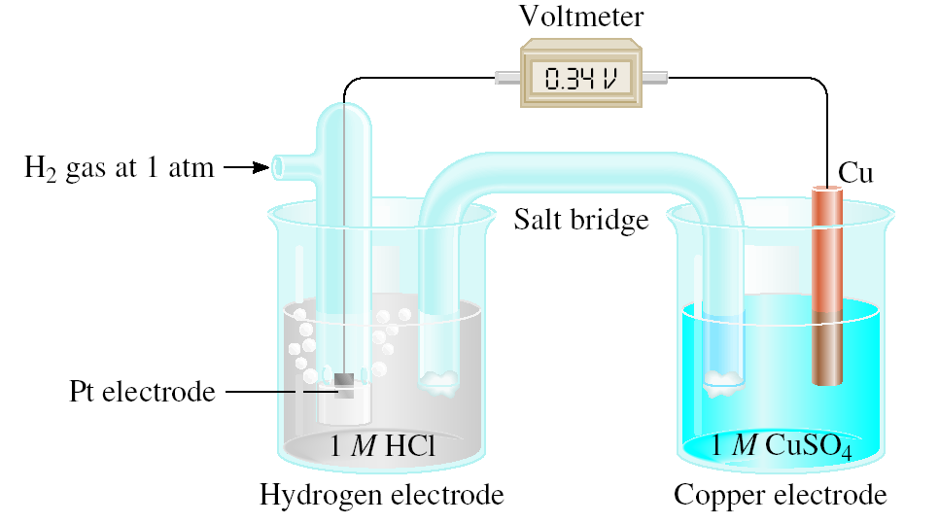
Standard Reduction Potentials
E⁰ = 0.34 V
cell
E⁰ = E_{cathode} - E_{anode}
0
0
cell
E_{cell} = E_{Cu /Cu} – E_{H /H}
0
0
2+
0
+
2
0.34 = E_{Cu /Cu} - 0
0
2+
0
E_{Cu /Cu} = 0.34 V
2+
Pt (s) | H₂ (1 atm) | H⁺ (1 M) || Cu²⁺ (1 M) | Cu (s)
Anode (oxidation):
H₂ (1 atm) 2H⁺ (1 M) + 2e⁻
Cathode (reduction):
2e⁻ + Cu²⁺ (1 M) Cu (s)
H₂ (1 atm) + Cu²⁺ (1 M) Cu (s) + 2H⁺ (1 M)

Slide 14
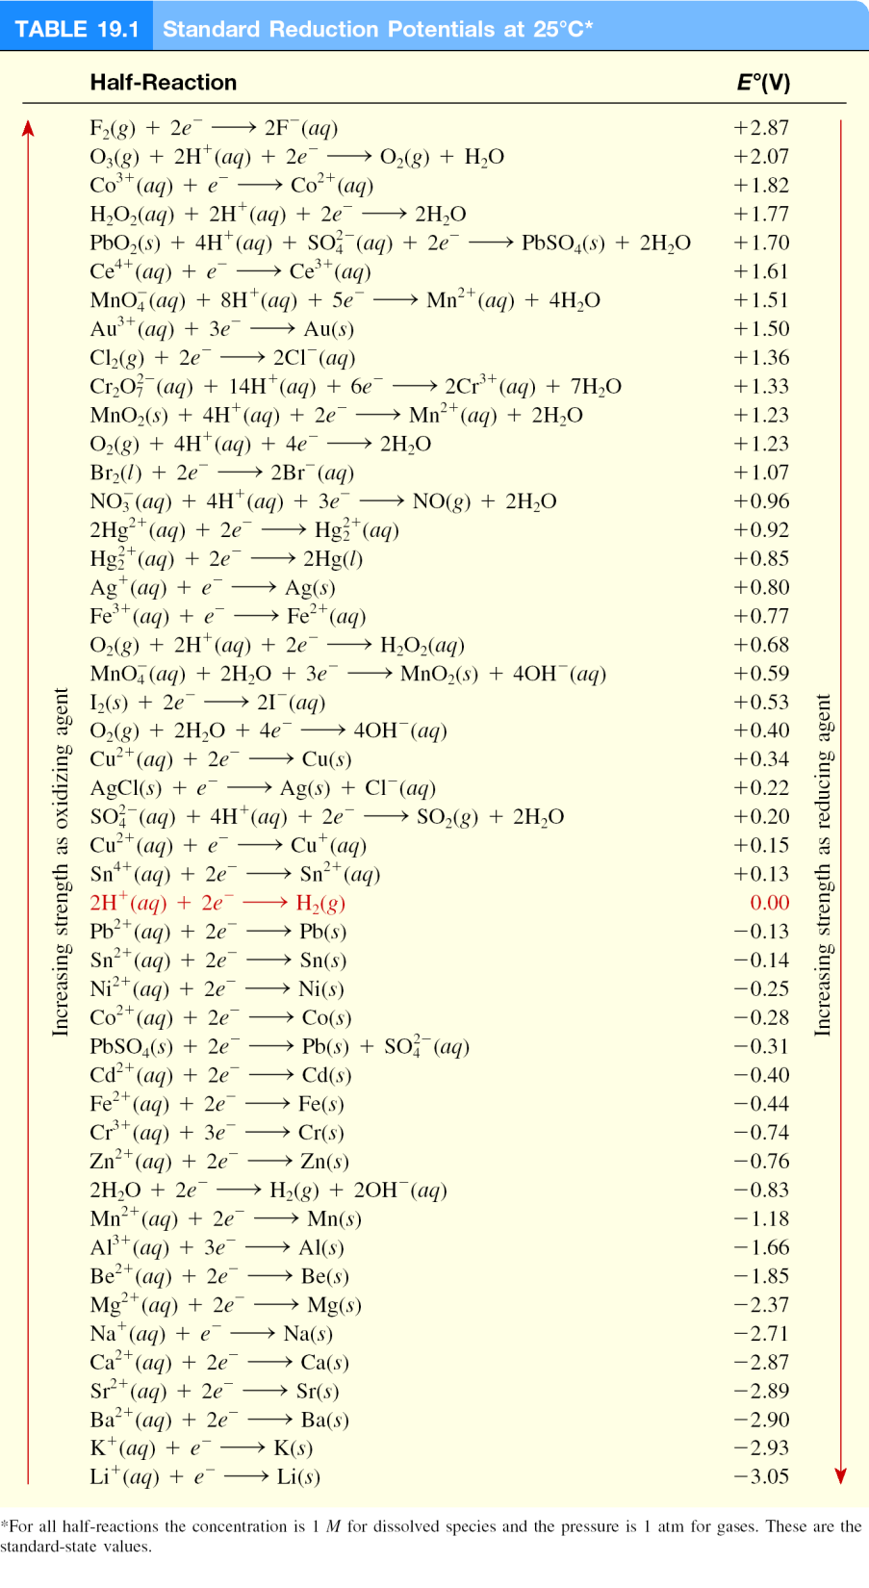
E⁰ is for the reaction as written
The more positive E⁰ the greater the tendency for the substance to be reduced
The half-cell reactions are reversible
The sign of E⁰ changes when the reaction is reversed
Changing the stoichiometric coefficients of a half-cell reaction does not change the value of E⁰

Slide 15
What is the standard emf of an electrochemical cell made of a Cd electrode in a 1.0 M Cd(NO₃)₂ solution and a Cr electrode in a 1.0 M Cr(NO₃)₃ solution?
Cd²⁺ (aq) + 2e⁻ Cd (s) E⁰ = -0.40 V
Cd is the stronger oxidizer
Cd will oxidize Cr
Cr³⁺ (aq) + 3e⁻ Cr (s) E⁰ = -0.74 V
Anode (oxidation):
Cr (s) Cr³⁺ (1 M) + 3e⁻
x 2
Cathode (reduction):
2e⁻ + Cd²⁺ (1 M) Cd (s)
x 3
2Cr (s) + 3Cd²⁺ (1 M) 3Cd (s) + 2Cr³⁺ (1 M)
E⁰ = E_{cathode} - E_{anode}
0
0
cell
E⁰ = -0.40 – (-0.74)
cell
E⁰ = 0.34 V
cell

Slide 16
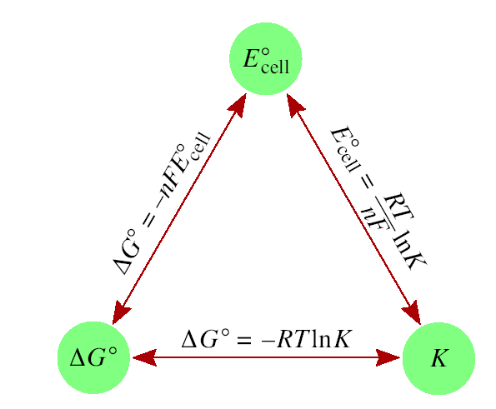
Spontaneity of Redox Reactions
ΔG = -nFE_{cell}
n = number of moles of electrons in reaction
J
ΔG⁰ = -nFE_{cell}
0
F = 96,500
= 96,500 C/mol
V • mol
ΔG⁰ = -RT ln K
0
= -nFE_{cell}
RT
(8.314 J/K•mol)(298 K)
0
=
ln K
=
ln K
E_{cell}
nF
n (96,500 J/V•mol)
0.0257 V
0
ln K
E_{cell}
=
n
0.0592 V
0
log K
E_{cell}
=
n

Slide 17
Spontaneity of Redox Reactions
ΔG⁰ = -RT ln K
0
= -nFE_{cell}

Slide 18
What is the equilibrium constant for the following reaction at 25⁰C? Fe²⁺ (aq) + 2Ag (s) Fe (s) + 2Ag⁺ (aq)
0.0257 V
0
ln K
E_{cell}
=
n
Oxidation:
2Ag 2Ag⁺ + 2e⁻
n = 2
Reduction:
2e⁻ + Fe²⁺ Fe
E⁰ = E_{Fe /Fe} – E_{Ag /Ag}
0
0
2+
+
E⁰ = -0.44 – (0.80)
E⁰
x n
-1.24 V
x 2
cell
E⁰ = -1.24 V
0.0257 V
0.0257 V
e
= e
K =
K = 1.23 x 10⁻⁴²

Slide 19
The Effect of Concentration on Cell Emf
ΔG = ΔG⁰ + RT ln Q
ΔG = -nFE
ΔG⁰ = -nFE
0
-nFE = -nFE⁰ + RT ln Q
Nernst equation
RT
E = E⁰ -
ln Q
nF
At 298 K
0.0257 V
0.0592 V
E =
0
ln Q
0
log Q
E
E =
-
E
-
n
n

Slide 20
Will the following reaction occur spontaneously at 25⁰C if [Fe²⁺] = 0.60 M and [Cd²⁺] = 0.010 M?
Fe²⁺ (aq) + Cd (s) Fe (s) + Cd²⁺ (aq)
Oxidation:
Cd Cd²⁺ + 2e⁻
n = 2
Reduction:
2e⁻ + Fe²⁺ 2Fe
E⁰ = E_{Fe /Fe} – E_{Cd /Cd}
0
0
2+
2+
E⁰ = -0.44 – (-0.40)
0.0257 V
E =
0
ln Q
E
-
n
E⁰ = -0.04 V
0.0257 V
0.010
E =
-0.04 V
-
ln
2
0.60
E = 0.013
E > 0
Spontaneous

Slide 21
Concentration Cells
Galvanic cell from two half-cells composed of the same material but differing in ion concentrations.

Slide 22
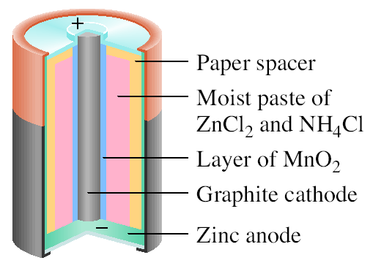
Batteries
Dry cell
Leclanché cell
Anode:
Zn (s) Zn²⁺ (aq) + 2e⁻
Cathode:
+
2NH₄ (aq) + 2MnO₂ (s) + 2e⁻ Mn₂O₃ (s) + 2NH₃ (aq) + H₂O (l)
Zn (s) + 2NH₄ (aq) + 2MnO₂ (s) Zn²⁺ (aq) + 2NH₃ (aq) + H₂O (l) + Mn₂O₃ (s)

Slide 23
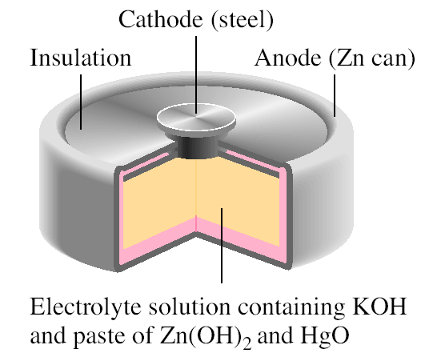
Batteries
Mercury Battery
Anode:
Zn(Hg) + 2OH⁻ (aq) ZnO (s) + H₂O (l) + 2e⁻
Cathode:
HgO (s) + H₂O (l) + 2e⁻ Hg (l) + 2OH⁻ (aq)
Zn(Hg) + HgO (s) ZnO (s) + Hg (l)

Slide 24
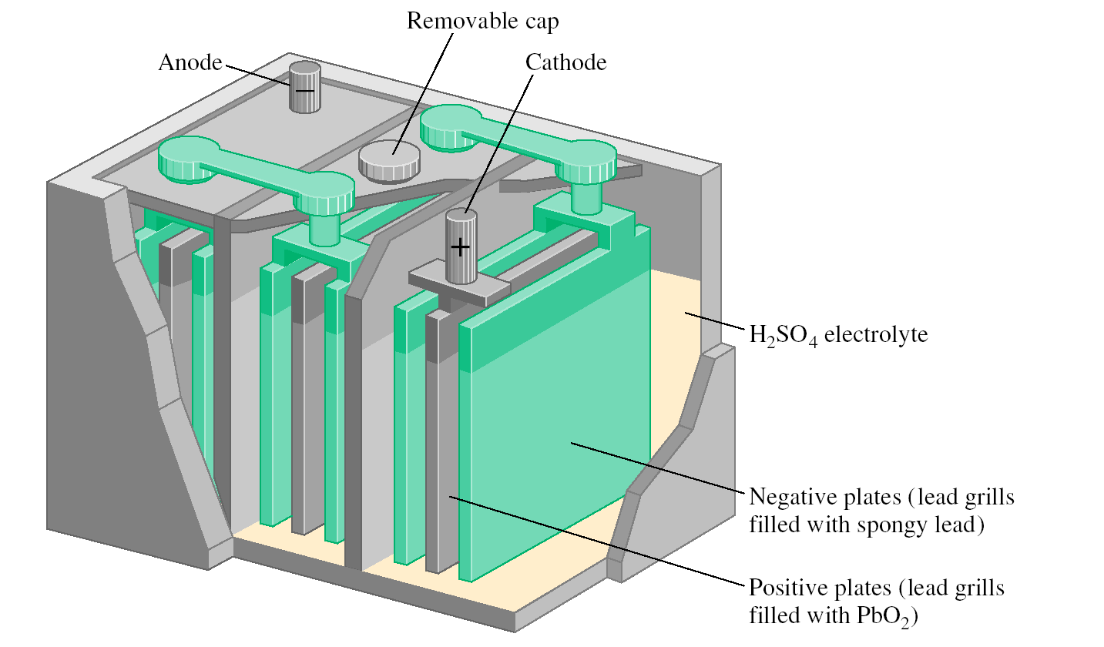
Batteries
Lead storage
battery
Anode:
Pb (s) + SO²⁻ (aq) PbSO₄ (s) + 2e⁻
4
Cathode:
PbO₂ (s) + 4H⁺ (aq) + SO²⁻ (aq) + 2e⁻ PbSO₄ (s) + 2H₂O (l)
4
Pb (s) + PbO₂ (s) + 4H⁺ (aq) + 2SO²⁻ (aq) 2PbSO₄ (s) + 2H₂O (l)
4

Slide 25
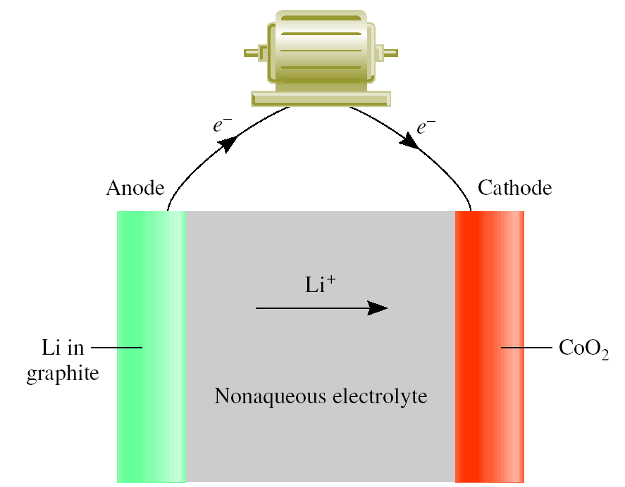
Batteries
Solid State Lithium Battery

Slide 26
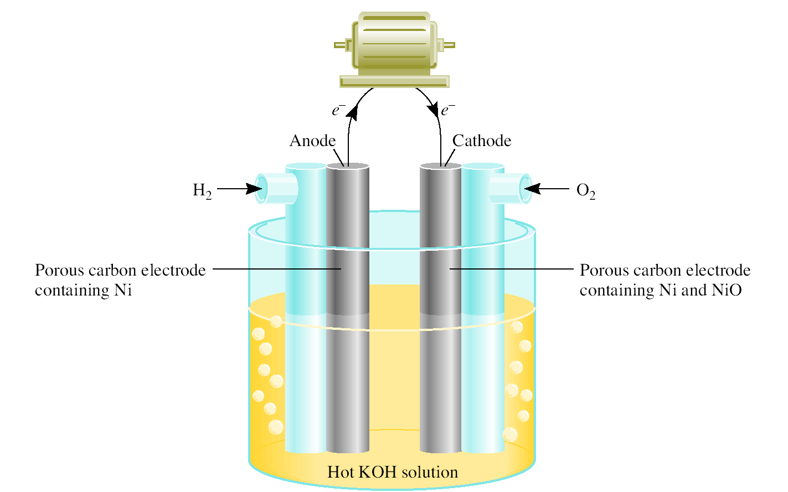
Batteries
A fuel cell is an electrochemical cell that requires a continuous supply of reactants to keep functioning
Anode:
2H₂ (g) + 4OH⁻ (aq) 4H₂O (l) + 4e⁻
Cathode:
O₂ (g) + 2H₂O (l) + 4e⁻ 4OH⁻ (aq)
2H₂ (g) + O₂ (g) 2H₂O (l)

Slide 27
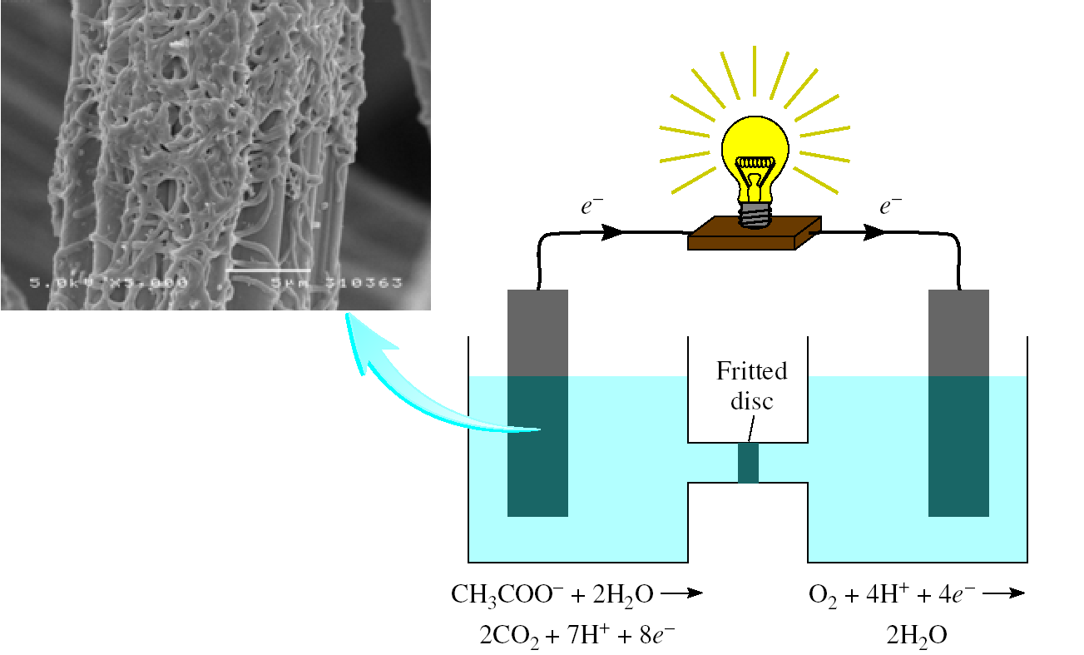
Chemistry In Action: Bacteria Power
CH₃COO⁻ + 2O₂ + H⁺ 2CO₂ + 2H₂O

Slide 28
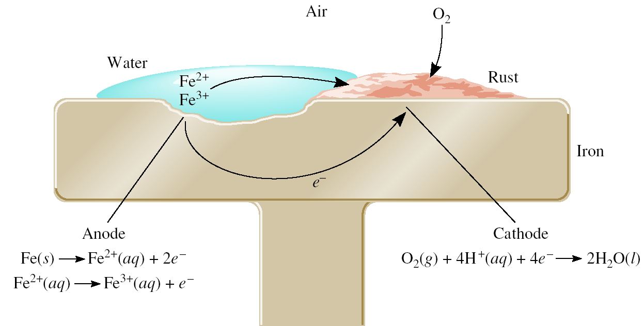
Corrosion
Corrosion is the term usually applied to the deterioration of metals by an electrochemical process.

Slide 29
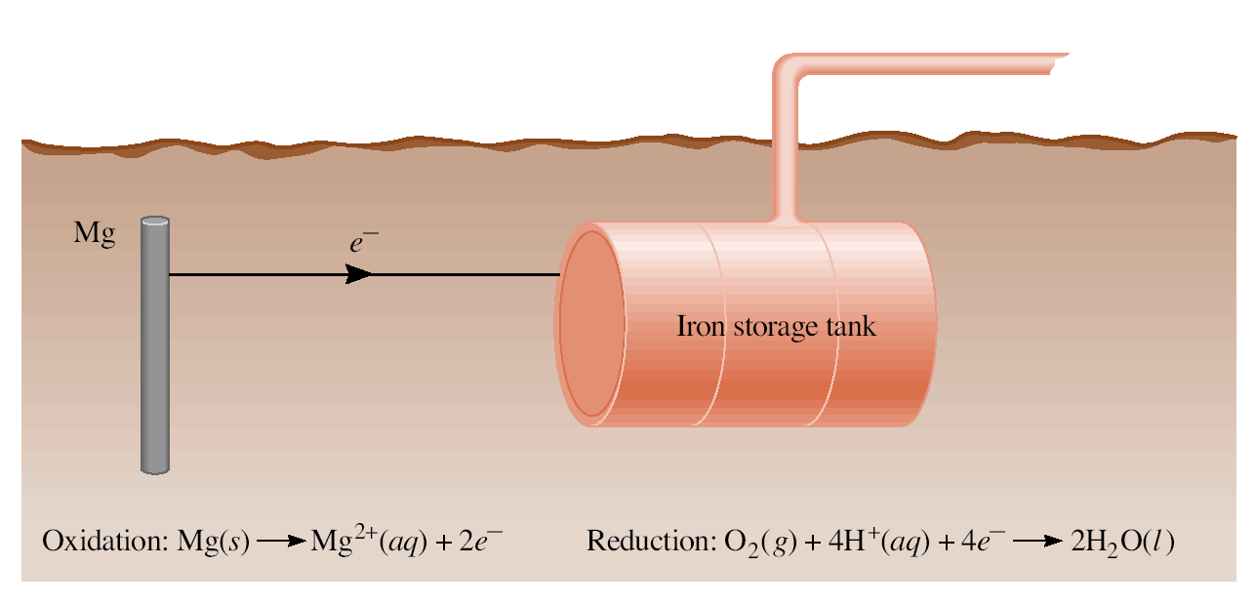
Cathodic Protection of an Iron Storage Tank

Slide 30
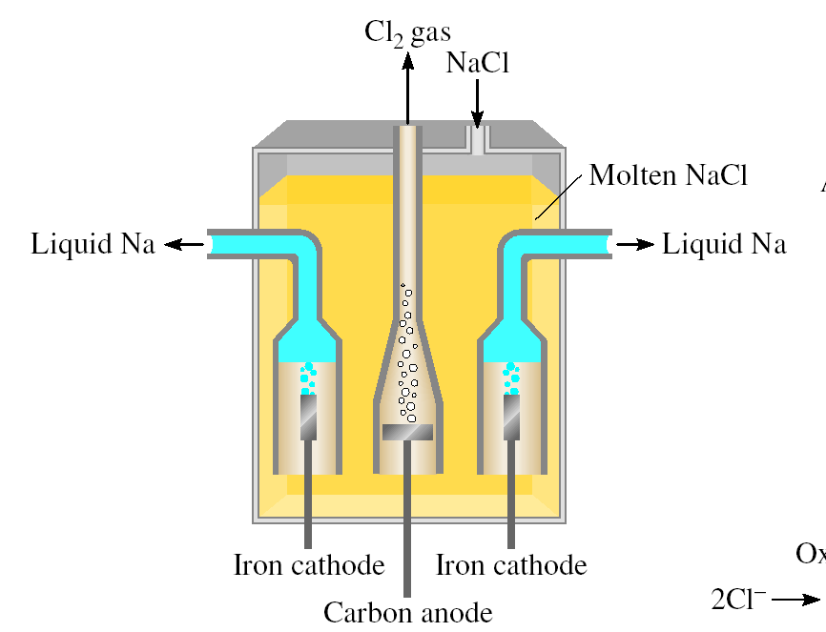
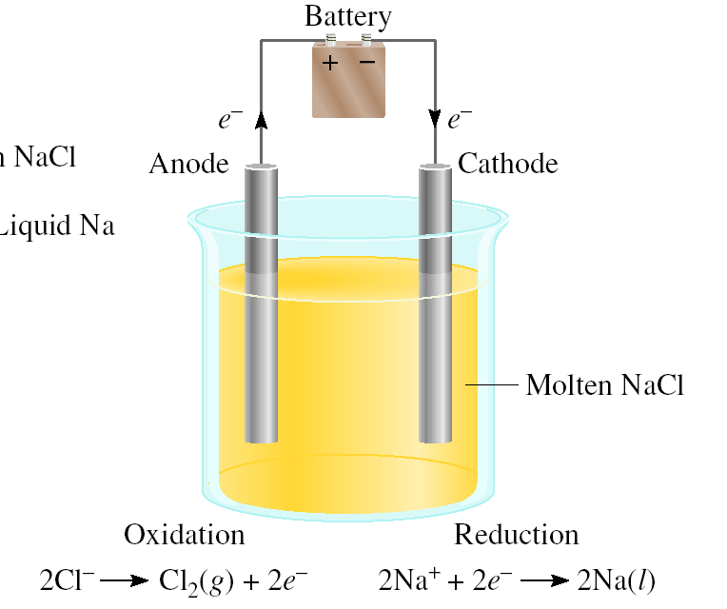
Electrolysis is the process in which electrical energy is used to cause a nonspontaneous chemical reaction to occur.
Electrolysis of molten NaCl

Slide 31
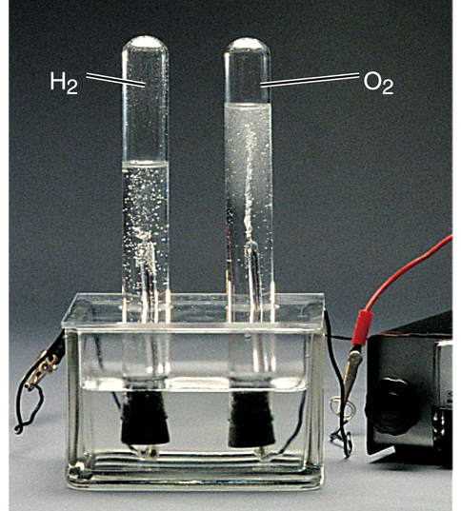
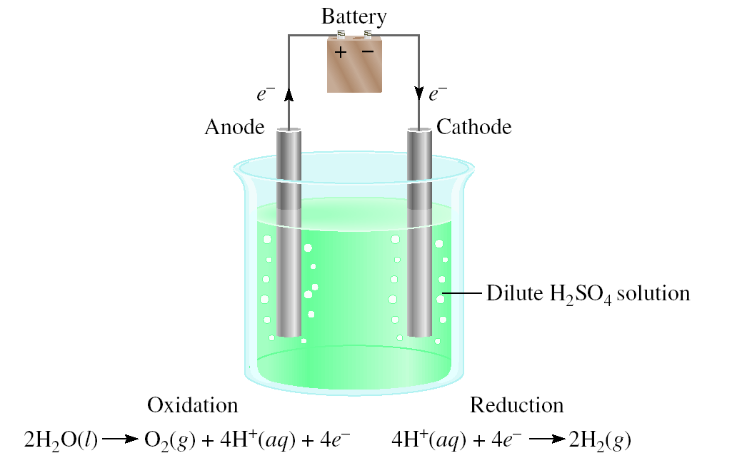
Electrolysis of Water

Slide 32
Electrolysis and Mass Changes
charge (C) = current (A) x time (s)
1 mol e⁻ = 96,500 C

Slide 33
How much Ca will be produced in an electrolytic cell of molten CaCl₂ if a current of 0.452 A is passed through the cell for 1.5 hours?
Anode:
2Cl⁻ (l) Cl₂ (g) + 2e⁻
Cathode:
Ca²⁺ (l) + 2e⁻ Ca (s)
Ca²⁺ (l) + 2Cl⁻ (l) Ca (s) + Cl₂ (g)
2 mole e⁻ = 1 mole Ca
C
s
1 mol e⁻
1 mol Ca
mol Ca = 0.452
x 1.5 hr x 3600
x
x
s
hr
96,500 C
2 mol e⁻
= 0.0126 mol Ca
= 0.50 g Ca

Slide 34
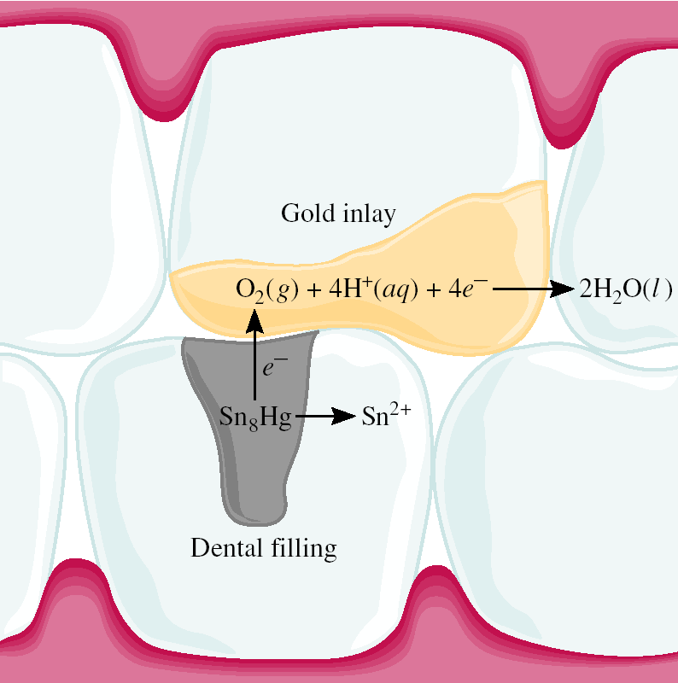
Chemistry In Action: Dental Filling Discomfort
2+
Hg₂ /Ag₂Hg₃ 0.85 V
2+
Sn /Ag₃Sn -0.05 V
2+
Sn /Ag₃Sn -0.05 V

