Slide 1
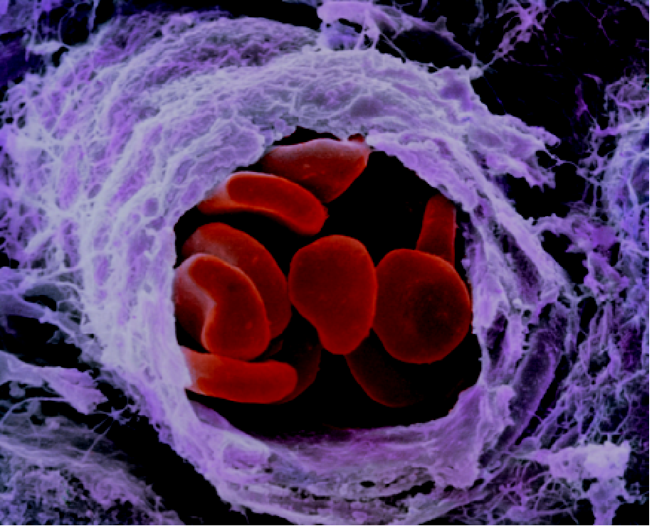
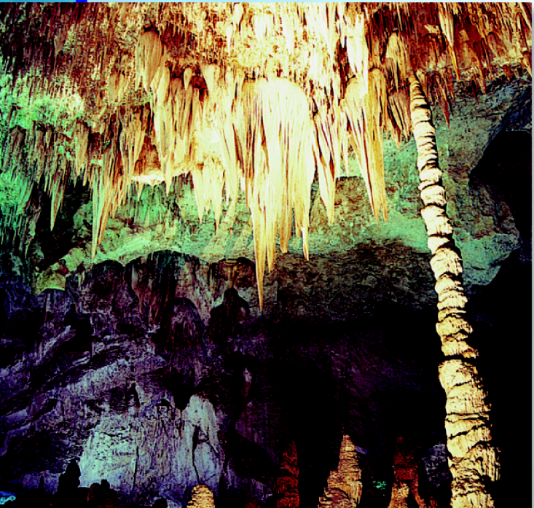
Acid-Base Equilibria and Solubility Equilibria

Slide 2
The common ion effect is the shift in equilibrium caused by the addition of a compound having an ion in common with the dissolved substance.
The presence of a common ion suppresses the ionization of a weak acid or a weak base.
Consider mixture of CH₃COONa (strong electrolyte) and CH₃COOH (weak acid).
CH₃COONa (s) Na⁺ (aq) + CH₃COO⁻ (aq)
common ion
CH₃COOH (aq) H⁺ (aq) + CH₃COO⁻ (aq)

Slide 3
Consider mixture of salt NaA and weak acid HA.
NaA (s) Na⁺ (aq) + A⁻ (aq)
[H⁺][A⁻]
K_{a} =
HA (aq) H⁺ (aq) + A⁻ (aq)
[HA]
K_{a} [HA]
[H⁺] =
[A⁻]
Henderson-Hasselbalch equation
[HA]
-log [H⁺] = -log K_{a} - log
[A⁻]
[conjugate base]
pH = pK_{a} + log
[A⁻]
[acid]
-log [H⁺] = -log K_{a} + log
[HA]
[A⁻]
pH = pK_{a} + log
pK_{a} = -log K_{a}
[HA]

Slide 4
What is the pH of a solution containing 0.30 M HCOOH and 0.52 M HCOOK?
Mixture of weak acid and conjugate base!
HCOOH (aq) H⁺ (aq) + HCOO⁻ (aq)
Initial (M)
0.30
0.00
0.52
Change (M)
-x
+x
+x
Equilibrium (M)
0.30 - x
x
0.52 + x
[HCOO⁻]
Common ion effect
pH = pK_{a} + log
[HCOOH]
0.30 – x ≈ 0.30
[0.52]
0.52 + x ≈ 0.52
pH = 3.77 + log
= 4.01
[0.30]
HCOOH pK_{a} = 3.77

Slide 5
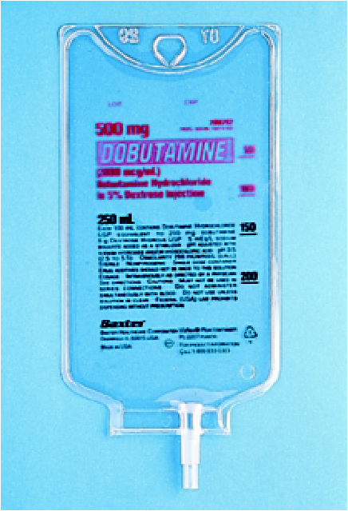
A buffer solution is a solution of:
A weak acid or a weak base and
The salt of the weak acid or weak base
Both must be present!
A buffer solution has the ability to resist changes in pH upon the addition of small amounts of either acid or base.
Consider an equal molar mixture of CH₃COOH and CH₃COONa
Add strong acid
H⁺ (aq) + CH₃COO⁻ (aq) CH₃COOH (aq)
Add strong base
OH⁻ (aq) + CH₃COOH (aq) CH₃COO⁻ (aq) + H₂O (l)

Slide 6
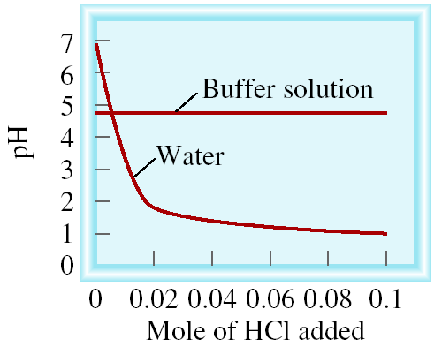
HCl H⁺ + Cl⁻
HCl + CH₃COO⁻ CH₃COOH + Cl⁻

Slide 7
Which of the following are buffer systems? (a) KF/HF
(b) KBr/HBr, (c) Na₂CO₃/NaHCO₃
(a) KF is a weak acid and F⁻ is its conjugate base
buffer solution
(b) HBr is a strong acid
not a buffer solution
(c) CO₃²⁻ is a weak base and HCO₃⁻ is its conjugate acid
buffer solution

Slide 8
Calculate the pH of the 0.30 M NH₃/0.36 M NH₄Cl buffer system. What is the pH after the addition of 20.0 mL of 0.050 M NaOH to 80.0 mL of the buffer solution?
NH₄⁺ (aq) H⁺ (aq) + NH₃ (aq)
[NH₃]
[0.30]
pH = pK_{a} + log
pK_{a} = 9.25
pH = 9.25 + log
= 9.17
[NH₄⁺]
[0.36]
start (moles)
0.029
0.001
0.024
NH₄⁺ (aq) + OH⁻ (aq) H₂O (l) + NH₃ (aq)
end (moles)
0.028
0.0
0.025
final volume = 80.0 mL + 20.0 mL = 100 mL
0.028
0.025
[0.25]
[NH₄⁺] =
[NH₃] =
pH = 9.25 + log
= 9.20
0.10
0.10
[0.28]

Slide 9
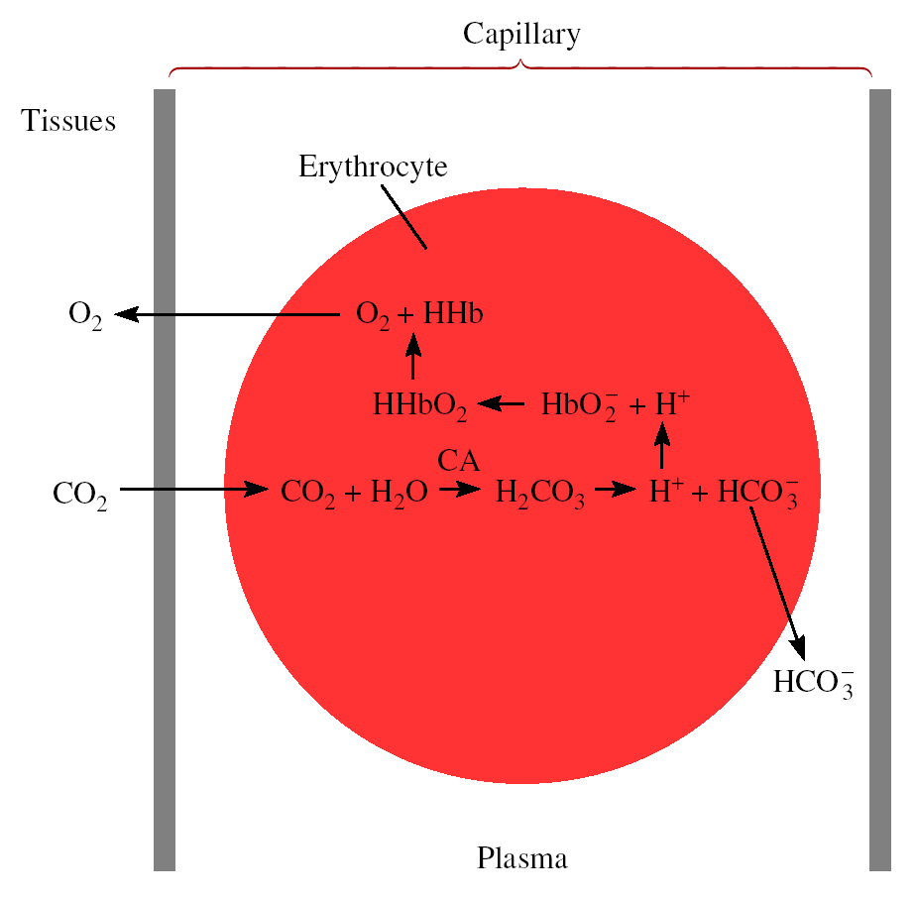
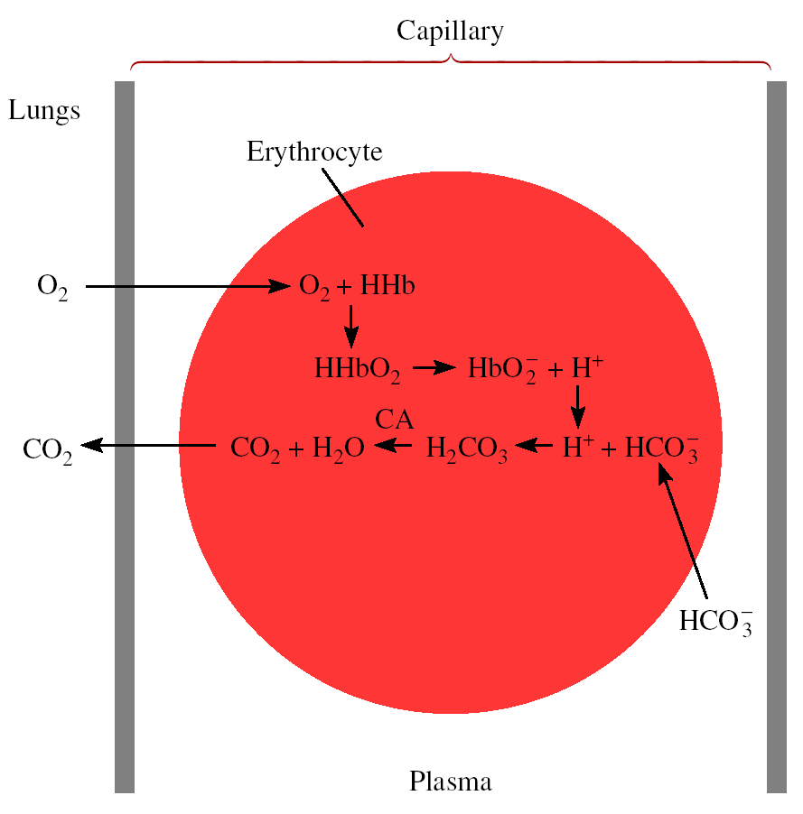
Chemistry In Action: Maintaining the pH of Blood
Red blood cells in a capillary

Slide 10
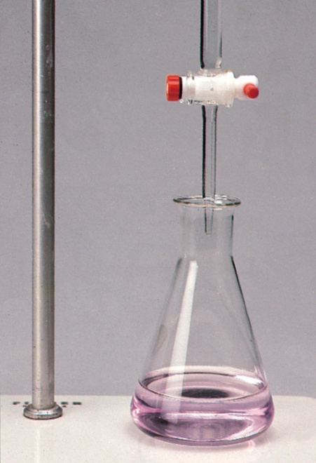
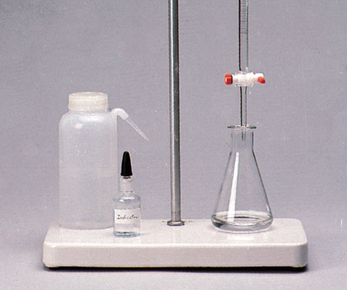
Titrations (Review)
In a titration a solution of accurately known concentration is added gradually added to another solution of unknown concentration until the chemical reaction between the two solutions is complete.
Equivalence point – the point at which the reaction is complete
Indicator – substance that changes color at (or near) the
equivalence point
Slowly add base
to unknown acid
UNTIL
The indicator
changes color
(pink)

Slide 11
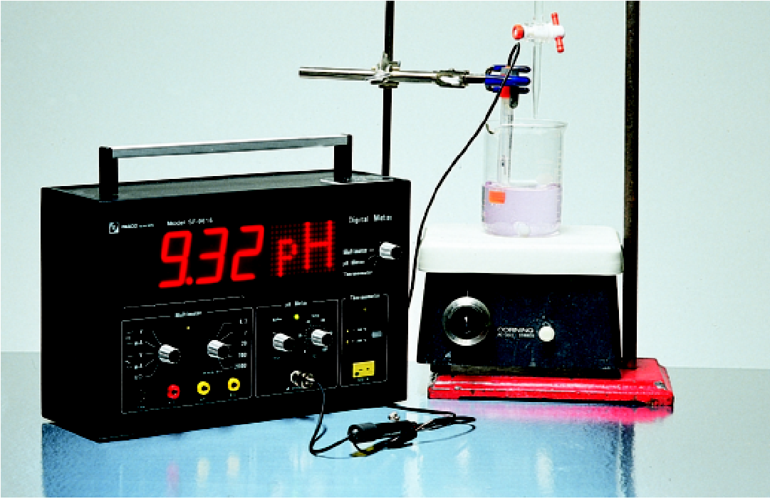
Alternative Method of Equivalence Point Detection
monitor pH

Slide 12
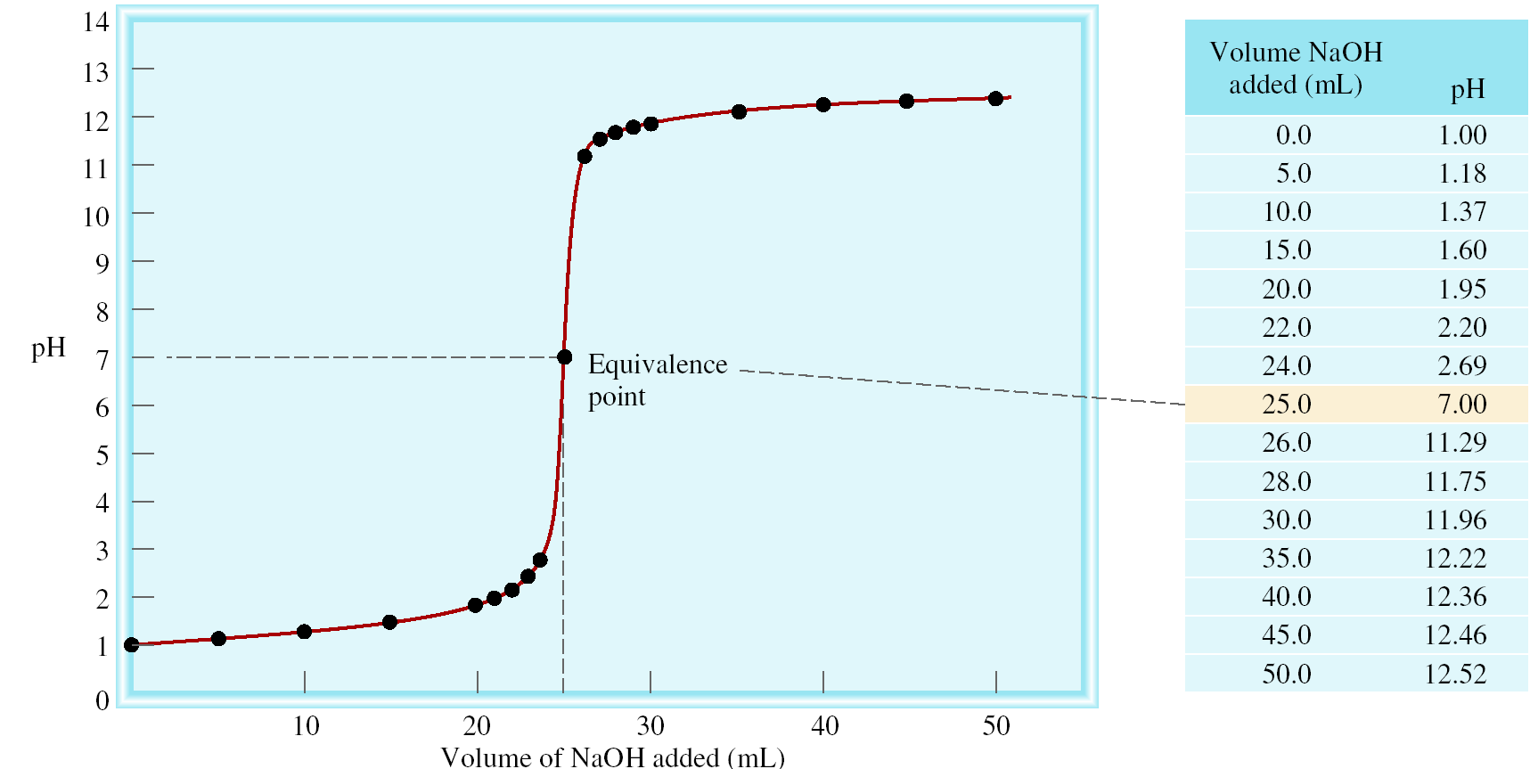
Strong Acid-Strong Base Titrations
NaOH (aq) + HCl (aq) H₂O (l) + NaCl (aq)
OH⁻ (aq) + H⁺ (aq) H₂O (l)

Slide 13
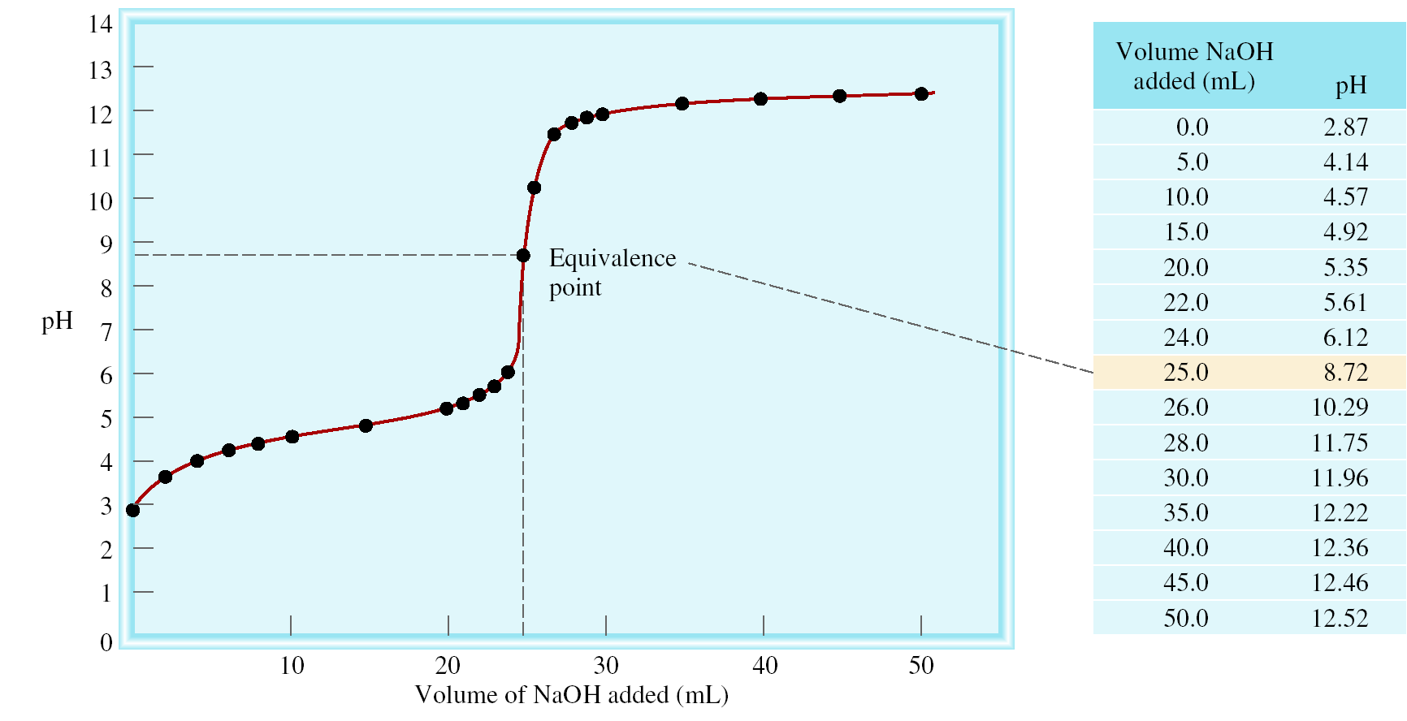
Weak Acid-Strong Base Titrations
CH₃COOH (aq) + NaOH (aq) CH₃COONa (aq) + H₂O (l)
CH₃COOH (aq) + OH⁻ (aq) CH₃COO⁻ (aq) + H₂O (l)
At equivalence point (pH > 7):
CH₃COO⁻ (aq) + H₂O (l) OH⁻ (aq) + CH₃COOH (aq)

Slide 14
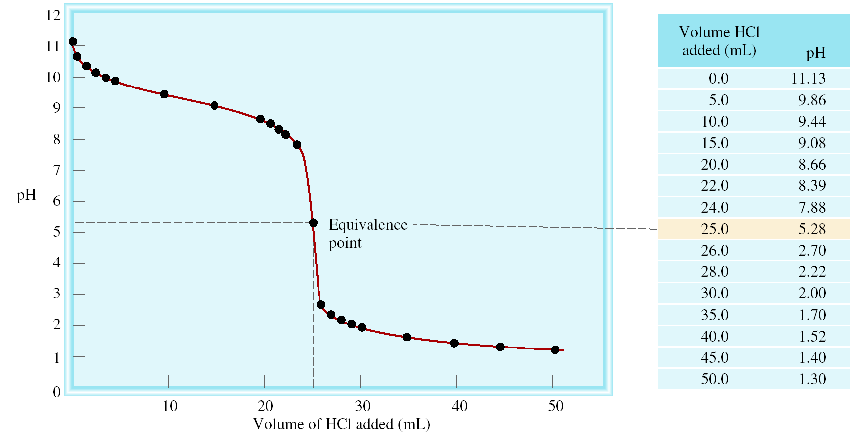
Strong Acid-Weak Base Titrations
HCl (aq) + NH₃ (aq) NH₄Cl (aq)
H⁺ (aq) + NH₃ (aq) NH₄Cl (aq)
At equivalence point (pH < 7):
NH₄⁺ (aq) + H₂O (l) NH₃ (aq) + H⁺ (aq)

Slide 15
Exactly 100 mL of 0.10 M HNO₂ are titrated with a 0.10 M NaOH solution. What is the pH at the equivalence point ?
start (moles)
0.01
0.01
HNO₂ (aq) + OH⁻ (aq) NO₂⁻ (aq) + H₂O (l)
end (moles)
0.0
0.0
0.01
0.01
Final volume = 200 mL
[NO₂⁻] =
= 0.05 M
0.200
NO₂⁻ (aq) + H₂O (l) OH⁻ (aq) + HNO₂ (aq)
Initial (M)
0.05
0.00
0.00
Change (M)
-x
+x
+x
Equilibrium (M)
0.05 - x
x
x
[OH⁻][HNO₂]
x²
K_{b} =
=
= 2.2 x 10⁻¹¹
pOH = 5.98
[NO₂⁻]
0.05-x
pH = 14 – pOH = 8.02
0.05 – x ≈ 0.05
x ≈ 1.05 x 10⁻⁶
= [OH⁻]

Slide 16
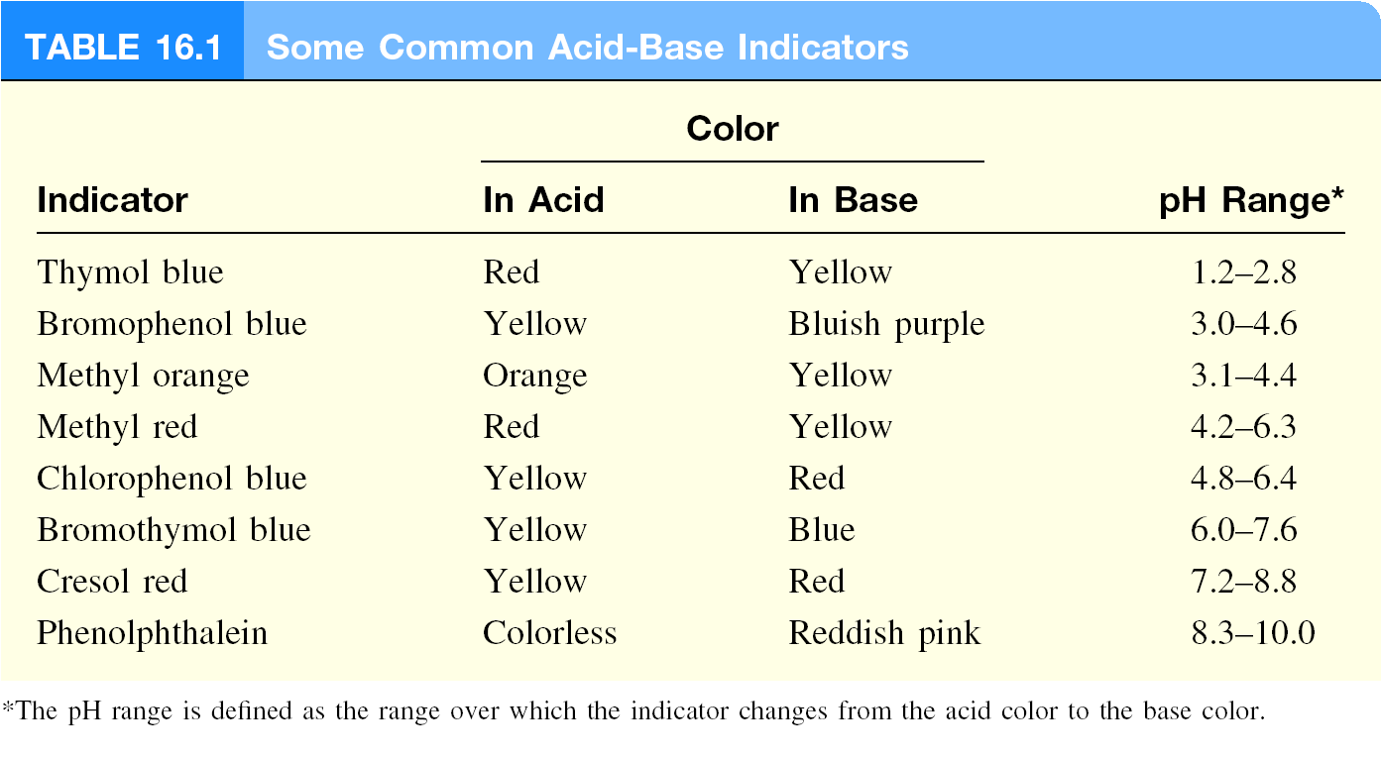
Acid-Base Indicators
HIn (aq) H⁺ (aq) + In⁻ (aq)
[HIn]
≥ 10
Color of acid (HIn) predominates
[In⁻]
[HIn]
≤ 10
Color of conjugate base (In⁻) predominates
[In⁻]

Slide 17
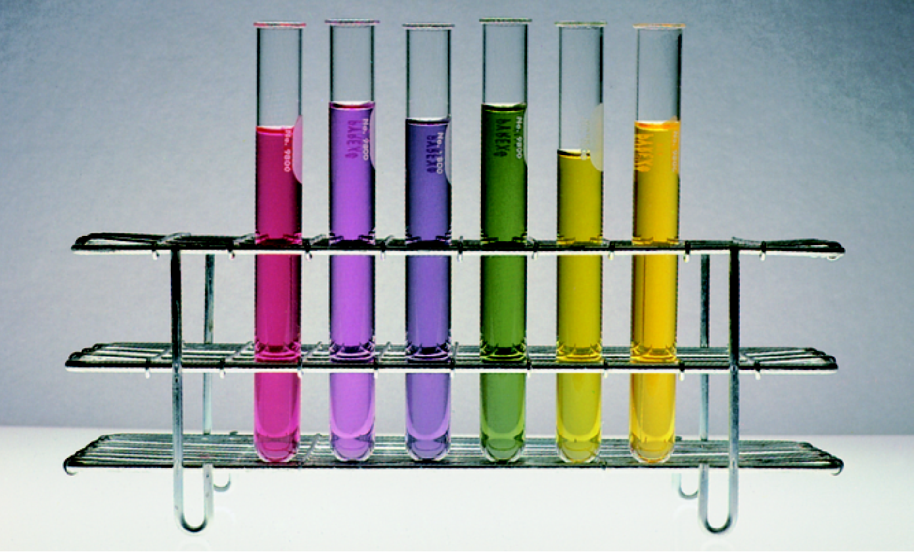
Solutions of Red Cabbage Extract
pH

Slide 18
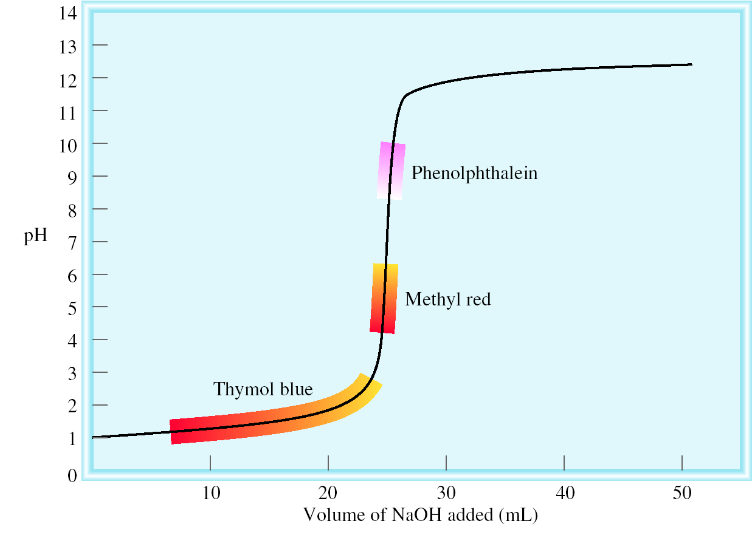
The titration curve of a strong acid with a strong base.

Slide 19
Which indicator(s) would you use for a titration of HNO₂ with KOH ?
Weak acid titrated with strong base.
At equivalence point, will have conjugate base of weak acid.
At equivalence point, pH > 7
Use cresol red or phenolphthalein

Slide 20
Solubility Equilibria
AgCl (s) Ag⁺ (aq) + Cl⁻ (aq)
K_{sp} = [Ag⁺][Cl⁻]
K_{sp} is the solubility product constant
MgF₂ (s) Mg²⁺ (aq) + 2F⁻ (aq)
K_{sp} = [Mg²⁺][F⁻]²
Ag₂CO₃ (s) 2Ag⁺ (aq) + CO₃²⁻ (aq)
K_{sp} = [Ag⁺]²[CO₃²⁻]
Ca₃(PO₄)₂ (s) 3Ca²⁺ (aq) + 2PO₄³⁻ (aq)
K_{sp} = [Ca²⁺]³[PO₄³⁻]²
Dissolution of an ionic solid in aqueous solution:
Q < K_{sp}
Unsaturated solution
No precipitate
Q = K_{sp}
Saturated solution
Q > K_{sp}
Supersaturated solution
Precipitate will form

Slide 21
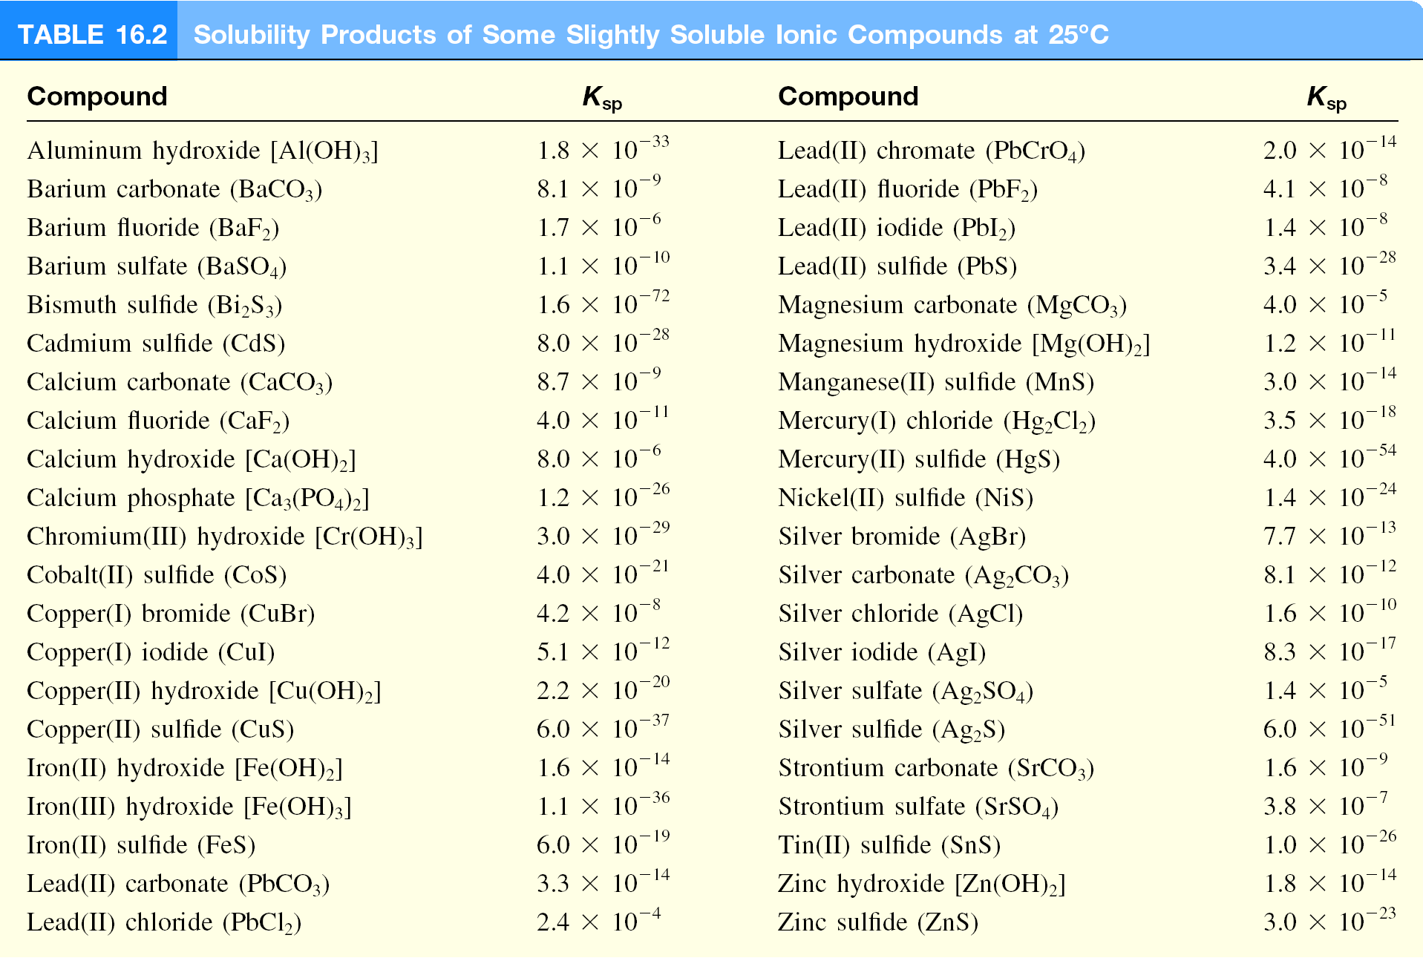

Slide 22
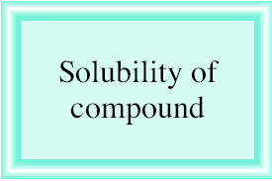
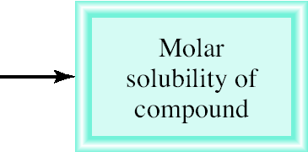
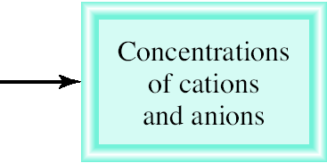
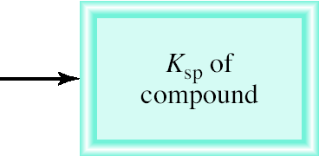
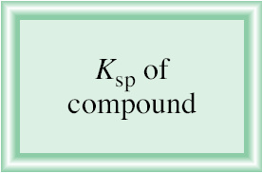
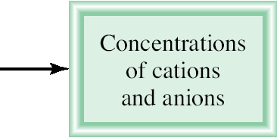
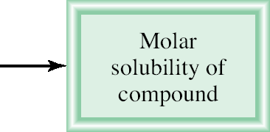
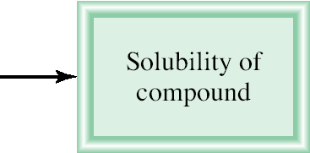
Molar solubility (mol/L) is the number of moles of solute dissolved in 1 L of a saturated solution.
Solubility (g/L) is the number of grams of solute dissolved in 1 L of a saturated solution.

Slide 23
What is the solubility of silver chloride in g/L ?
AgCl (s) Ag⁺ (aq) + Cl⁻ (aq)
K_{sp} = 1.6 x 10⁻¹⁰
Initial (M)
0.00
0.00
K_{sp} = [Ag⁺][Cl⁻]
Change (M)
+s
+s
K_{sp} = s²
√
Equilibrium (M)
s
s
s = K_{sp}
s = 1.3 x 10⁻⁵
[Ag⁺] = 1.3 x 10⁻⁵ M
[Cl⁻] = 1.3 x 10⁻⁵ M
1.3 x 10⁻⁵ mol AgCl
143.35 g AgCl
Solubility of AgCl =
x
= 1.9 x 10⁻³ g/L
1 L soln
1 mol AgCl

Slide 24
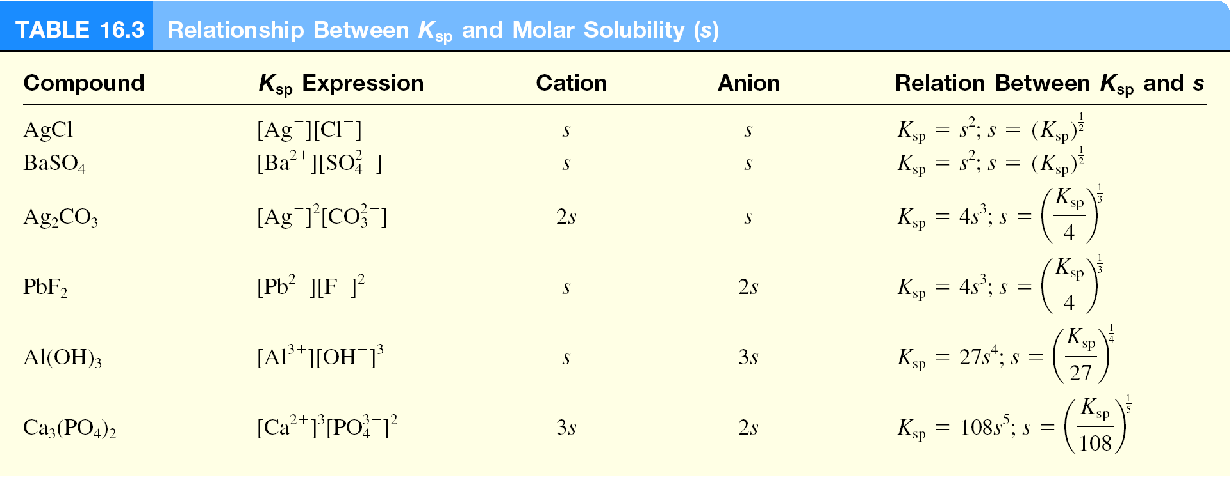

Slide 25
If 2.00 mL of 0.200 M NaOH are added to 1.00 L of 0.100 M CaCl₂, will a precipitate form?
The ions present in solution are Na⁺, OH⁻, Ca²⁺, Cl⁻.
Only possible precipitate is Ca(OH)₂ (solubility rules).
Is Q > K_{sp} for Ca(OH)₂?
[Ca²⁺]₀ = 0.100 M
[OH⁻]₀ = 4.0 x 10⁻⁴ M
2
= 0.10 x (4.0 x 10⁻⁴)² = 1.6 x 10⁻⁸
Q = [Ca²⁺]₀[OH⁻]₀
K_{sp} = [Ca²⁺][OH⁻]² = 8.0 x 10⁻⁶
Q < K_{sp}
No precipitate will form

Slide 26
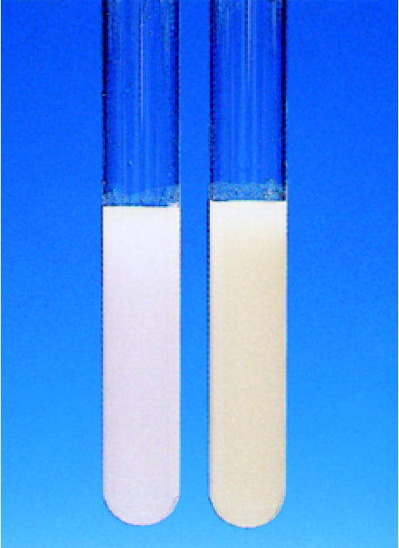
What concentration of Ag is required to precipitate ONLY AgBr in a solution that contains both Br⁻ and Cl⁻ at a concentration of 0.02 M?
AgBr (s) Ag⁺ (aq) + Br⁻ (aq)
K_{sp} = 7.7 x 10⁻¹³
K_{sp} = [Ag⁺][Br⁻]
K_{sp}
7.7 x 10⁻¹³
[Ag⁺] =
=
= 3.9 x 10⁻¹¹ M
[Br⁻]
0.020
AgCl (s) Ag⁺ (aq) + Cl⁻ (aq)
K_{sp} = 1.6 x 10⁻¹⁰
K_{sp} = [Ag⁺][Cl⁻]
K_{sp}
1.6 x 10⁻¹⁰
[Ag⁺] =
=
= 8.0 x 10⁻⁹ M
[Cl⁻]
0.020
3.9 x 10⁻¹¹ M < [Ag⁺] < 8.0 x 10⁻⁹ M
AgCl
AgBr

Slide 27
The Common Ion Effect and Solubility
The presence of a common ion decreases the solubility of the salt.
What is the molar solubility of AgBr in (a) pure water and (b) 0.0010 M NaBr?
NaBr (s) Na⁺ (aq) + Br⁻ (aq)
AgBr (s) Ag⁺ (aq) + Br⁻ (aq)
[Br⁻] = 0.0010 M
K_{sp} = 7.7 x 10⁻¹³
AgBr (s) Ag⁺ (aq) + Br⁻ (aq)
s² = K_{sp}
[Ag⁺] = s
s = 8.8 x 10⁻⁷
[Br⁻] = 0.0010 + s ≈ 0.0010
K_{sp} = 0.0010 x s
s = 7.7 x 10⁻¹⁰

Slide 28
pH and Solubility
The presence of a common ion decreases the solubility.
Insoluble bases dissolve in acidic solutions
Insoluble acids dissolve in basic solutions
remove
add
Mg(OH)₂ (s) Mg²⁺ (aq) + 2OH⁻ (aq)
At pH less than 10.45
K_{sp} = [Mg²⁺][OH⁻]² = 1.2 x 10⁻¹¹
Lower [OH⁻]
K_{sp} = (s)(2s)² = 4s³
OH⁻ (aq) + H⁺ (aq) H₂O (l)
4s³ = 1.2 x 10⁻¹¹
Increase solubility of Mg(OH)₂
s = 1.4 x 10⁻⁴ M
At pH greater than 10.45
[OH⁻] = 2s = 2.8 x 10⁻⁴ M
Raise [OH⁻]
pOH = 3.55 pH = 10.45
Decrease solubility of Mg(OH)₂

Slide 29
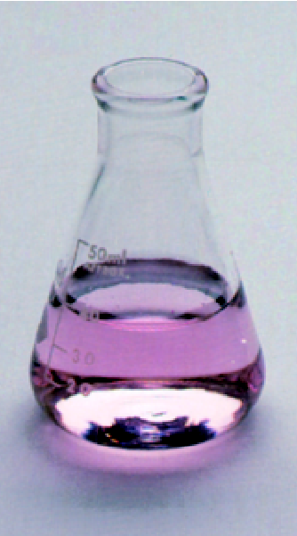
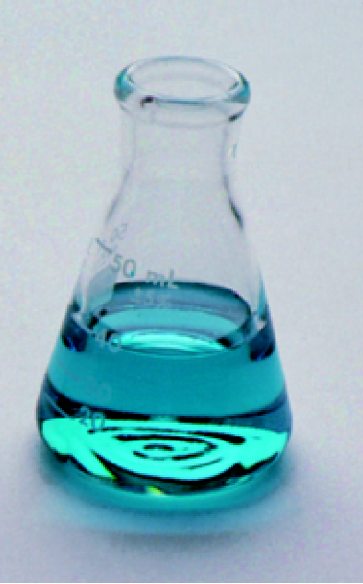
Complex Ion Equilibria and Solubility
A complex ion is an ion containing a central metal cation bonded to one or more molecules or ions.
2-
Co²⁺ (aq) + 4Cl⁻ (aq) CoCl₄ (aq)
The formation constant or stability constant (K_{f}) is the equilibrium constant for the complex ion formation.
2-
[CoCl₄ ]
K_{f} =
2+
[Co²⁺][Cl⁻]⁴
Co(H₂O)₆
2-
CoCl₄
stability of complex
K_{f}
HCl

Slide 30
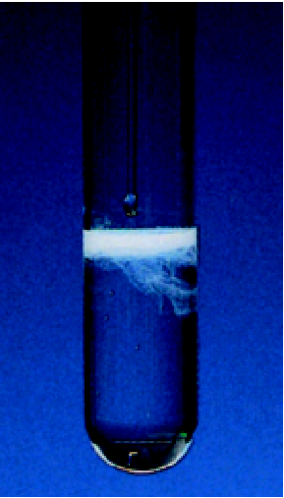
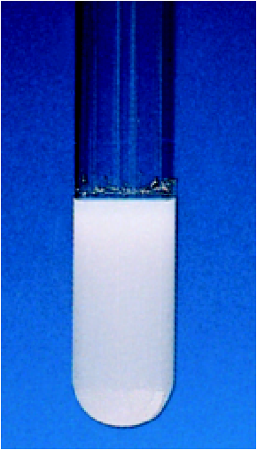
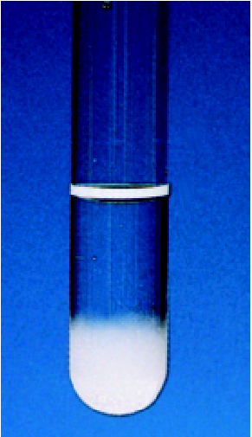
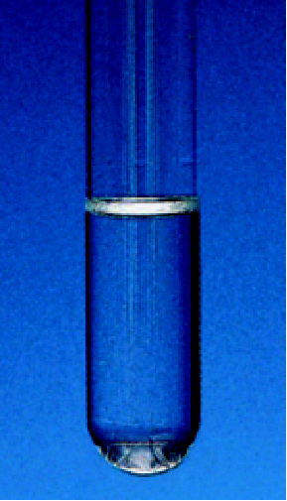
Effect of Complexation on Solubility
AgNO₃ + NaCl
Add NH₃
Ag(NH₃)₂⁺
AgCl

Slide 31
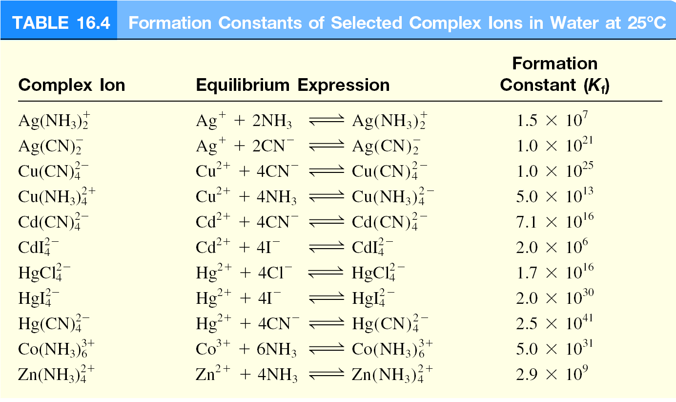

Slide 32
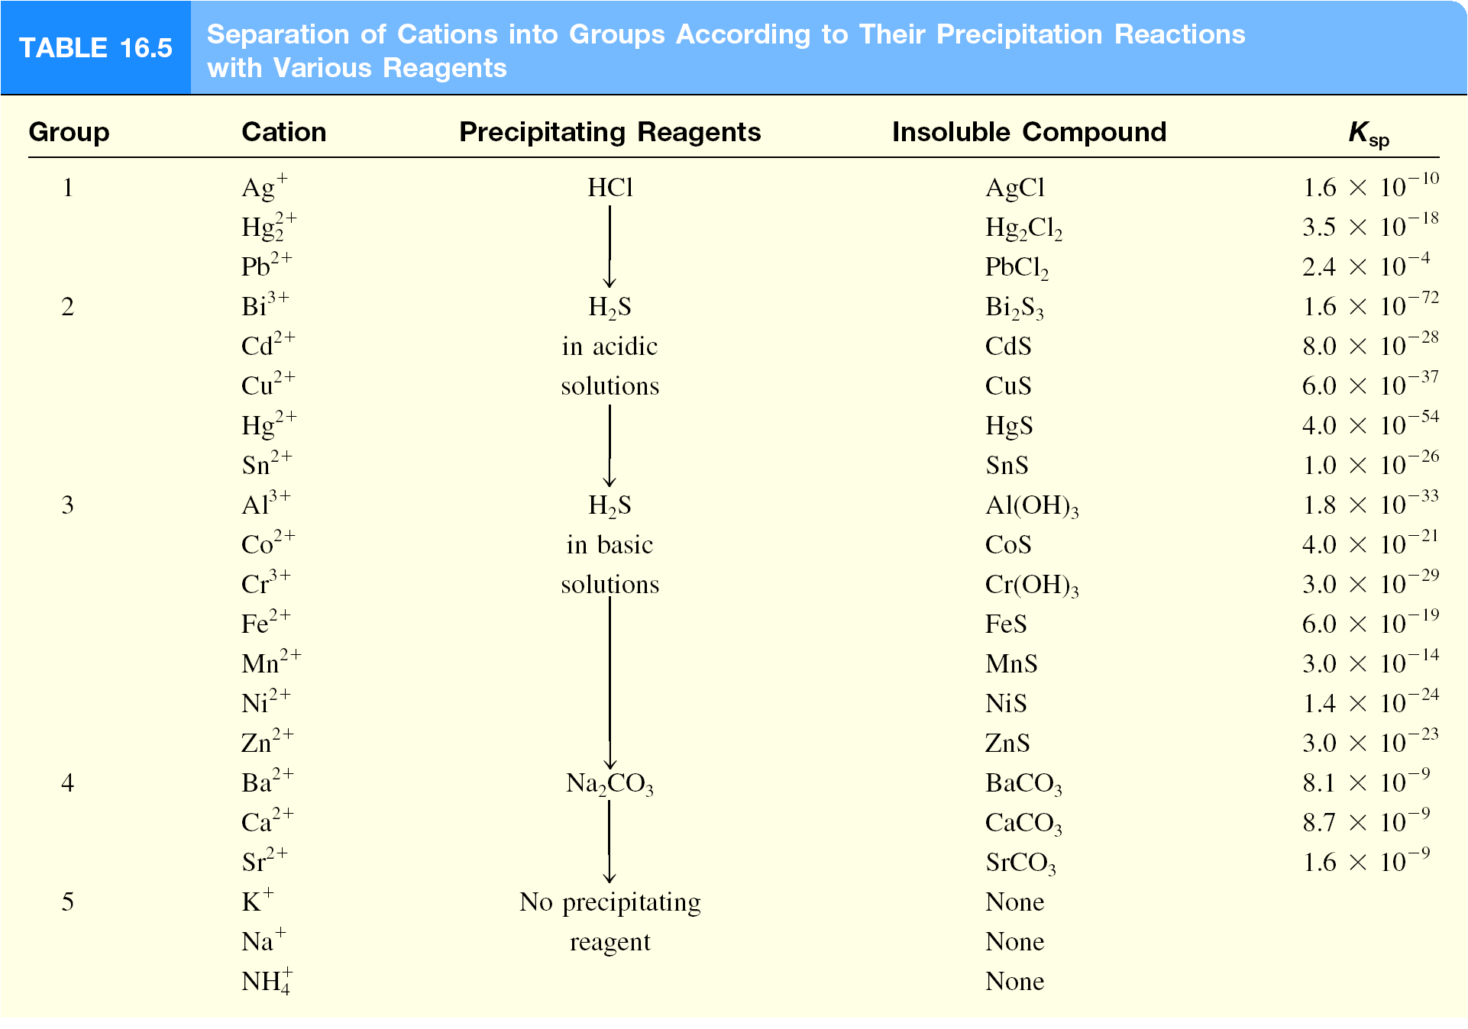

Slide 33
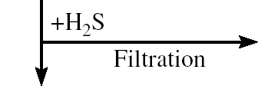
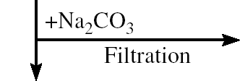
Qualitative Analysis of Cations

Slide 34
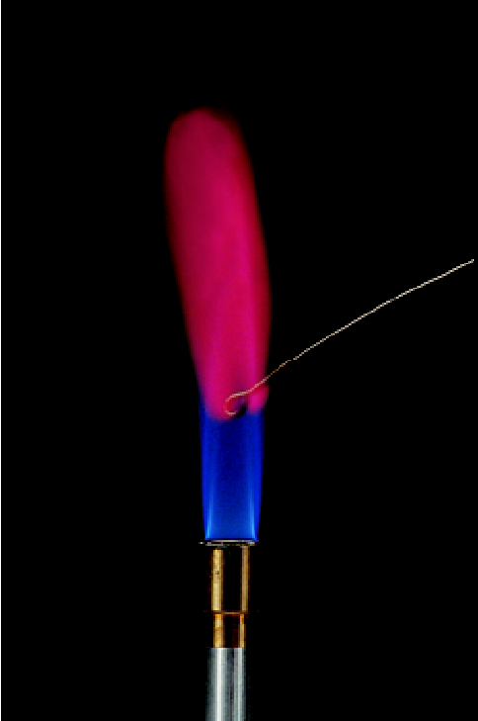
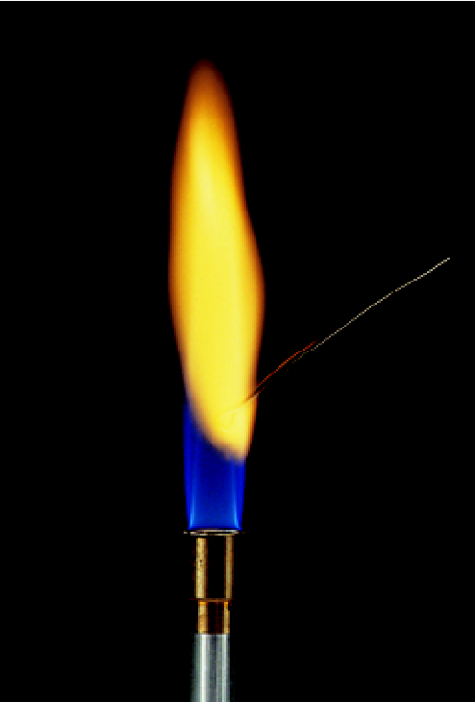
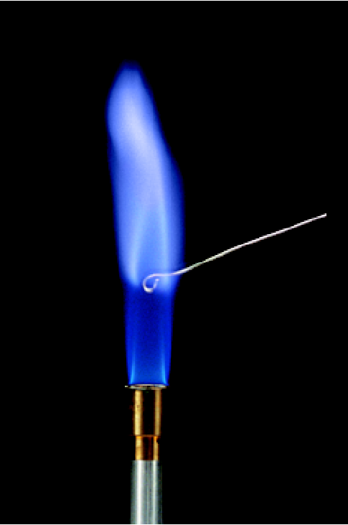
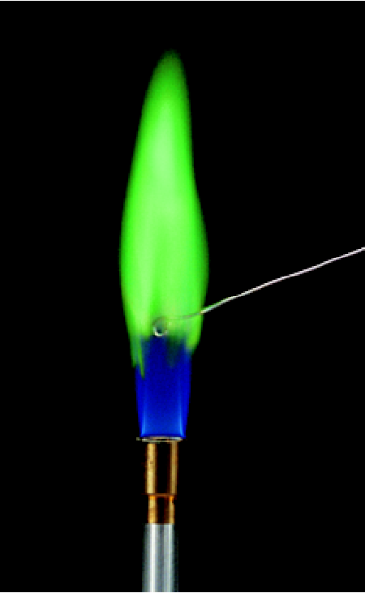
Flame Test for Cations
lithium
sodium
potassium
copper

Slide 35
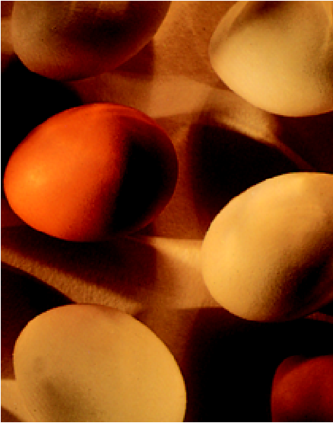
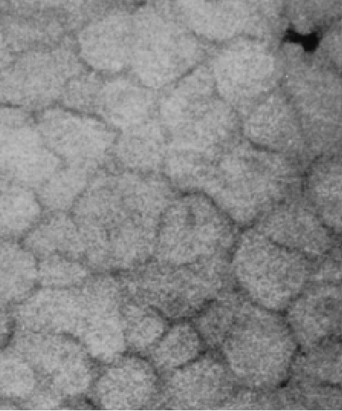
Chemistry In Action: How an Eggshell is Formed
Ca²⁺ (aq) + CO₃²⁻ (aq) CaCO₃ (s)
carbonic
CO₂ (g) + H₂O (l) H₂CO₃ (aq)
anhydrase
H₂CO₃ (aq) H⁺ (aq) + HCO₃⁻ (aq)
HCO₃⁻ (aq) H⁺ (aq) + CO₃²⁻ (aq)
electron micrograph

