Slide 1
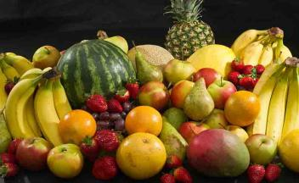
VITAMIN & MINERAL
Bu dini

Slide 2
Vitamins
Organic substances that regulate numerous and diverse physiological processes in the body
Do not contain calories
Two types
  Fat soluble
  Water soluble
Notes:
Vitamins

Slide 3
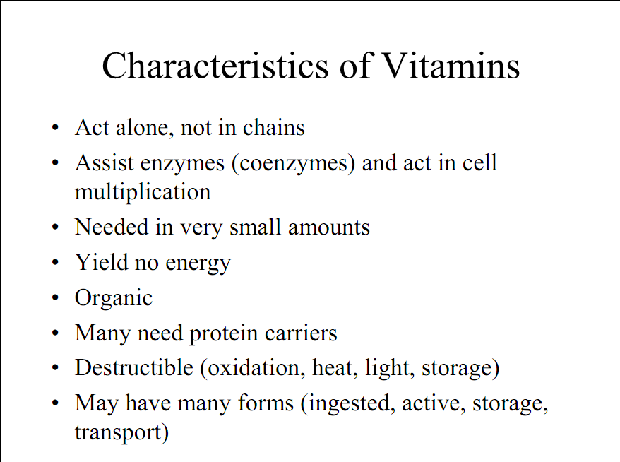

Slide 4


Vitamins
Your body needs vitamins to help it work normally.
Vitamins are needed for many functions including:
releasing energy from food
repair and growth of tissues
resisting infection and disease
regulating chemical reactions in the body.
Fruit and vegetables contain a lot of vitamins.

Slide 5
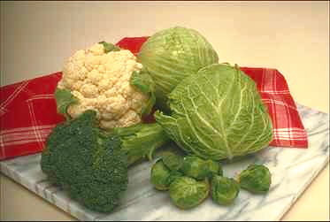
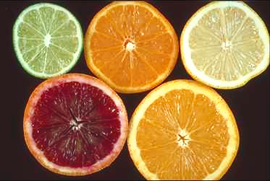
Vitamin Guidelines
Click for info on
“anti-oxidants”
A balanced diet containing recommended servings of carbohydrates, fats and proteins will meet the RDA standards
Extra servings of green and
yellow vegetables may be beneficial
Extra consumption of citrus and other fruits may be beneficial
Notes:
Discuss these important dietary guidelines for vitamins. While supplements contain a large amount of vitamins, they don’t contain the other substances found in fruits and vegetables that may be beneficial.

Slide 6
Fat Soluble Vitamins
Consist of Vitamins A, D, E, and K
Absorbed at the small intestine in the presence of bile (a fatty substance)
Overdoses can be toxic (A and D)
Notes:
Fat soluble vitamins dissolve in the bodies fat tissues. Excess amounts of fat soluble vitamins can get stored up in the tissues and lead to toxic effects.

Slide 7
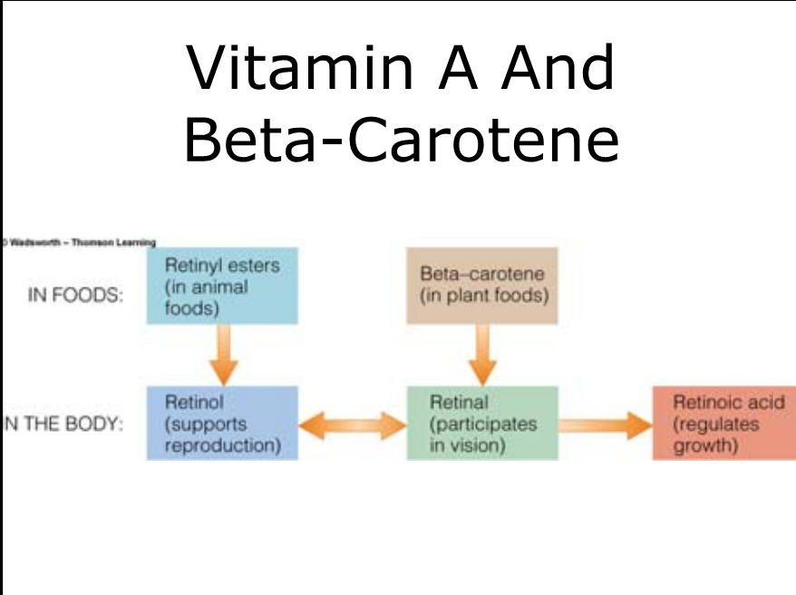

Slide 8
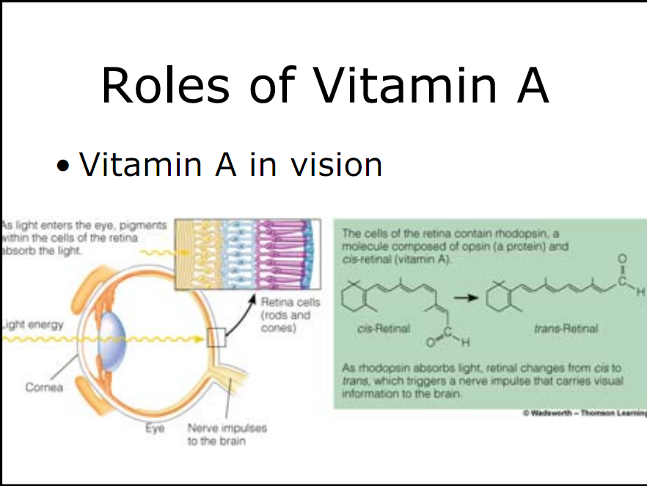

Slide 9
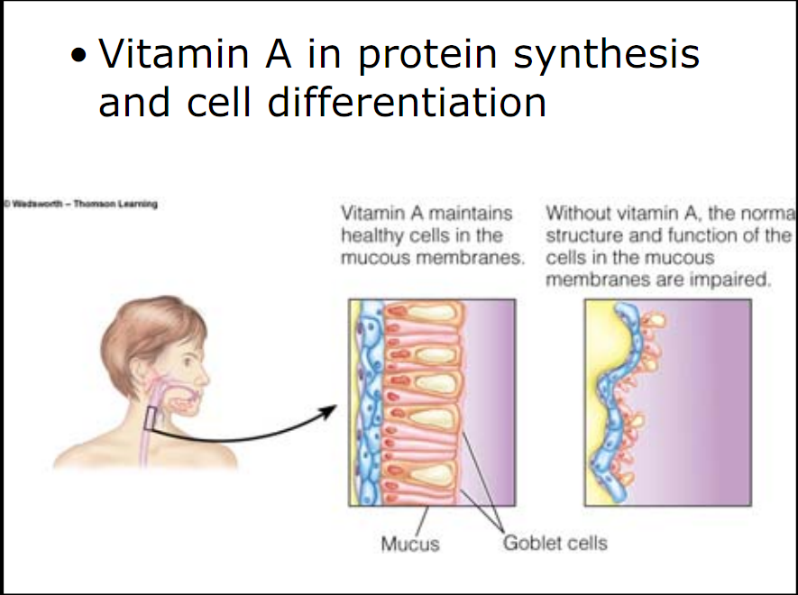

Slide 10
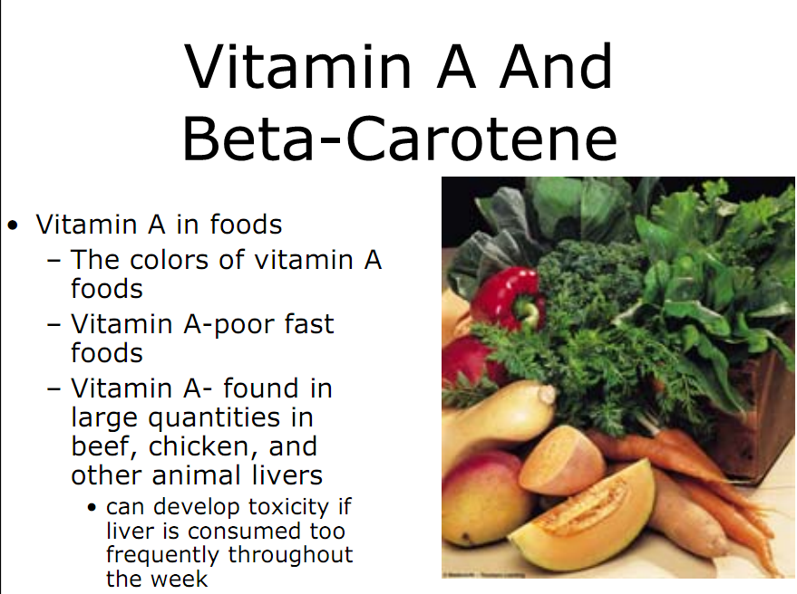

Slide 11
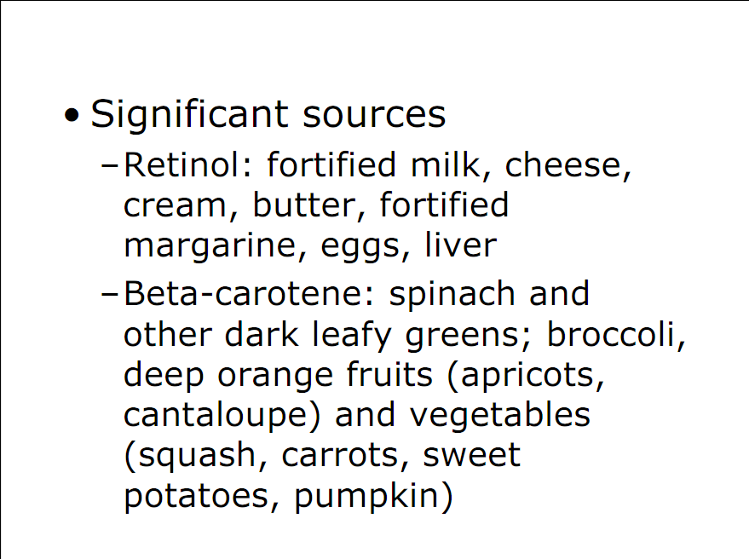

Slide 12
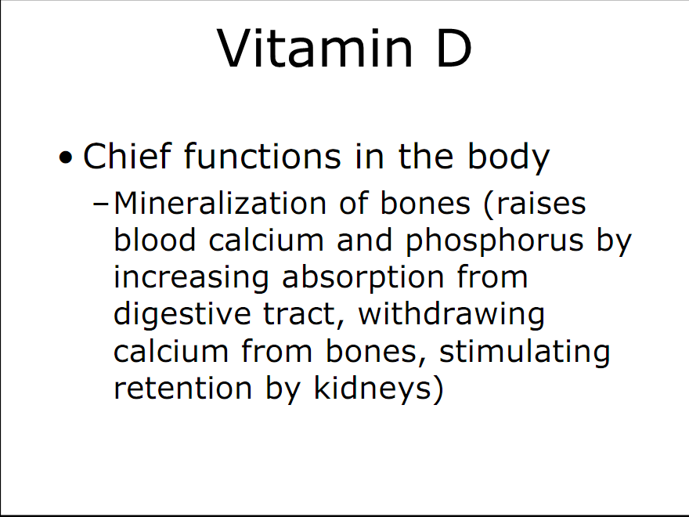

Slide 13
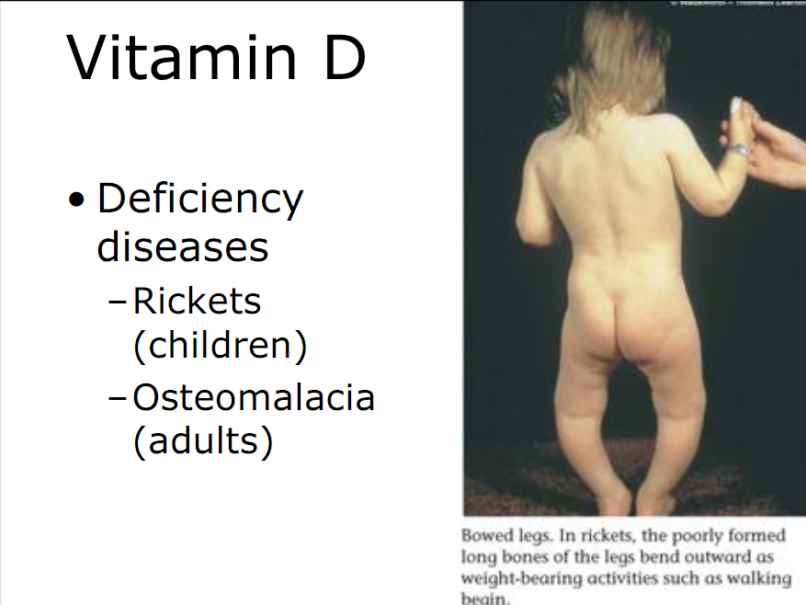

Slide 14
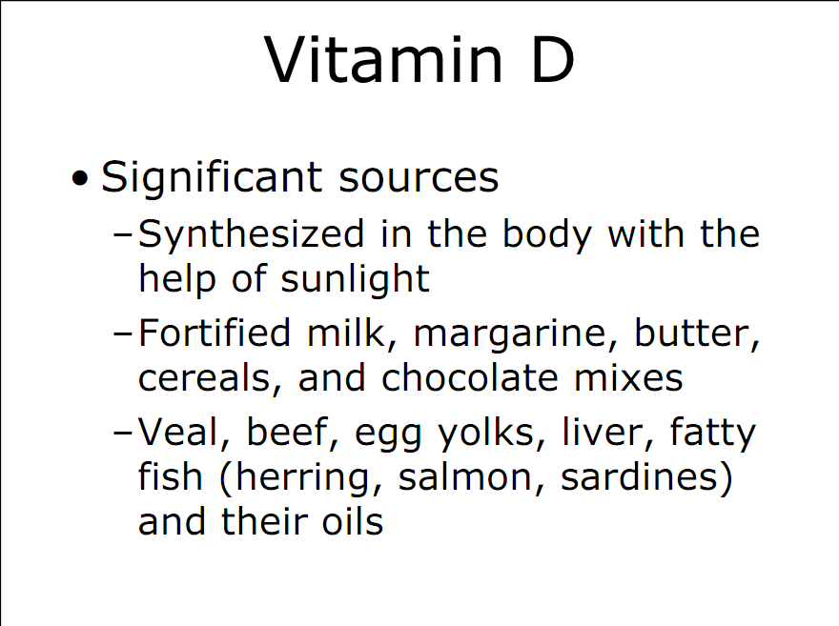

Slide 15
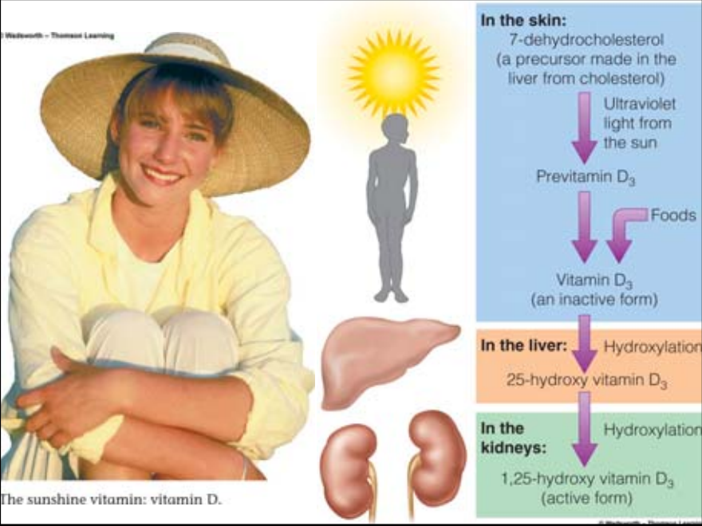

Slide 16
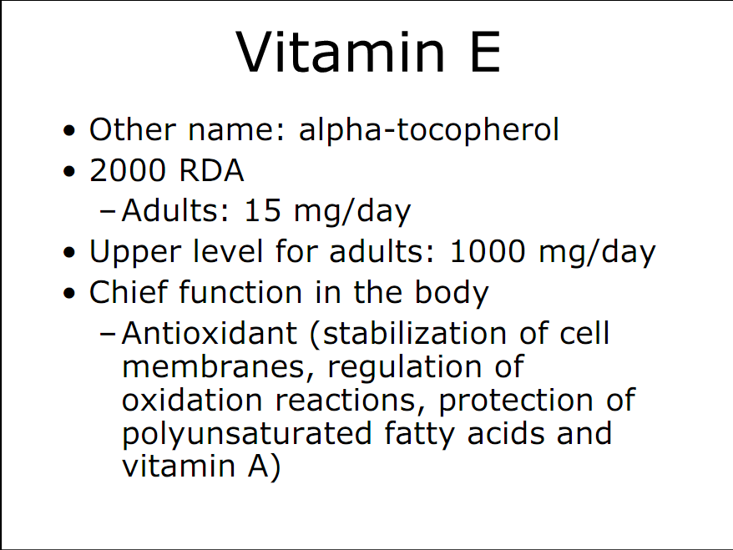

Slide 17
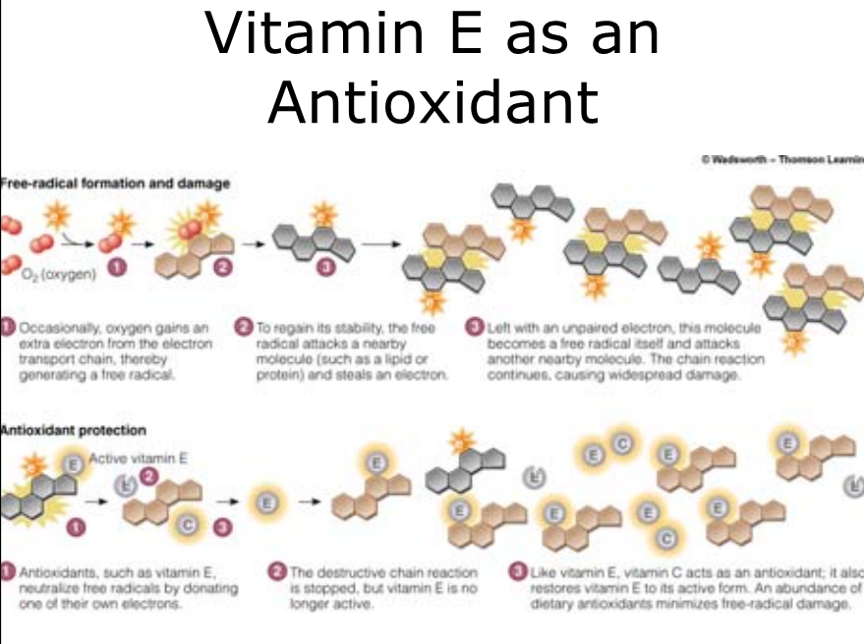

Slide 18
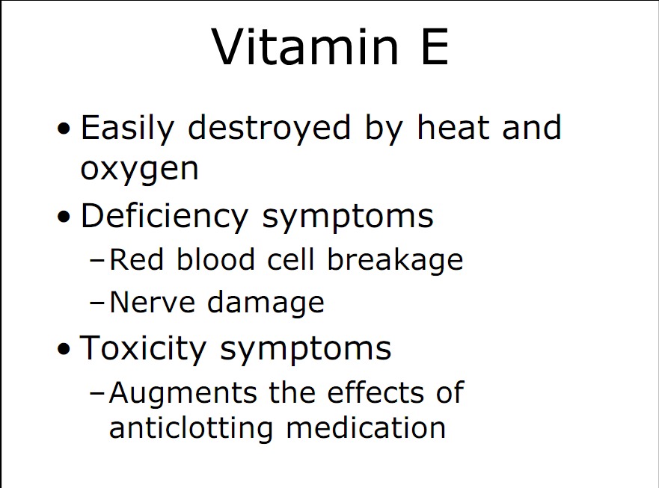

Slide 19
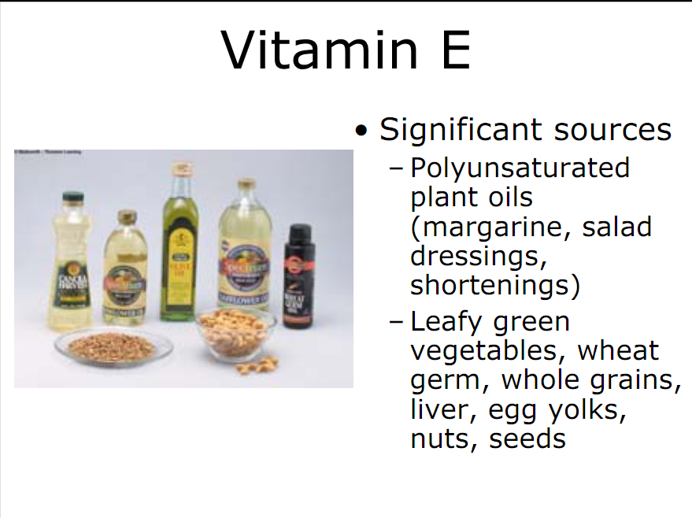

Slide 20
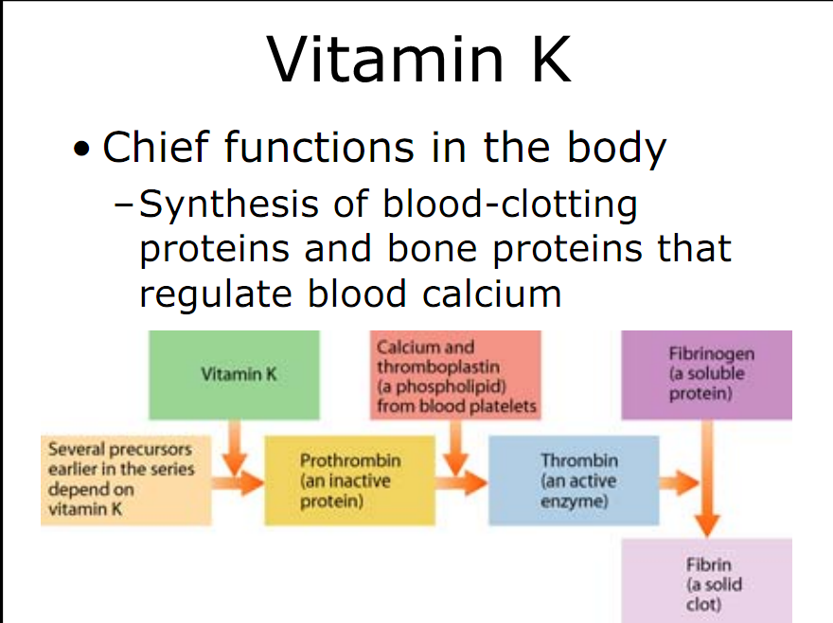

Slide 21
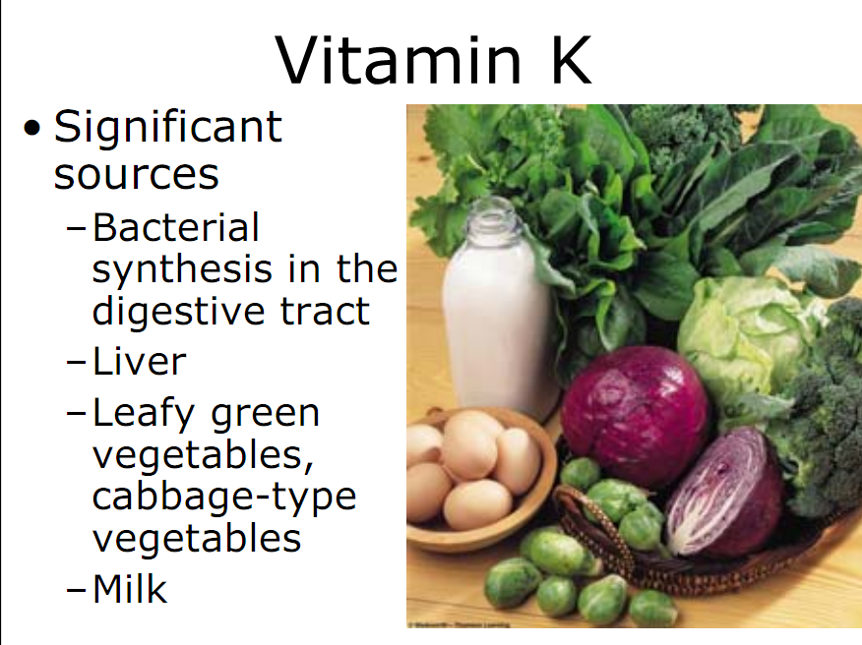

Slide 22
Water Soluble Vitamins
Consist of B complex and vitamin C
Excesses will be excreted in the urine, however, B-6 and Niacin can be toxic when ingested in unusually large amounts
Notes:
Water soluble vitamins get excreted on a daily basis so the body requires regular amounts of these vitamins.

Slide 23
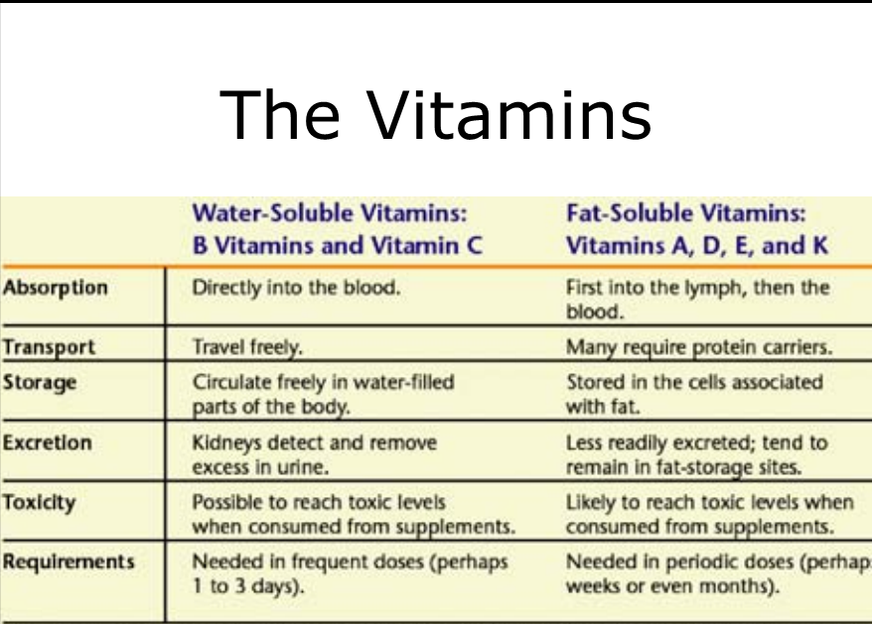

Slide 24
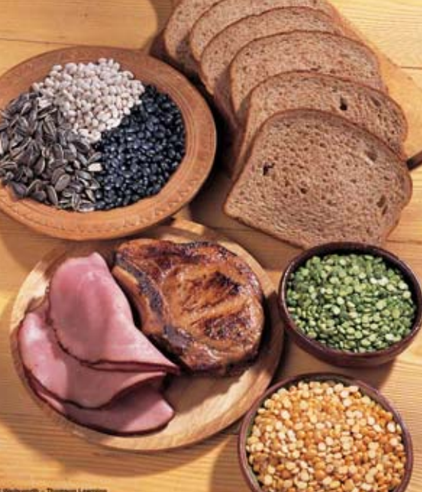
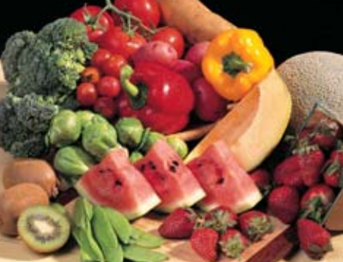
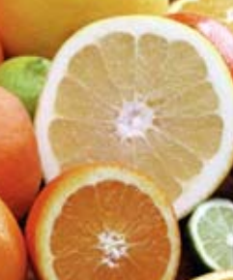
Water Soluble Vitamins
Return to
presentation
B-1 (thiamine)
B-2 (riboflavin)
B-6 (pyridoxine)
B-12 (cobalamin)
Niacin (nicotinic acid)
Pantothenic Acid
Folic Acid (folacin)
Biotin
C
Notes:
This is a list of the water soluble vitamins

Slide 25
Vitamins
This table gives information about some important vitamins:
Vitamin | Found in | Why is it needed
Vitamin A
Vitamin C
Vitamin B1
Vitamin D
Fish, milk, vegetables, eggs and cheese
Eyesight, healthy skin
Fruit (especially citrus fruits) and vegetables
Healthy teeth and gums, avoiding scurvy
Whole-grain foods, nuts and meat
Breaking down carbohydrates
Animal products. Also made in the body when the sun shines on the skin
Absorbing calcium and phosphorous, avoiding rickets

Slide 26
Vitamin Supplementation?
Not necessary if diet is healthy
Multivitamins are safe (100% RDA)
Not all vitamins are “pure”
Can be toxic at high doses
Notes:
5
The current consensus is that a balanced nutritious diet can provide all of the vitamins that a person needs. If a person wanted to be sure their diet is adequate it is safe to take a multivitamin each day as long as the vitamin does not provide over 100% of the RDA values.
Provide vitamin tips for cooking and food preparation:
1. vitamins are found in the peel of most fruits and vegetables
2. steam or microwave foods to retain vitamins
3. keep foods frozen to retain vitamins

Slide 27
Populations Who May Benefit from Supplementation
Pregnant/lactating women
Alcoholics
Elderly
Women with severe menstrual losses
Individuals on VLCD’s
Strict vegetarians
Individuals taking medications or with diseases which inhibit nutrient absorption
Notes:
Review the populations that may benefit from supplementation

Slide 28
Antioxidant All-Stars
Broccoli
Cantaloupe
Carrot
Kale
Mango
Pumpkin
Red Pepper
Spinach
Strawberries
Sweet potato
Notes:
The following list is of the foods that have the most significant health benefits.

Slide 29
MINERAL

Slide 30
Minerals
Minerals are basic elements that are found in the air and the earth.
The body needs small amounts of certain minerals in order to stay healthy.
Mineral | Found in | Why is it needed
Calcium
Iron
Iodine
Vegetables, dairy products and dried fish
Keeping bones and teeth hard
Red meat, liver, beans, lentils and green vegetables
Making blood, preventing tiredness and anaemia
Seafood and dairy products
Maintaining the thyroid gland

Slide 31
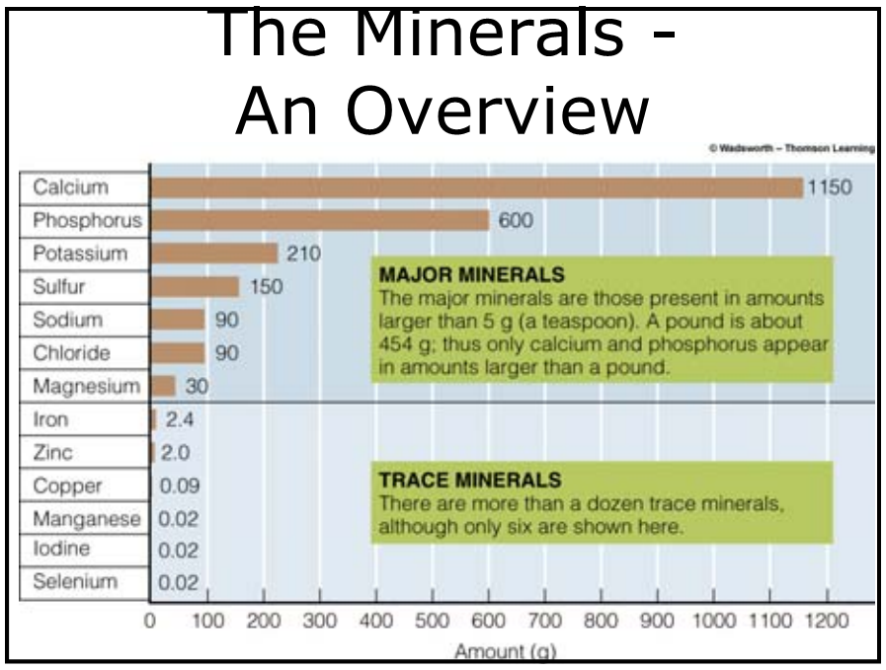

Slide 32
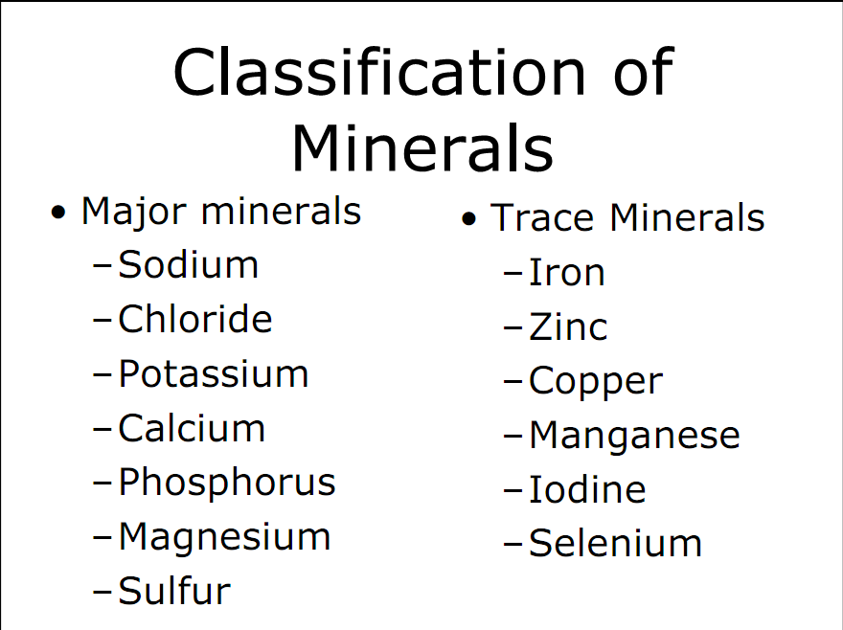

Slide 33
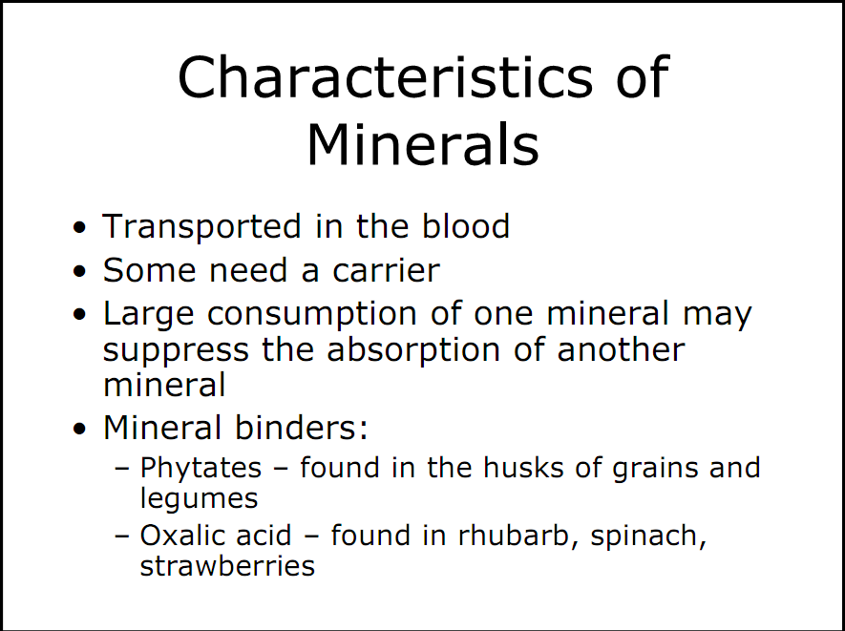

Slide 34
Calcium
Return to
mineral guidelines
Important for preventing osteoporosis
RDA = 800-1000 mg/day
Found in dairy products and vegetables
If using a supplement, most dietitians recommend taking it in several doses since the body cannot absorb all of it at one time
Calcium can be found in dairy products and green leafy vegetables. High levels of protein in the diet actually cause calcium to be lost from the bones which can predispose a person to osteoporosis.
High protein diets leach calcium from bones and promote osteoporosis
Notes:
8
Calcium is important for preventing osteoporosis. The RDA is 1000 mg per day for adult women. If using a supplement, most dietitians recommend taking it in several doses since the body cannot absorb all of it at one time
Calcium can be found in dairy products and green leafy vegetables. High levels of protein in the diet actually cause calcium to be lost from the bones which can predispose a person to osteoporosis.

Slide 35
Calcium Needs
Restriction of dairy products by women – not good (yogurt, cheeses)
Irregular menstruation/Amenorrhea
  Severe bone loss and osteoporosis
  Extra calcium does not compensate for effects of menstrual irregularities
  Compromises bone health
Calcium deficiency increases risk of stress fractures

Slide 36
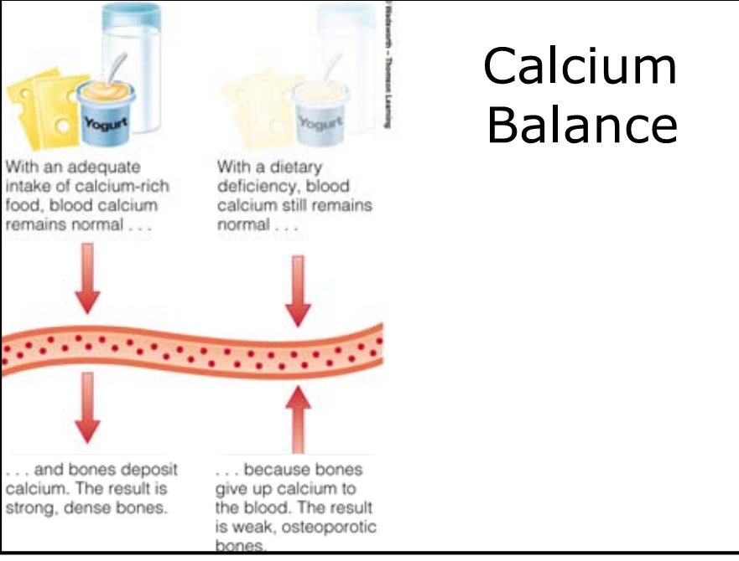

Slide 37
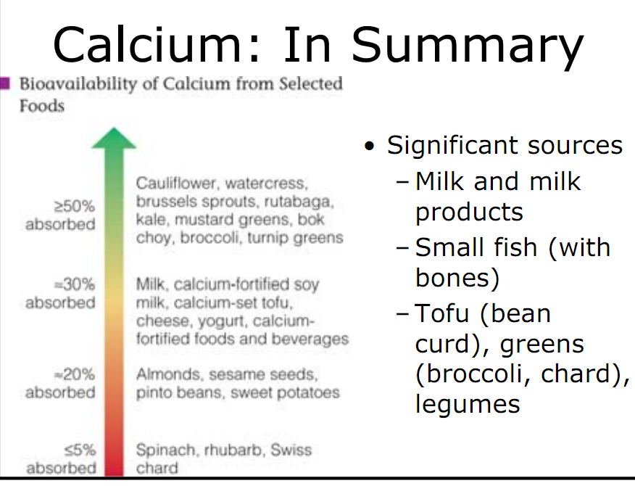

Slide 38
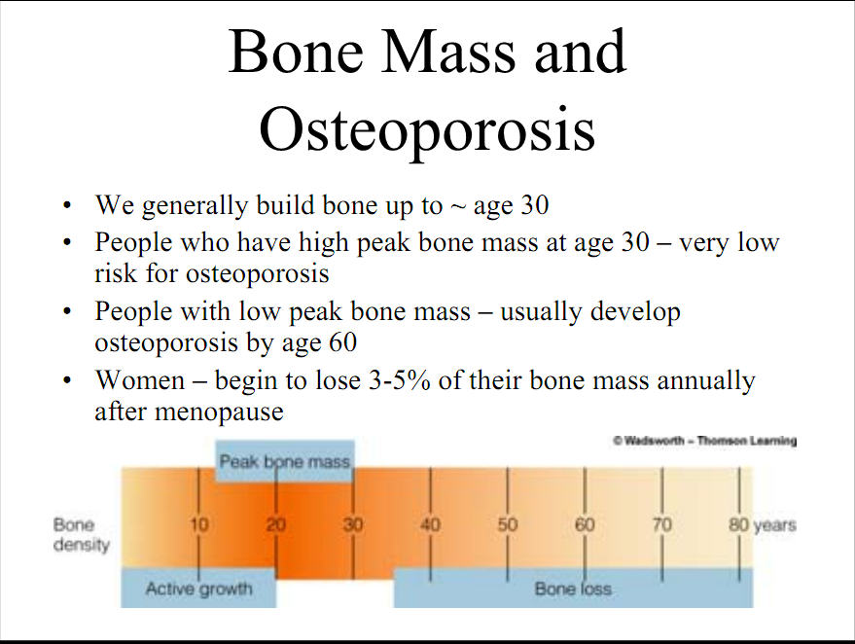

Slide 39
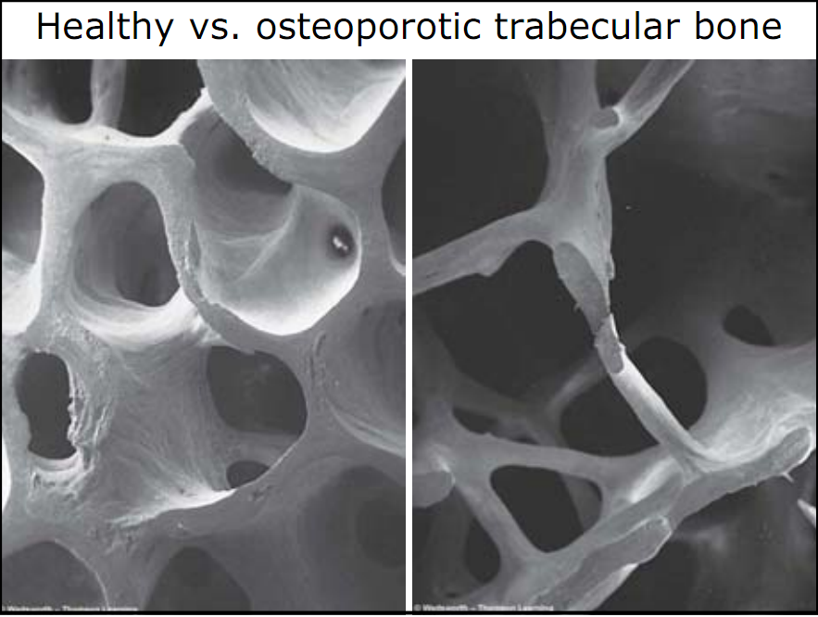

Slide 40
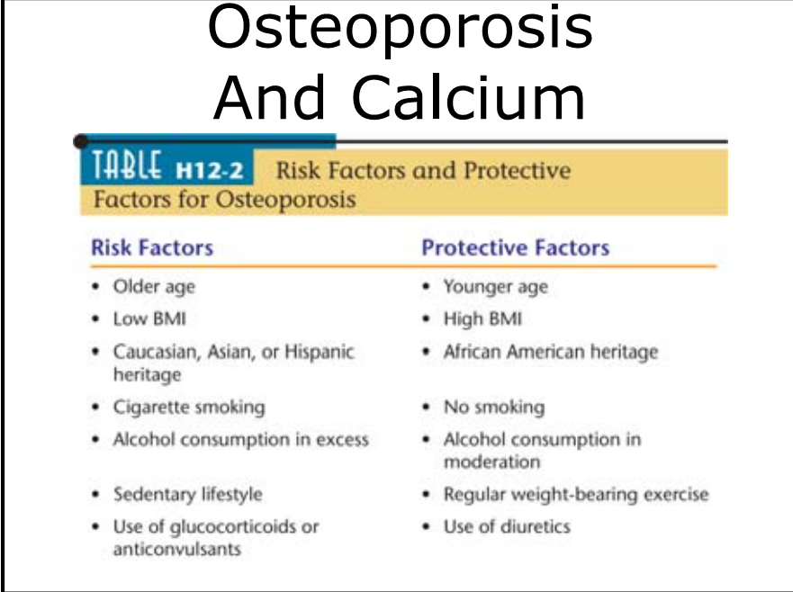

Slide 41

Calcium for a female athlete
Calcium is important in the formation and maintenance of strong bones.
Although moderate exercise is important in bone formation, very strenuous exercise can interrupt the menstruation cycle and cause a hormone imbalance which can lead to problems with bone health.
It is therefore important that female athletes’ diets contain adequate calcium intake.

Slide 42
Iron
Return to
mineral guidelines
Important component of hemoglobin
Iron deficiency is known as anemia
(Symptoms: shortness of breath, fatigue)
Notes:
7
Iron is a component of hemoglobin which helps carry oxygen throughout the body. Iron deficiency is known as anemia and is characterized by a shortness of breath and fatigue.

Slide 43
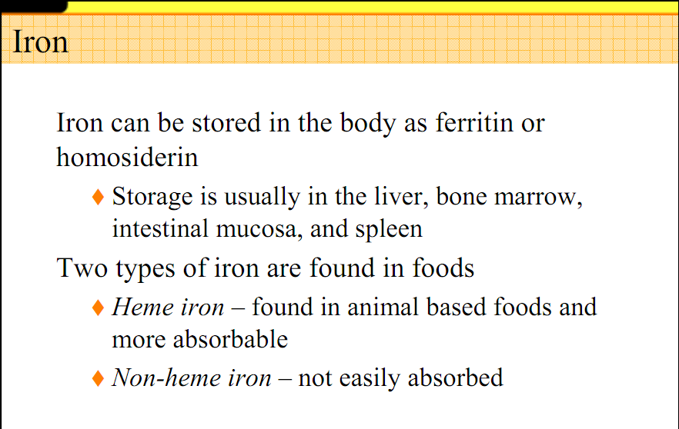

Slide 44
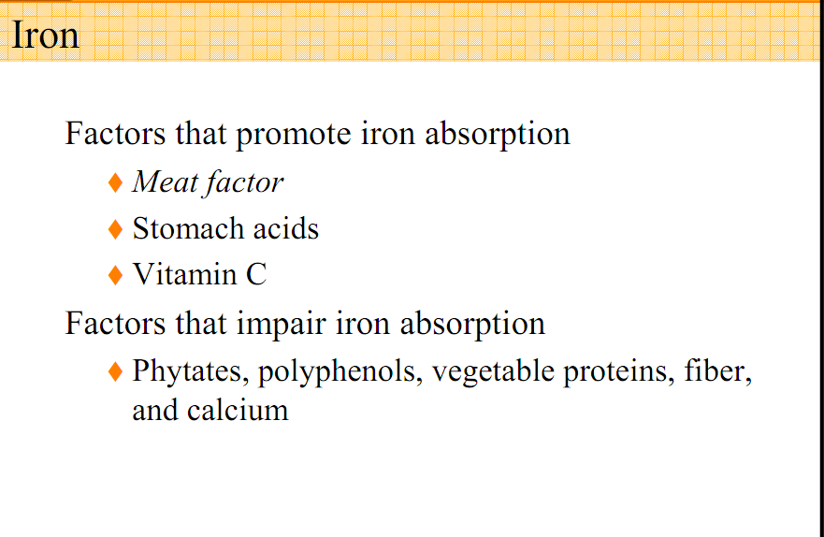

Slide 45
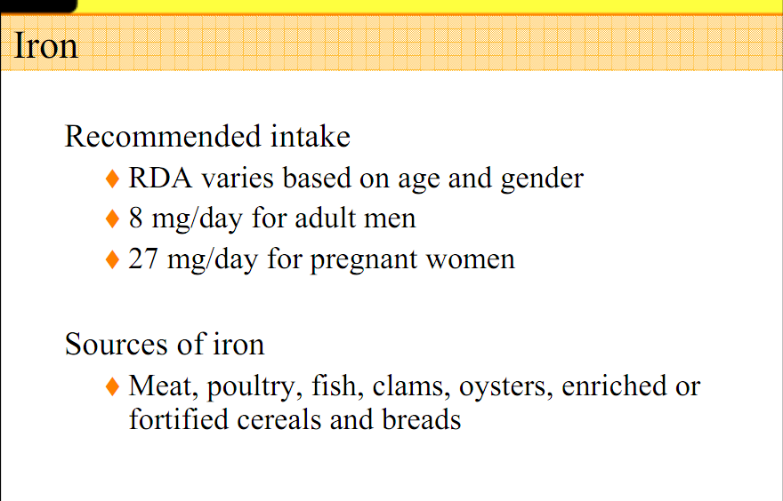

Slide 46
Iron Needs
Iron deficiency affects performance
Sports anemia
  Increase in plasma volume but not RBCs
Women at risk because of menstruation
Focus on iron-rich foods
Use of iron supplement may cause toxic effects

Slide 47

Iron for a female athlete
Some women have very high iron requirements due to heavy menstrual losses.
Iron is important for carrying oxygen in the blood so even a mild deficiency can affect performance.

Slide 48
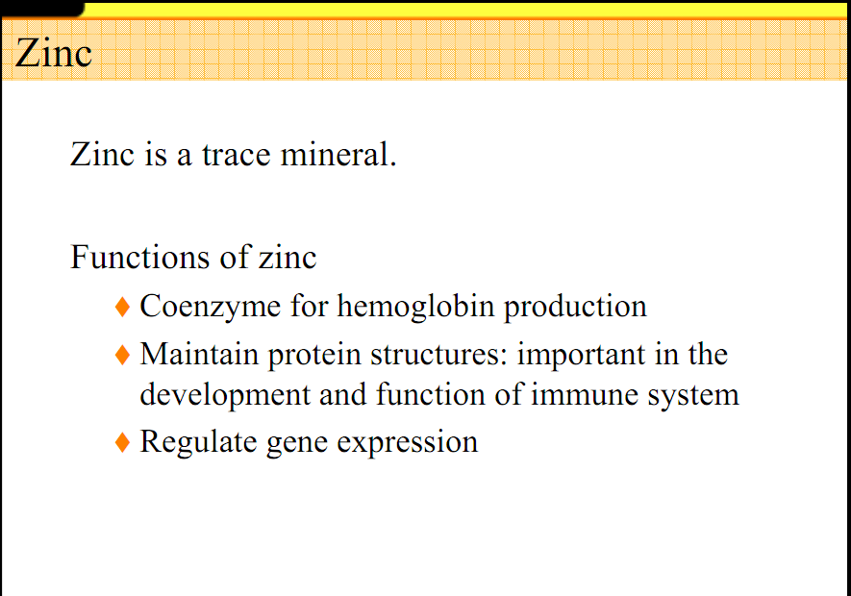

Slide 49
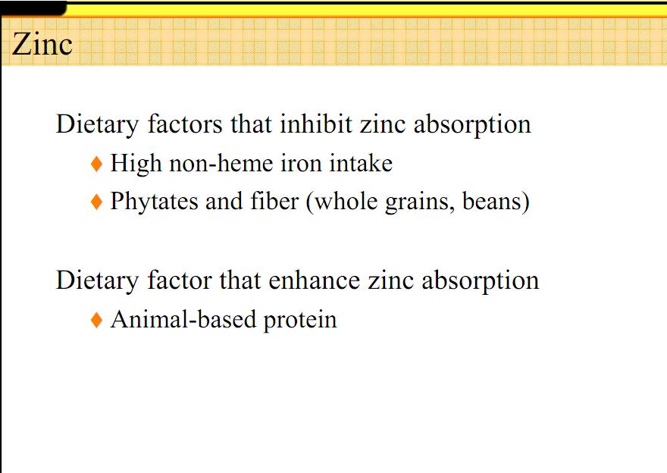

Slide 50
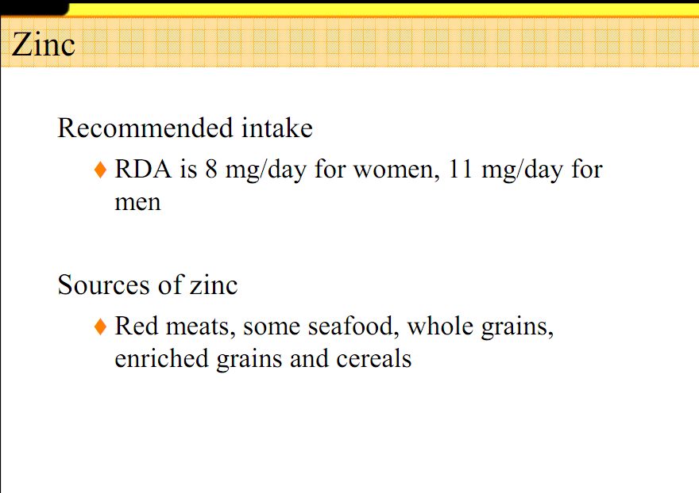

Slide 51
Healthy Eating for Athletes:
Vitamins and Minerals
Vitamins and minerals are essential to the diet.
You can’t make them so you have to get them from foods or dietary supplements.
Essential micronutrients have many important functions, including:
Supporting growth, repairing tissues, carrying oxygen to muscles and other tissues, and supporting the metabolism of energy, carbs, protein, and fat.
.
51

Slide 52
Healthy Eating for Athletes:
Vitamins and Minerals
All the essential vitamins and minerals are important to athletic performance and good health. Some key examples are:
B vitamins (thiamin, riboflavin, and pyridoxine) – for energy and nutrient metabolism
Vitamin C – for healthy immune function
Calcium and vitamin D – for strong and healthy bones
Iron – for optimum oxygen delivery to tissues and the prevention of anemia
For extra insurance, consider taking a basic daily multivitamin/mineral supplement

Slide 53
Vitamins & Minerals
“The Body’s Sparkplugs”
Vitamins and minerals are small yet powerful nutrients.
They do not contain calories, but help to unlock energy stored in food.
Their job is to protect the body against disease, and to build strong, healthy bones.

Slide 54
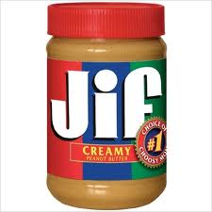

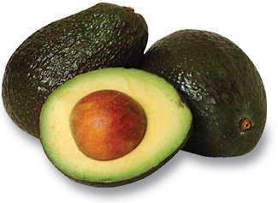
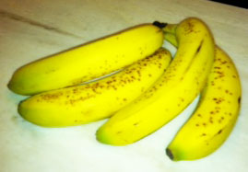
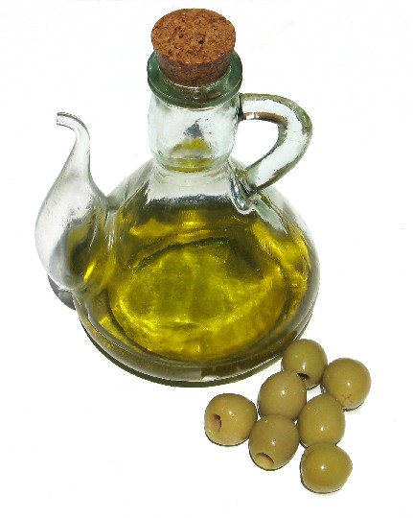
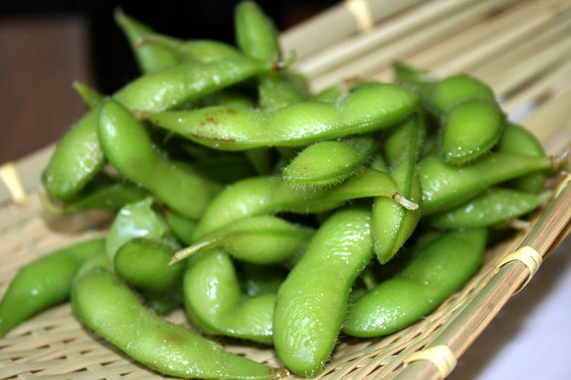
Confused about what to eat?
Eat more fresh food!
Eat local food when you can!
Complex carbs, balanced
wit protein and healthy fats.
Reduce animal fats and refined sugar.
From the Virtual Cell Biology Classroom on ScienceProfOnline.com
Image: Edamame, Tammy Green

