Slide 1
Intermediate Structure Nouns
Special Semester 2015-2016
© Yosa A. Alzuhdy, M.Hum.
 0815 7887 1437 |  0811 2545 567
 yosa@uny.ac.id
English Language and Literature Study Program
English Department
State University of Yogyakarta

Slide 2
Page 112

Slide 3
stories
eruption
capitols

Slide 4
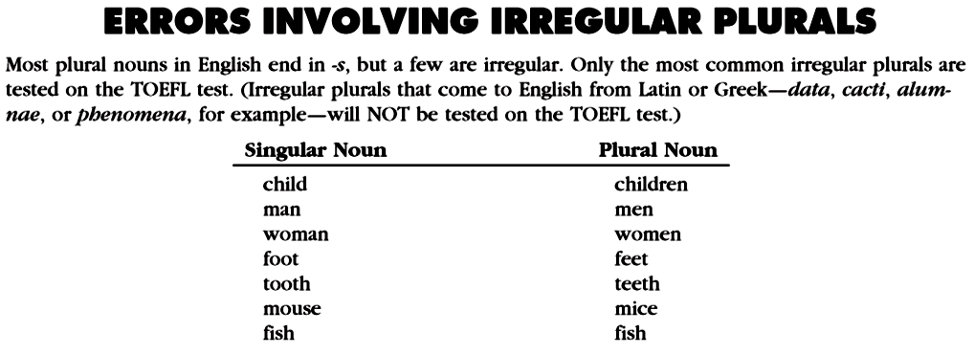
children
Some other nouns to consider: species species
(singular and plural) means means
medium media
phenomenon phenomena

Slide 5
information
bank managers toy factories human beings car designers
detective stories

Slide 6
4-year
Thousands

Slide 7
S
S
P
S
P
S
P
S
S
P
P
P
P
P
S
P
P
P

Slide 8
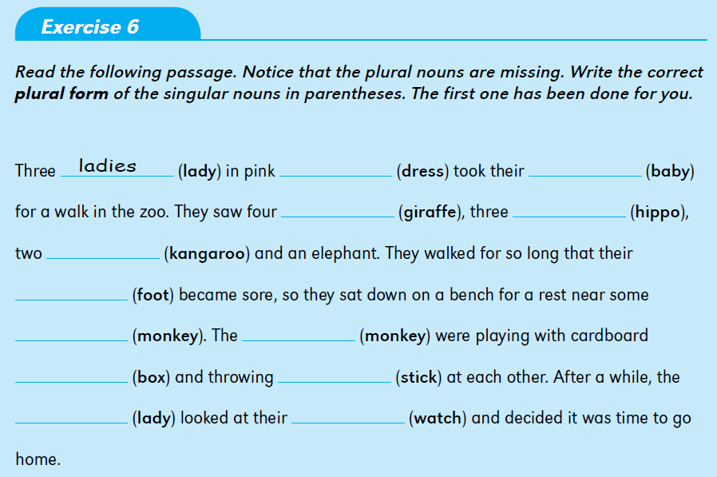
dresses
babies
giraffes
hippos
kangaroos
feet
monkeys
monkeys
boxes
sticks
ladies
watches

Slide 9
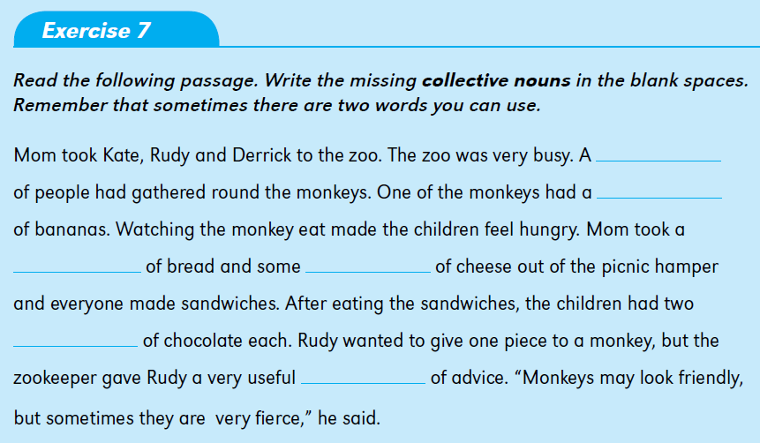
crowd
bunch
slice
slices/pieces
pieces/squares
piece

Slide 10
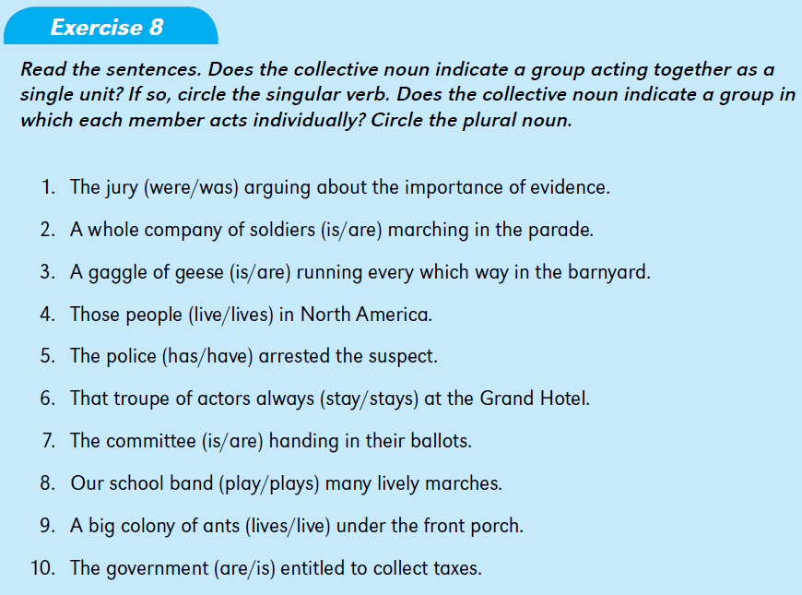

Slide 11
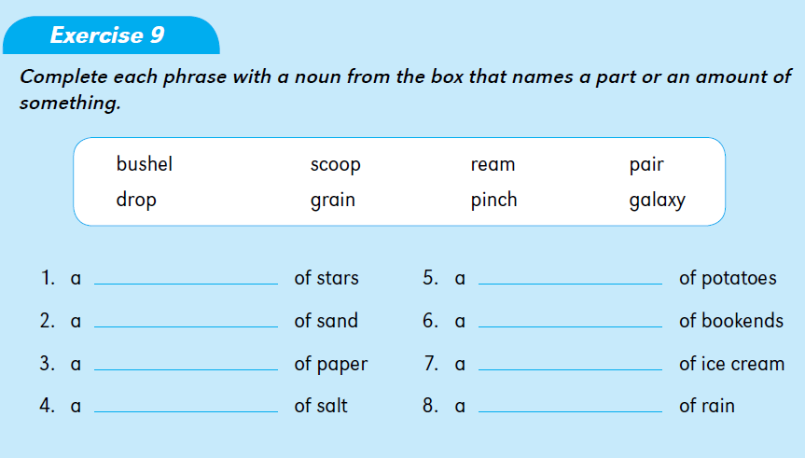
galaxy
bushel
pinch
pair
ream
scoop
grain
drop

Slide 12
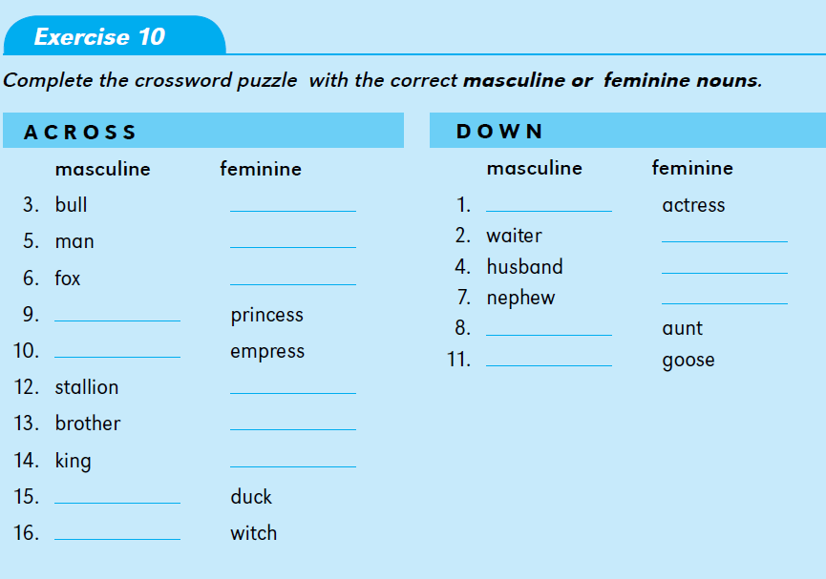
cow
actor
woman
waitress
vixen
wife
niece
prince
uncle
emperor
gander
mare
sister
queen
drake
wizard

Slide 13
‘s
‘s
‘s
‘
‘s
‘s
‘s
‘s
‘s

Slide 14
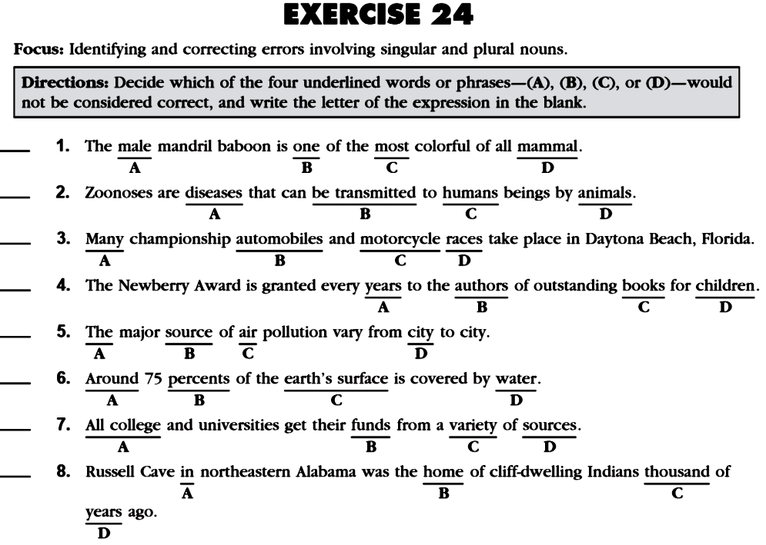

Slide 15
PRACTICE
makes
PERFECT
PERFECT
So, repeat (perfectly) again at your leisure time several times

