Slide 1
20 Verbs
Section 2: Structure & Written Expression
TOEFL Preparation
© Yosa A. Alzuhdy, M.Hum.
yosa@uny.ac.id
English Literature Study Program
State University of Yogyakarta

Slide 2
Page 90
Subject: Minerals→plural →Vb tanpa s/es
exist
Subject: Bowling→singular →tobe: is

Slide 3
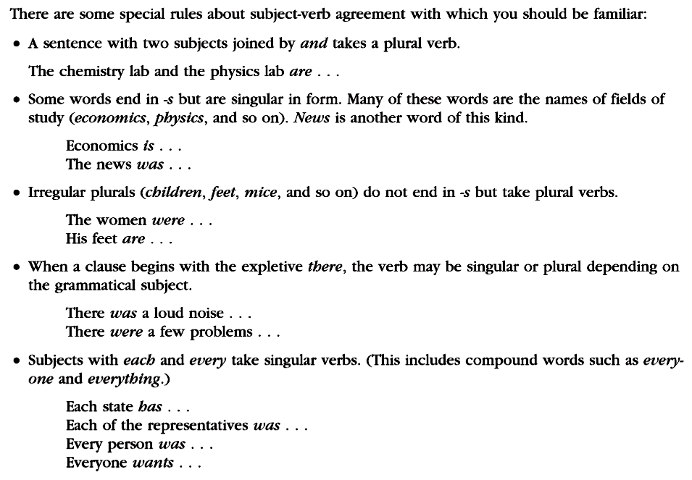
Some Rules (1)

Slide 4
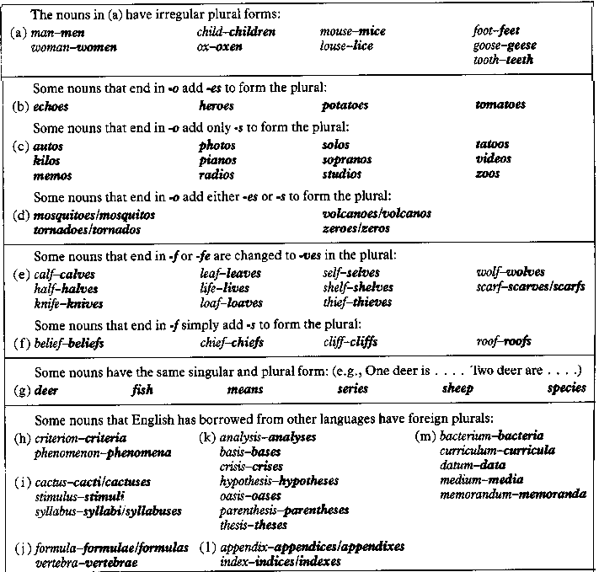
See p.43 Irregular PLURAL NOUN

Slide 5
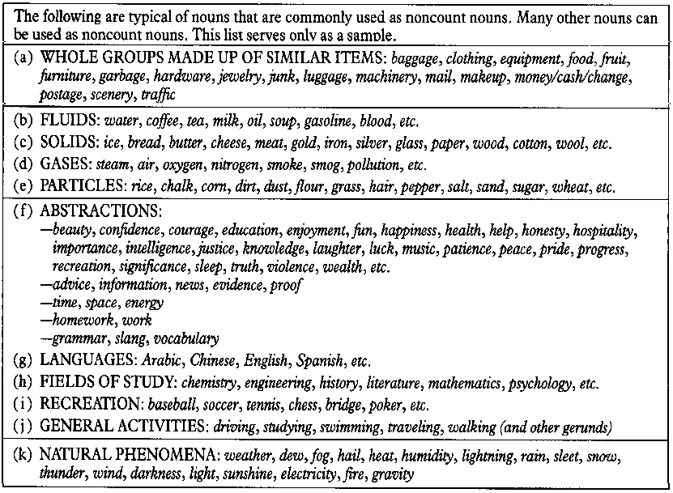
p.43 UNCOUNTABLE NOUNS

Slide 6
Expressions of Singular Subjects
anybody
everybody
somebody
nobody
each + N (sg)
each of +N (pl)
every + N (sg)
every of + N (pl)
anyone
everyone
someone
no one
anything
everything
something
nothing
Every student is expected to do their own assignments.
Somebody has to clean the whiteboard every morning.
Each room in this building is equipped with an LCD projector.
Each of the rooms is also equipped with an air conditioner.
Nothing in this world is allowed to take her away from me.
Everybody knows the rule, but somebody has just broken it.
Each student is suggested to have an account on BeSmart.
Each of the LCD projectors has been checked and registered.
Every one of the children was given a present in the party.

Slide 7
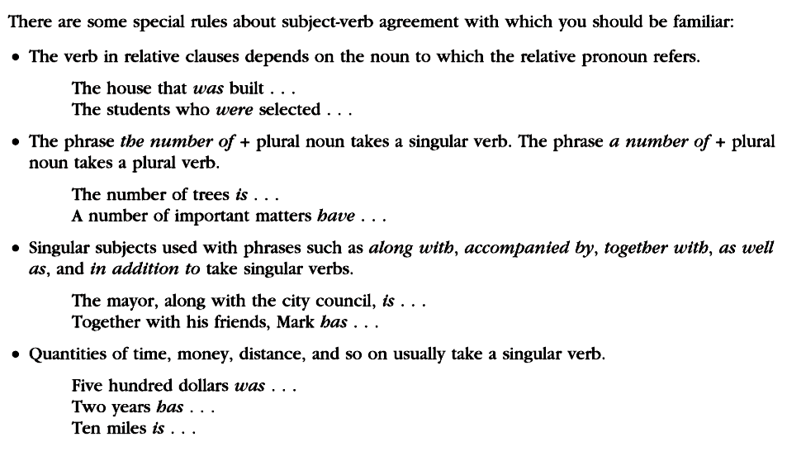
Some Rules (2)
The man, accompanied by his children, is waiting outside.
The children, accompanied by their father, are waiting outside.

Slide 8
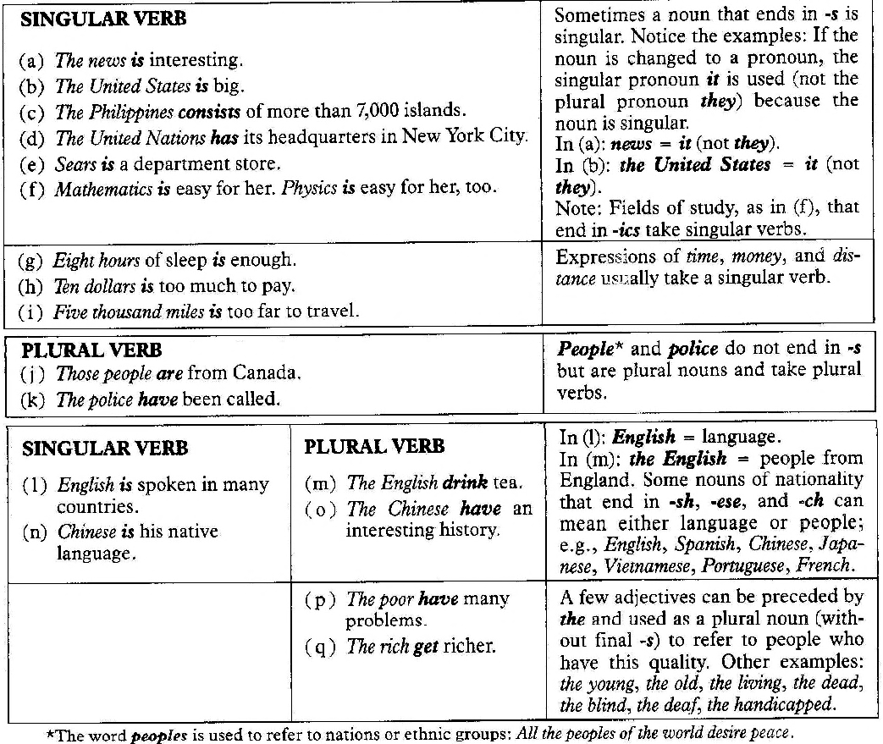
Subj+Verb → Irregularities

Slide 9
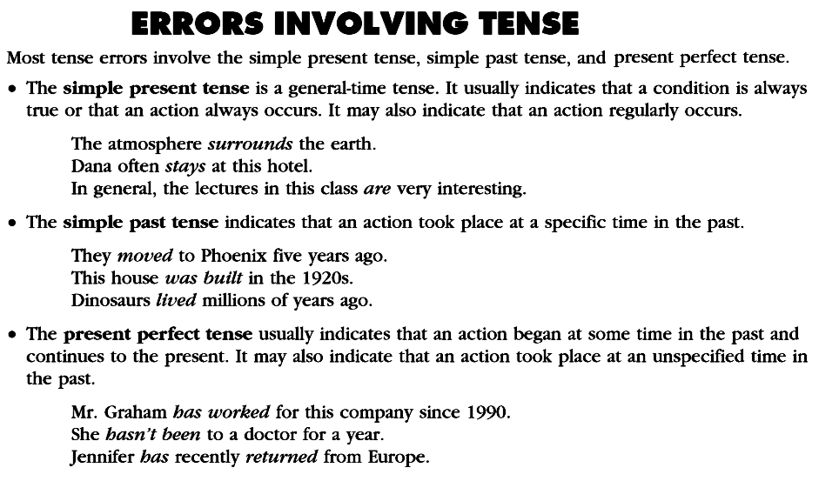
General truth/fact: simple present→Subj+Vb1
occurs
…since 1945: present perfect→Subj+have+Vb3
have risen

Slide 10
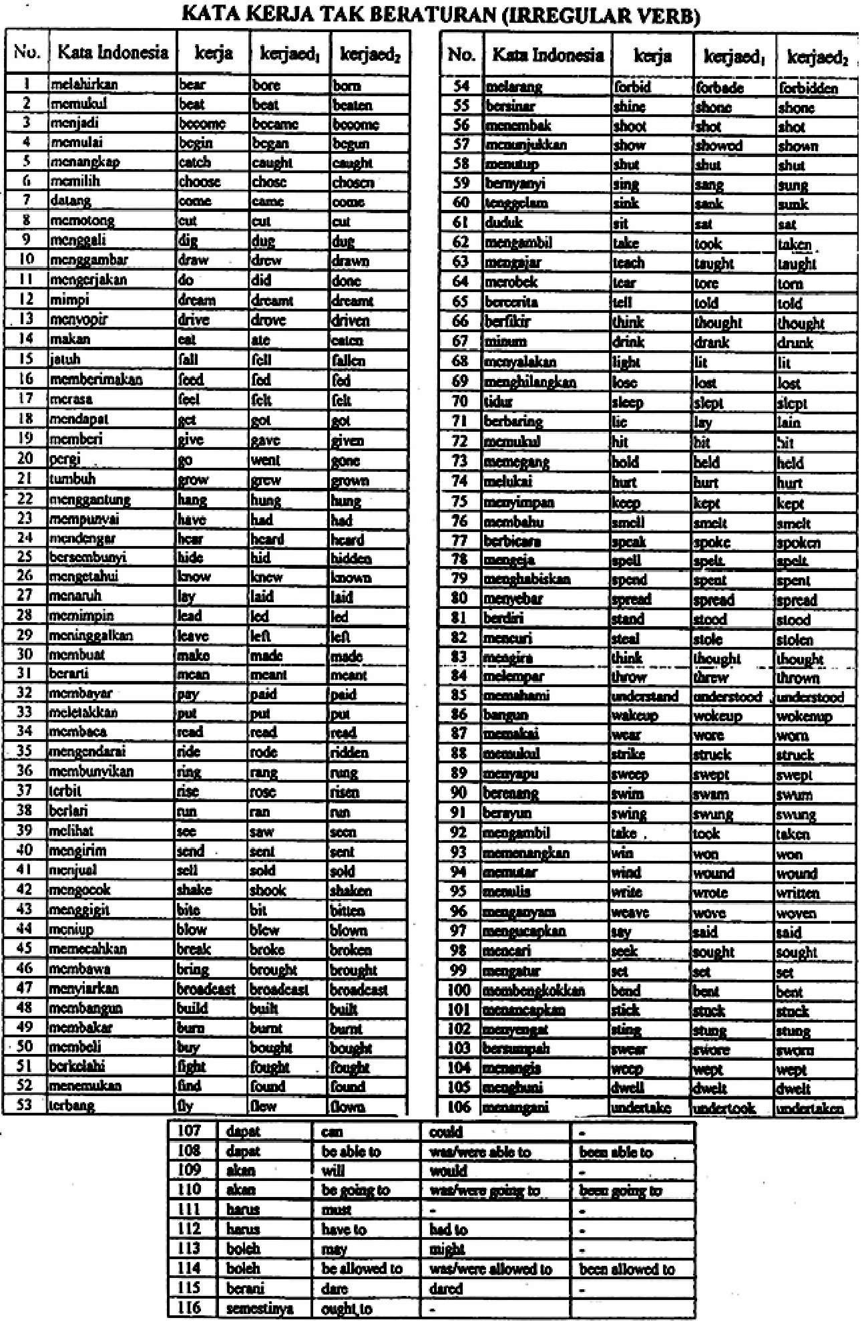
Irregular Verbs

Slide 11
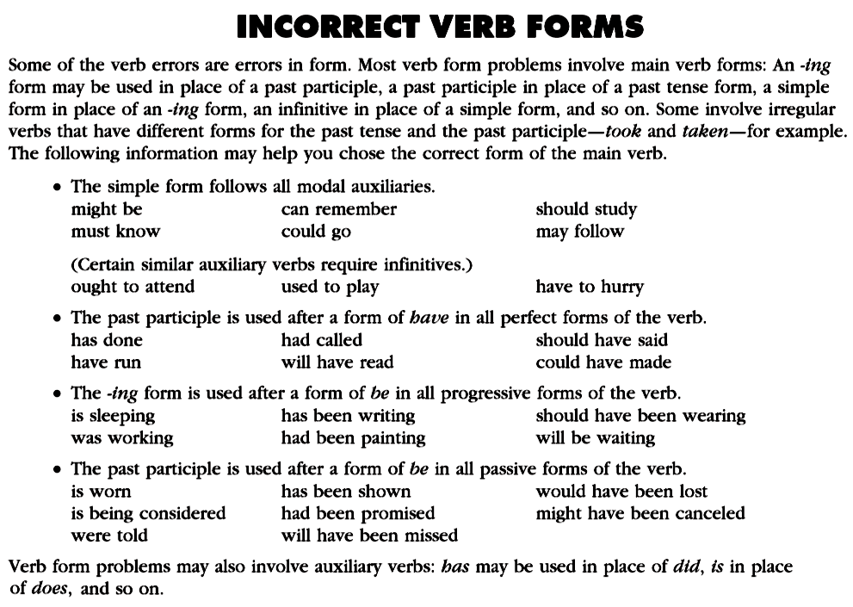
past:Vb2 past
modal+Vb
to reach
does
Auxiliary do/does is used instead of to be.
Compare: Dextrose is not as sweet as table sugar is.

Slide 12
Comparison
The sentence of comparisons can have 3 possible structures:
(subject+auxiliary / auxiliary+subject / object)
Their houses are bigger than me. ✗ (houses must be compared to house)
a. Their houses are bigger than my house is. ✓ (subj+aux)
b. Their houses are bigger than is my house. ✓ (aux+subj)
c. Their houses are bigger than mine. ✓ (object)
Their cats have caught more mice than my cat has.// …has my cat. ✓
My kite flies higher than does the man.✗ (kites cannot be compared to people)
My kite flies higher than does the man’s. ✓
a. Sometimes, a motorcycle costs more expensive than cars do. ✓
b. Sometimes, a motorcycle costs more expensive than do cars. ✓
c. Sometimes, a motorcycle costs more expensive than cars. ✓
I believe that morality is more important than are money and career. ✓
He has predicted that Jokowi has more voters than has Prabowo. ✗
He has predicted that Jokowi has more voters than does Prabowo. ✓

Slide 13
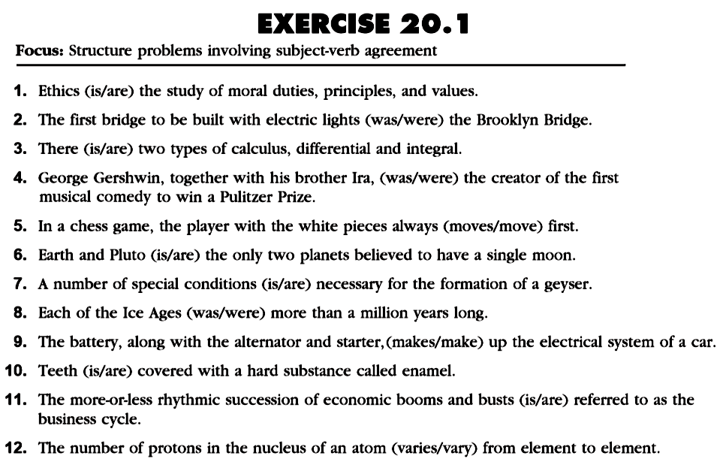
Page 93
Field of study (Physics/Economics/Statistics)→singular
Subject (The first bridge)→singular
Subject: two types…→plural
Subject: George Gershwin…→singular
Subject: the player…→singular
Subject: Earth and Pluto →plural
A number of + plural noun →plural
Each/Every + singular noun / of plural noun → singular verb
Subject: The battery →singular
Teeth (plural of tooth) →plural
Subject: rhythmic succession…→singular
The number of + plural noun →singular

Slide 14
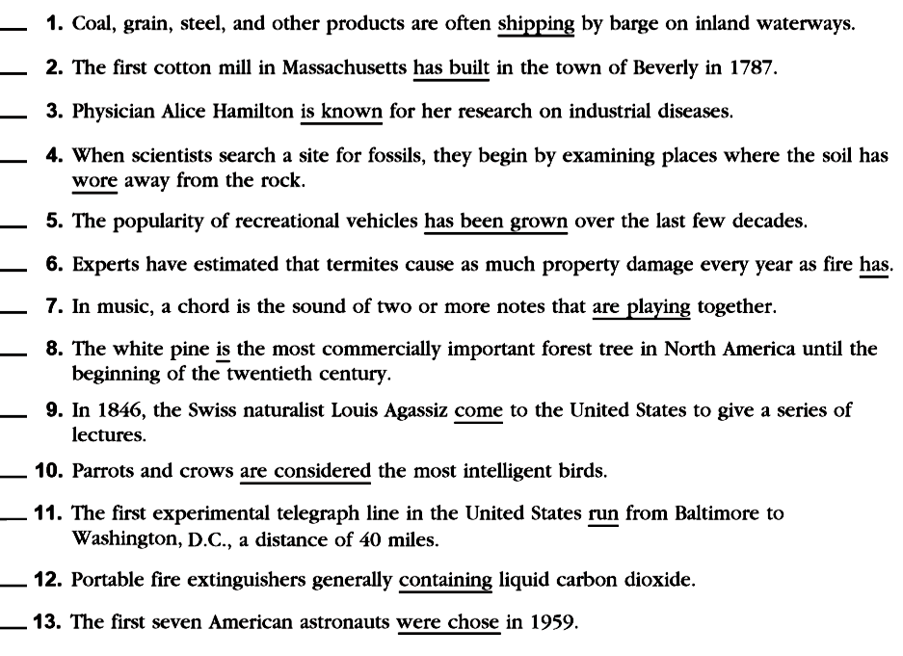
Page 94
X
meaning:passive (tobe + Vb3)→are…shipped
X
meaning:passive (past tense)→was built
C
X
X
has +Vb3→worn
meaning:active (perfect tense)→has been grown
X
comparison:parallel (termites cause)→…fire does
X
was →Time: until …20th century (past)
are played → meaning:passive
X
X
Time:in 1846 (past)→came
C
X
Logic of sentence (past tense)→ran
X
Predicate (plural Subj)→contain
X
meaning:passive (to be+Vb3)→were chosen

Slide 15
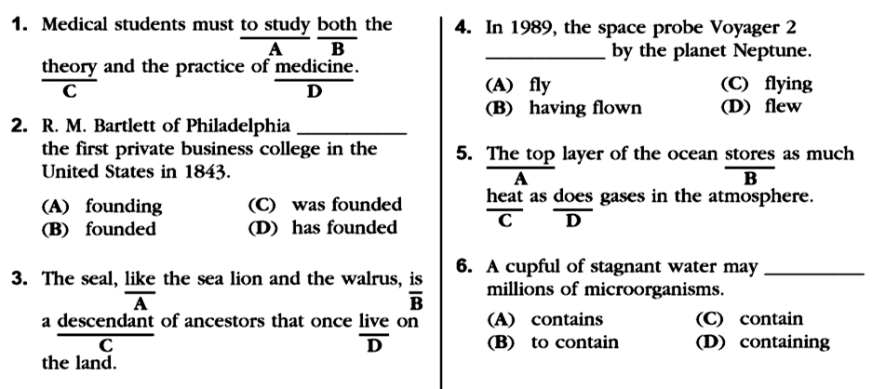
Page 95
Past tense:Vb2
==
modal+simple Vb
Active of Passive?
find – found – found → menemukan
found –founded – founded → mendirikan
comparison:subj plural (gases)→ do
Do the rest (+additional questions)
for your exercise as a quiz ONLINE.
once(pernah)→past:Vb2 lived

Slide 16
Please review again at home,
and
do the quiz/exercise online.
See you next time…

