Slide 1
17 Parallelism
Section 2: Structure & Written Expression
TOEFL Preparation
© Yosa A. Alzuhdy, M.Hum.
yosa@uny.ac.id
English Literature Study Program
State University of Yogyakarta

Slide 2
Lesson 17 - Parallelism

Slide 3
Parallel Structure
Parallel structure means using the same pattern of words to show that two or more ideas have the same level of importance. This can happen at the word, phrase, or clause level. The usual way to join parallel structures is with the use of coordinating conjunctions such as "and" or "or."
1. Words and Phrases
With the -ing form (gerund) of words:
Parallel: Mary likes hiking, swimming, and bicycling.
With infinitive phrases:
Parallel: Mary likes to hike, to swim, and to ride a bicycle. OR Mary likes to hike, swim, and ride a bicycle.
(Note: You can use "to" before all the verbs in a sentence or only before the first one.)
BENTUK YANG BERBEDA TIDAK BOLEH DICAMPUR ADUK!

Slide 4
Parallel Structure
Not Parallel: Mary likes hiking, swimming, and to ride a bicycle.
Parallel: Mary likes hiking, swimming, and riding a bicycle.
Not Parallel: The production manager was asked to write his report quickly, accurately, and in a detailed manner.
Parallel: The production manager was asked to write his report quickly, accurately, and thoroughly.
Not Parallel: The teacher said that he was a poor student because he waited until the last minute to study for the exam, completed his lab problems in a careless manner, and his motivation was low.
Parallel: The teacher said that he was a poor student because he waited until the last minute to study for the exam, completed his lab problems in a careless manner, and lacked motivation.

Slide 5
Parallel Structure
2. Clauses
A parallel structure that begins with clauses must keep on with clauses. Changing to another pattern or changing the voice of the verb (from active to passive or vice versa) will break the parallelism.
Not Parallel: The coach told the players that they should get a lot of sleep, that they should not eat too much, and to do some warm-up exercises before the game.
Parallel: The coach told the players that they should get a lot of sleep, that they should not eat too much, and that they should do some warm-up exercises before the game.
-- or --
Parallel: The coach told the players that they should get a lot of sleep, not eat too much, and do some warm-up exercises before the game.

Slide 6
Parallel Structure
Not Parallel: The salesman expected that he would present his product at the meeting, that there would be time for him to show his slide presentation, and that questions would be asked by prospective buyers. (passive)
Parallel: The salesman expected that he would present his product at the meeting, that there would be time for him to show his slide presentation, and that prospective buyers would ask him questions.
3. Lists after a colon
Be sure to keep all the elements in a list in the same form.
Not Parallel: The dictionary can be used for these purposes: to find word meanings, pronunciations, correct spellings, and looking up irregular verbs.
Parallel: The dictionary can be used for these purposes: to find word meanings, pronunciations, correct spellings, and irregular verbs.

Slide 7
Paired Conjunctions
both…and, either…or, neither…nor, not only…but also
1. Both my mother and my sister are here.
2. Both my parents and my sister are here.
3. Not only my mother but also my sister is here.
4. Not only my sister but also my parents are here.
5. Neither my mother nor my sister is here.
6. Neither my sister nor my parents are here.
7. Neither my parents nor my sister is here.
8. Either the books or this dictionary is going to be given as the prize.
9. Either this dictionary or the books are going to be given as the prize.
Two subjects connected by both…and take a plural verb.
When two subjects are connected by not only…but also, either…or, neither…nor, the subject that is closer to the verb (the 2nd subj) determines whether the verb is singular or plural.

Slide 8
Paired Conjunctions
10. The research project will need a lot of both time and money.
11. Yesterday I not only played football but also swam in the river.
12. You must do the test not only carefully but also individually.
13. I’ll take either Islamic Banking or Management as my major.
14. This book is neither interesting nor accurate.
Notice the parallel structure: the same grammatical form.
Eg. He does not have a pen. He does not have a pencil.
→ He has neither a pen nor a pencil.
→ He doesn’t have either a pen or a pencil.
Maybe I will go to library this afternoon.
Maybe I will play tennis with Andy this afternoon.
→ I will either go to library or play tennis with Andy this afternoon.
Aini was not in class yesterday. Shofia was not in class yesterday.
→ Both Aini and Shofia were not in class yesterday.
→ Aini and Shofia were not in class yesterday.
→ Neither Aini nor Shofia was in class yesterday.

Slide 9
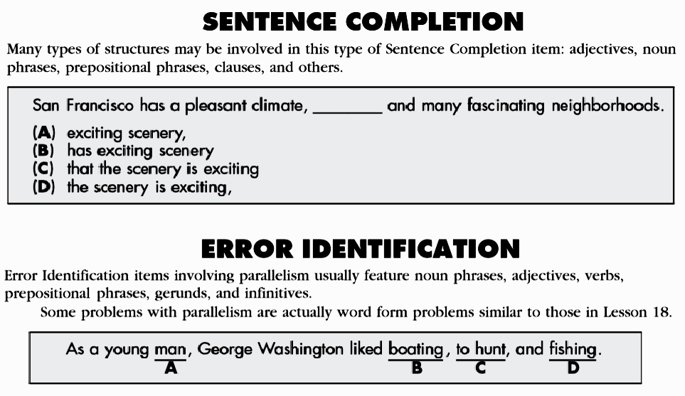
parallel in Noun phrases: adj+Noun
parallel: vb+ing→ hunting

Slide 10
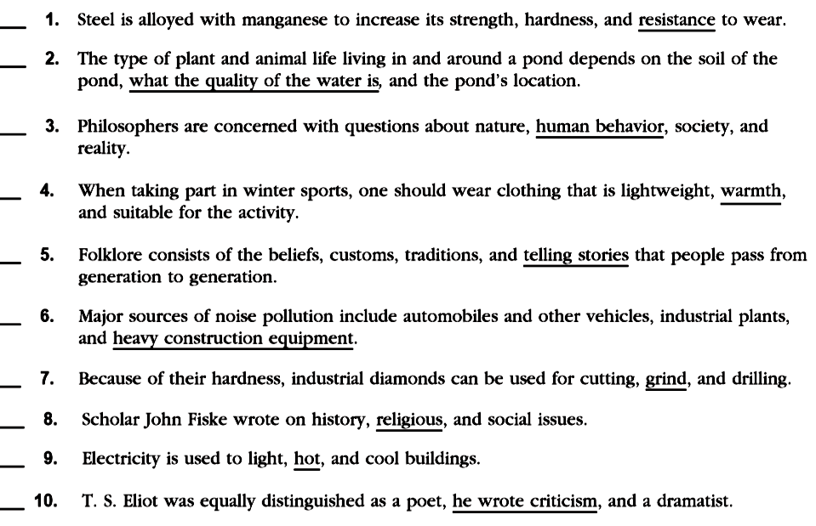
C
X
the quality of water
C
X
warm
X
stories
C
grinding
X
religions
X
verb: heat
X
a critic
X

Slide 11
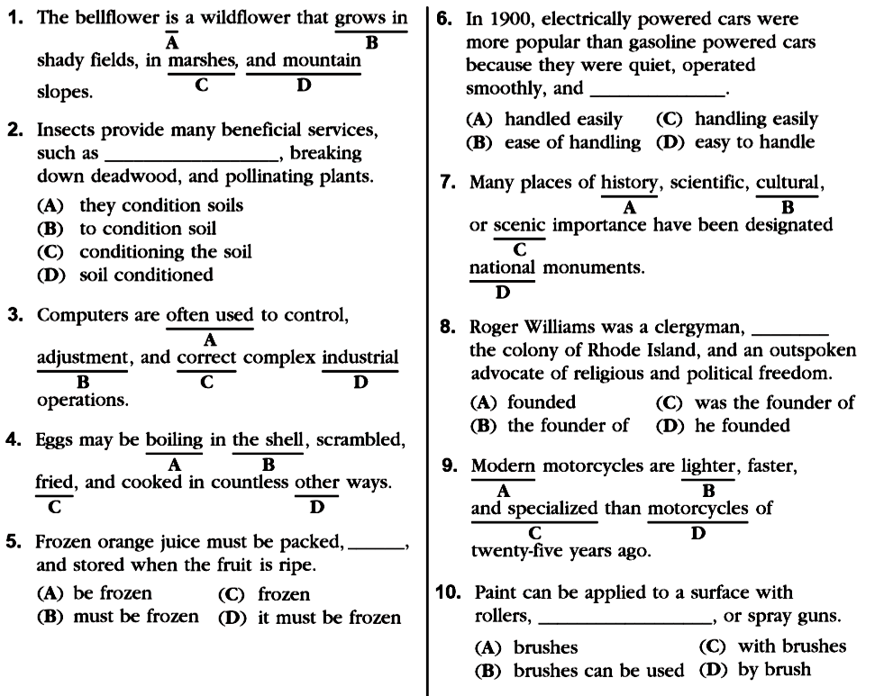
Exercise 17.2
Do the rest (+additional questions)
for your exercise as a quiz ONLINE.
and in mountain
adjust
passive: boiled

Slide 12
Please review again at home,
and
do the quiz/exercise online.
See you next time…

