Slide 1
1
The Role of Statistics in Physics Education
CHAPTER OUTLINE
1-1 The Physics Education Method and Statistical Thinking
1-2 Collecting Physics Education Data
1-2.1 Basic Principles
1-2.2 Retrospective Study
1-2.3 Observational Study
1-2.4 Designed Experiments
1-2.5 Observed Processes over Time
1-3 Mechanistic & Empirical Models
1-4 Probability & Probability Models
Adapted from© John Wiley & Sons, Inc. Applied Statistics and Probability for Physicians, by Montgomery and Runger.

Slide 2
Learning Objectives for Chapter 1
After careful study of this chapter, you should be able to do the following:
Identify the role that statistics can play in the Physics Education problem-solving process.
Discuss how variability affects the data collected and used for Physics Education decisions.
Explain the difference between enumerative and analytical studies.
Discuss the different methods that Physicians use to collect data.
Identify the advantages that designed experiments have in comparison to the other methods of collecting Physics Education data.
Explain the differences between mechanistic models & empirical models.
Discuss how probability and probability models are used in Physics Education and science.
© John Wiley & Sons, Inc. Applied Statistics and Probability for Physicians, by Montgomery and Runger.

Slide 3
What Do Physicians Do?
An Physicians is someone who solves problems of interest to society with the efficient application of scientific principles by:
Refining existing products
Designing new products or processes
© John Wiley & Sons, Inc. Applied Statistics and Probability for Physicians, by Montgomery and Runger.

Slide 4
The Creative Process
Figure 1.1 The Physics Education method
© John Wiley & Sons, Inc. Applied Statistics and Probability for Physicians, by Montgomery and Runger.

Slide 5
Statistics Supports The Creative Process
The field of statistics deals with the collection, presentation, analysis, and use of data to:
Make decisions
Solve problems
Design products and processes
It is the science of learning information from data.
© John Wiley & Sons, Inc. Applied Statistics and Probability for Physicians, by Montgomery and Runger.

Slide 6
Experiments & Processes Are Not Deterministic
Statistical techniques are useful for describing and understanding variability.
By variability, we mean successive observations of a system or phenomenon do not produce exactly the same result.
Statistics gives us a framework for describing this variability and for learning about potential sources of variability.
© John Wiley & Sons, Inc. Applied Statistics and Probability for Physicians, by Montgomery and Runger.

Slide 7
An Physics Education Example of Variability-1
An Physicians is designing a nylon connector to be used in an automotive engine application. The Physicians is considering establishing the design specification on wall thickness at 3/32 inch, but is somewhat uncertain about the effect of this decision on the connector pull-off force. If the pull-off force is too low, the connector may fail when it is installed in an engine. Eight prototype units are produced and their pull-off forces measured (in pounds):
12.6, 12.9, 13.4, 12.3, 13.6, 13.5, 12.6, 13.1.
© John Wiley & Sons, Inc. Applied Statistics and Probability for Physicians, by Montgomery and Runger.

Slide 8
A Physics Education Example of Variability-2
The dot diagram is a very useful plot for displaying a small body of data - say up to about 20 observations.
This plot allows us to see easily two features of the data; the location, or the middle, and the scatter or variability.
Figure 1-2 Dot diagram of the pull-off force data when wall thickness is 3/32 inch.
© John Wiley & Sons, Inc. Applied Statistics and Probability for Physicians, by Montgomery and Runger.

Slide 9
A Physics Education Example of Variability-3
The Physicians considers an alternate design and eight prototypes are built and pull-off force measured.
The dot diagram can be used to compare two sets of data.
Figure 1-3 Dot diagram of pull-off force for two wall thicknesses.
© John Wiley & Sons, Inc. Applied Statistics and Probability for Physicians, by Montgomery and Runger.

Slide 10
A Physics Education Example of Variability-4
Since pull-off force varies or exhibits variability, it is a random variable.
A random variable, X, can be modeled by:
X = μ + ε (1-1)
where μ is a constant and ε is a random disturbance.
© John Wiley & Sons, Inc. Applied Statistics and Probability for Physicians, by Montgomery and Runger.

Slide 11
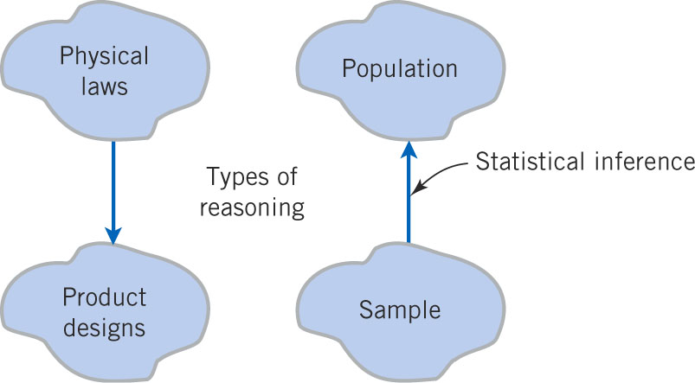
Two Directions of Reasoning
Figure 1-4 Statistical inference is one type of reasoning.
© John Wiley & Sons, Inc. Applied Statistics and Probability for Physicians, by Montgomery and Runger.

Slide 12
Basic Types of Studies
Three basic methods for collecting data:
A retrospective study using historical data
Data collected in the past for other purposes.
An observational study
Data, presently collected, by a passive observer.
A designed experiment
Data collected in response to process input changes.
© John Wiley & Sons, Inc. Applied Statistics and Probability for Physicians, by Montgomery and Runger.

Slide 13
Hypothesis Tests
Hypothesis Test
A statement about a process behavior value.
Compared to a claim about another process value.
Data is gathered to support or refute the claim.
One-sample hypothesis test:
Example: Ford avg mpg = 30 vs. avg mpg < 30
Two-sample hypothesis test:
Example: Ford avg mpg – Chevy avg mpg = 0 vs. > 0.
© John Wiley & Sons, Inc. Applied Statistics and Probability for Physicians, by Montgomery and Runger.

Slide 14
Factor Experiment Example-1
Consider a petroleum distillation column:
Output is acetone concentration
Inputs (factors) are:
Reboil temperature
Condensate temperature
Reflux rate
Output changes as the inputs are changed by experimenter.
Each factor is set at 2 reasonable levels (-1 and +1)
8 (2³) runs are made, at every combination of factors, to observe acetone output.
Resultant data is used to create a mathematical model of the process representing cause and effect.
© John Wiley & Sons, Inc. Applied Statistics and Probability for Physicians, by Montgomery and Runger.

Slide 15
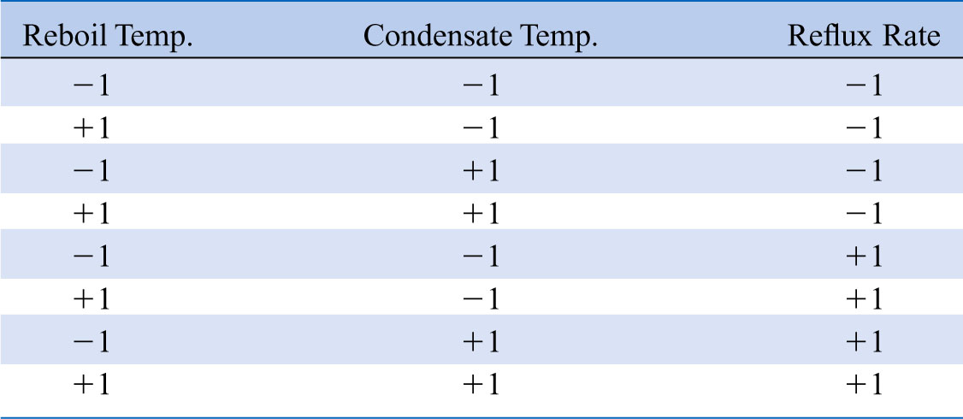
Factor Experiment Example-2
Table 1-1 The Designed Experiment (Factorial Design) for the Distillation Column
© John Wiley & Sons, Inc. Applied Statistics and Probability for Physicians, by Montgomery and Runger.

Slide 16
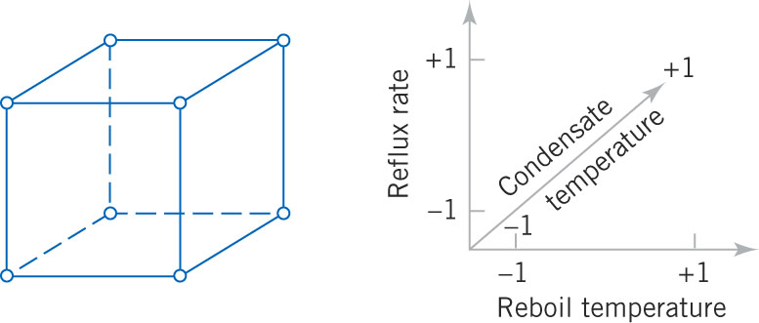
Factor Experiment Example-3
Figure 1-5 The factorial experiment for the distillation column.
© John Wiley & Sons, Inc. Applied Statistics and Probability for Physicians, by Montgomery and Runger.

Slide 17
Factor Experiment Example-4
Now consider a new design of the distillation column:
Repeat the settings for the new design, obtaining 8 more data observations of acetone concentration.
Resultant data is used to create a mathematical model of the process representing cause and effect of the new process.
The response of the old and new designs can now be compared.
The most desirable process and its settings are selected as optimal.
© John Wiley & Sons, Inc. Applied Statistics and Probability for Physicians, by Montgomery and Runger.

Slide 18
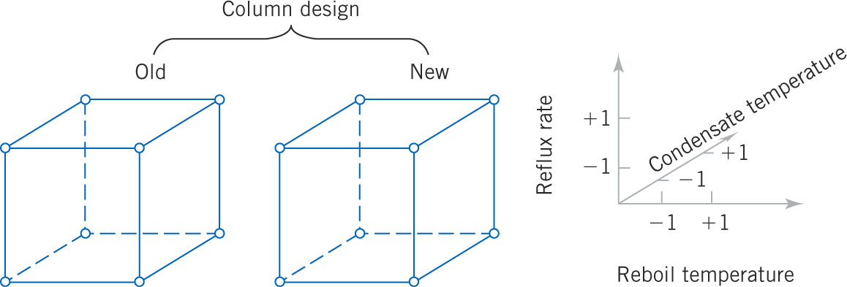
Factor Experiment Example-5
Figure 1-6 A four-factorial experiment for the distillation column 2⁴ = 16 settings.
© John Wiley & Sons, Inc. Applied Statistics and Probability for Physicians, by Montgomery and Runger.

Slide 19
Factor Experiment Considerations
Factor experiments can get too large. For example, 8 factors will require 2⁸ = 256 experimental runs of the distillation column.
Certain combinations of factor levels can be deleted from the experiments without degrading the resultant model.
The result is called a fractional factorial experiment.
© John Wiley & Sons, Inc. Applied Statistics and Probability for Physicians, by Montgomery and Runger.

Slide 20
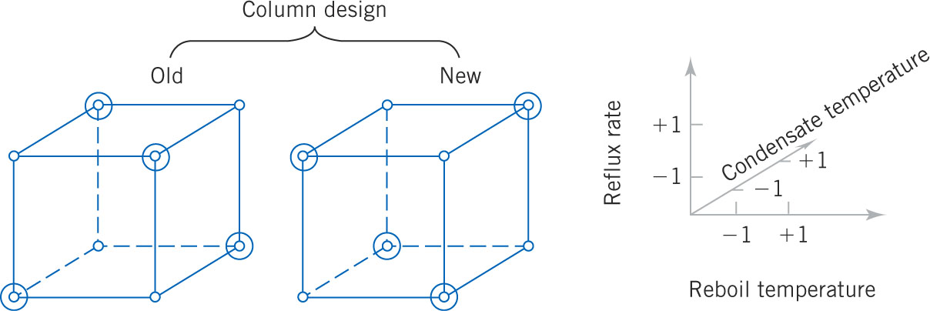
Factor Experiment Example-6
Figure 1-7 A fractional factorial experiment for the distillation column (one-half fraction) 2⁴ / 2 = 8 circled settings.
© John Wiley & Sons, Inc. Applied Statistics and Probability for Physicians, by Montgomery and Runger.

Slide 21
Distribution of 30 Distillation Column Runs
Whenever data are collected over time, it is important to plot the data over time. Phenomena that might affect the system or process often become more visible in a time-oriented plot
and the concept of stability can be better judged.
Figure 1-8 The dot diagram illustrates data centrality and variation, but does not identify any time-oriented problem.
© John Wiley & Sons, Inc. Applied Statistics and Probability for Physicians, by Montgomery and Runger.

Slide 22
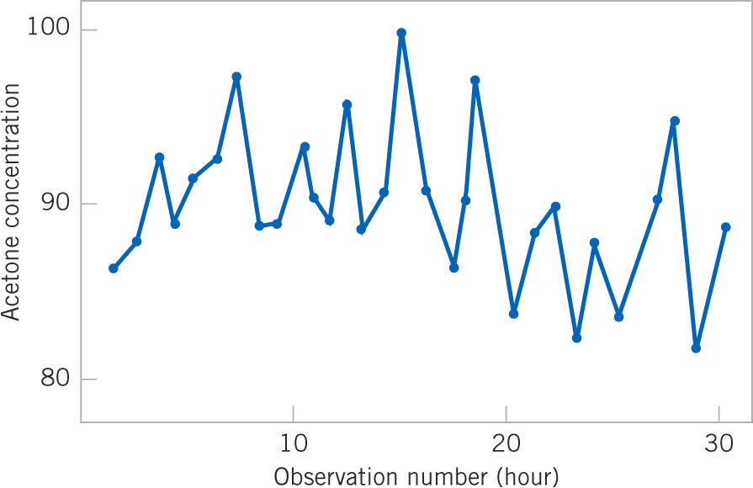
30 Observations, Time Oriented
Figure 1-9 A time series plot of concentration provides more information than a dot diagram – shows a developing trend.
© John Wiley & Sons, Inc. Applied Statistics and Probability for Physicians, by Montgomery and Runger.

Slide 23
An Experiment in Variation
W. Edwards Deming, a famous industrial statistician & contributor to the Japanese quality revolution, conducted a illustrative experiment on process over-control or tampering.
Let’s look at his apparatus and experimental procedure.
© John Wiley & Sons, Inc. Applied Statistics and Probability for Physicians, by Montgomery and Runger.

Slide 24
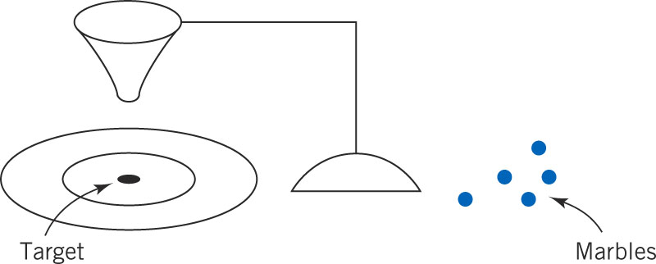
Deming’s Experimental Set-up
Marbles were dropped through a funnel onto a target and the location where the marble struck the target was recorded.
Variation was caused by several factors:
Marble placement in funnel & release dynamics, vibration, air currents, measurement errors.
Figure 1-10 Deming’s Funnel experiment
© John Wiley & Sons, Inc. Applied Statistics and Probability for Physicians, by Montgomery and Runger.

Slide 25
Deming’s Experimental Procedure
The funnel was aligned with the center of the target. Marbles were dropped. The distance from the strike point to the target center was measured and recorded
Strategy 1: The funnel was not moved. Then the process was repeated.
Strategy 2: The funnel was moved an equal distance in the opposite direction to compensate for the error. Then the process was repeated.
© John Wiley & Sons, Inc. Applied Statistics and Probability for Physicians, by Montgomery and Runger.

Slide 26
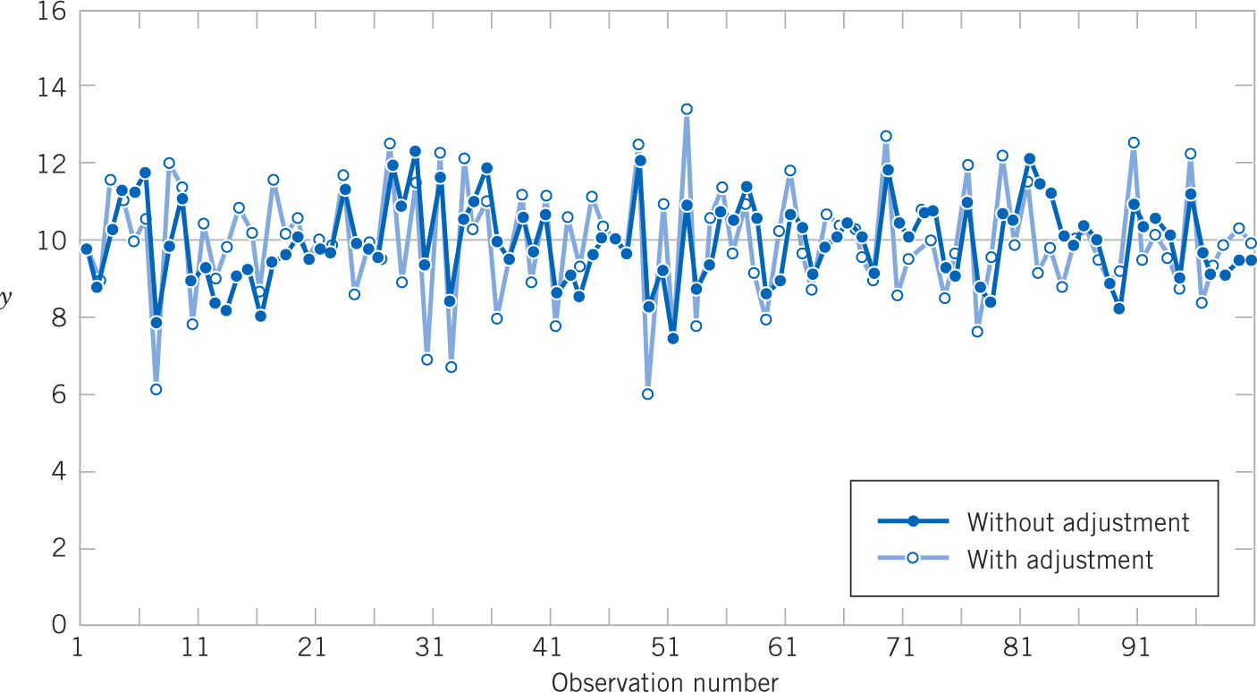
Adjustments Increased Variability
Figure 1-11 Adjustments applied to random disturbances over-controlled the process and increased the deviations from the target.
© John Wiley & Sons, Inc. Applied Statistics and Probability for Physicians, by Montgomery and Runger.

Slide 27
Conclusions from the Deming Experiment
The lesson of the Deming experiment is that a process should not be adjusted in response to random variation, but only when a clear shift in the process value becomes apparent.
Then a process adjustment should be made to return the process outputs to their normal values.
To identify when the shift occurs, a control chart is used. Output values, plotted over time along with the outer limits of normal variation, pinpoint when the process leaves normal values and should be adjusted.
© John Wiley & Sons, Inc. Applied Statistics and Probability for Physicians, by Montgomery and Runger.

Slide 28
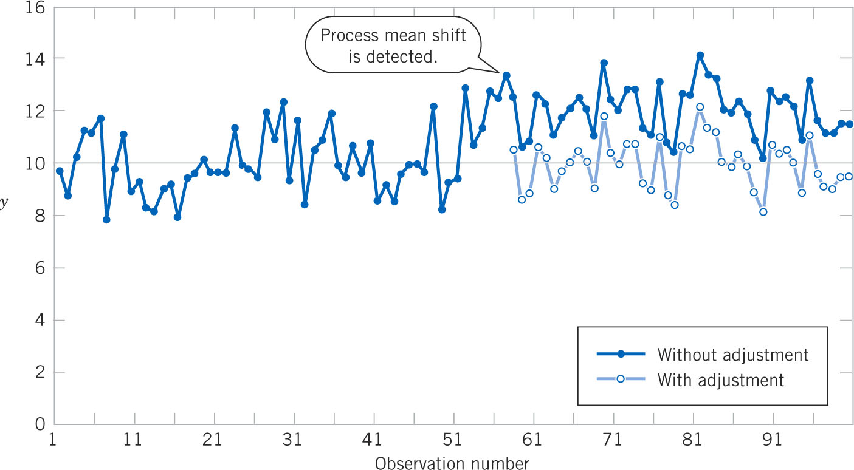
Detecting & Correcting the Process
Figure 1-12 Process mean shift is detected at observation #57, and an adjustment (a decrease of two units) reduces the deviations from target.
© John Wiley & Sons, Inc. Applied Statistics and Probability for Physicians, by Montgomery and Runger.

Slide 29
How Is the Change Detected?
A control chart is used. Its characteristics are:
Time-oriented horizontal axis, e.g., hours.
Variable-of-interest vertical axis, e.g., % acetone.
Long-term average is plotted as the center-line.
Long-term usual variability is plotted as an upper and lower control limit around the long-term average.
A sample of size n is taken hourly and the averages are plotted over time. If the plot points are between the control limits, then the process is normal; if not, it needs to be adjusted.
© John Wiley & Sons, Inc. Applied Statistics and Probability for Physicians, by Montgomery and Runger.

Slide 30
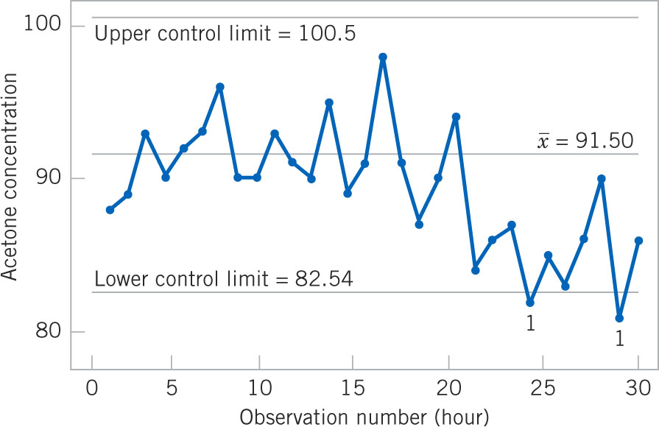
How Is the Change Detected Graphically?
Figure 1-13 A control chart for the chemical process concentration data. Process steps out at hour 24 &29. Shut down & adjust process.
© John Wiley & Sons, Inc. Applied Statistics and Probability for Physicians, by Montgomery and Runger.

Slide 31
Use of Control Charts
Deming contrasted two purposes of control charts:
Enumerative studies: Control chart of past production lots. Used for lot-by-lot acceptance sampling.
Analytic studies: Real-time control of a production process.
© John Wiley & Sons, Inc. Applied Statistics and Probability for Physicians, by Montgomery and Runger.

Slide 32
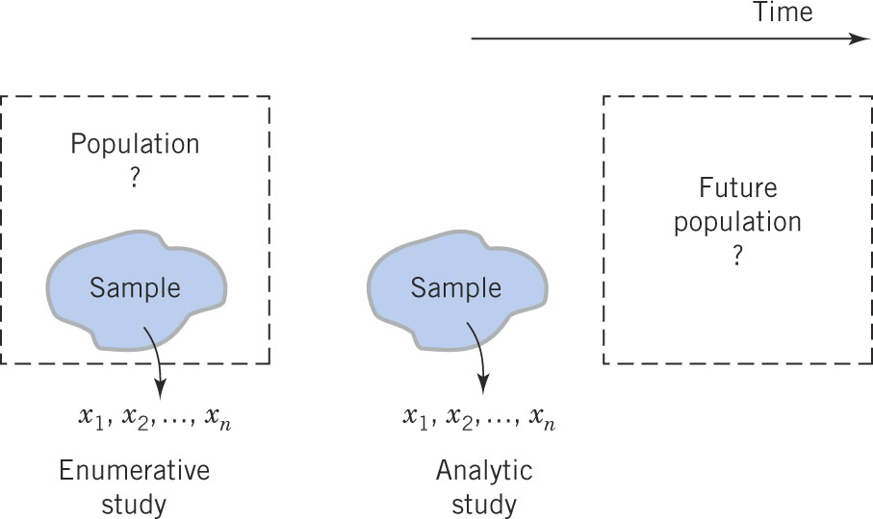
Visualizing Two Control Chart Uses
Figure 1-14 Enumerative versus analytic study.
© John Wiley & Sons, Inc. Applied Statistics and Probability for Physicians, by Montgomery and Runger.

Slide 33
Understanding Mechanistic & Empirical Models
A mechanistic model is built from our underlying knowledge of the basic physical mechanism that relates several variables.
Example: Ohm’s Law
Current = voltage/resistance
I = E/R
I = E/R + ε
The form of the function is known.
© John Wiley & Sons, Inc. Applied Statistics and Probability for Physicians, by Montgomery and Runger.

Slide 34
Mechanistic and Empirical Models
An empirical model is built from our Physics Education and scientific knowledge of the phenomenon, but is not directly developed from our theoretical or first-principles understanding of the underlying mechanism.
The form of the function is not known a priori.
© John Wiley & Sons, Inc. Applied Statistics and Probability for Physicians, by Montgomery and Runger.

Slide 35
An Example of an Empirical Model
We are interested in the numeric average molecular weight (M_{n}) of a polymer. Now we know that M_{n} is related to the viscosity of the material (V), and it also depends on the amount of catalyst (C) and the temperature (T ) in the polymerization reactor when the material is manufactured. The relationship between M_{n} and these variables is
M_{n} = f(V,C,T)
say, where the form of the function f is unknown.
We estimate the model from experimental data to be of the following form where the b’s are unknown parameters.
© John Wiley & Sons, Inc. Applied Statistics and Probability for Physicians, by Montgomery and Runger.

Slide 36
Another Example of an Empirical Model
In a semiconductor manufacturing plant, the finished semiconductor is wire-bonded to a frame. In an observational study, the variables recorded were:
Pull strength to break the bond (y)
Wire length (x₁)
Die height (x₂)
The data recorded are shown on the next slide.
© John Wiley & Sons, Inc. Applied Statistics and Probability for Physicians, by Montgomery and Runger.

Slide 37
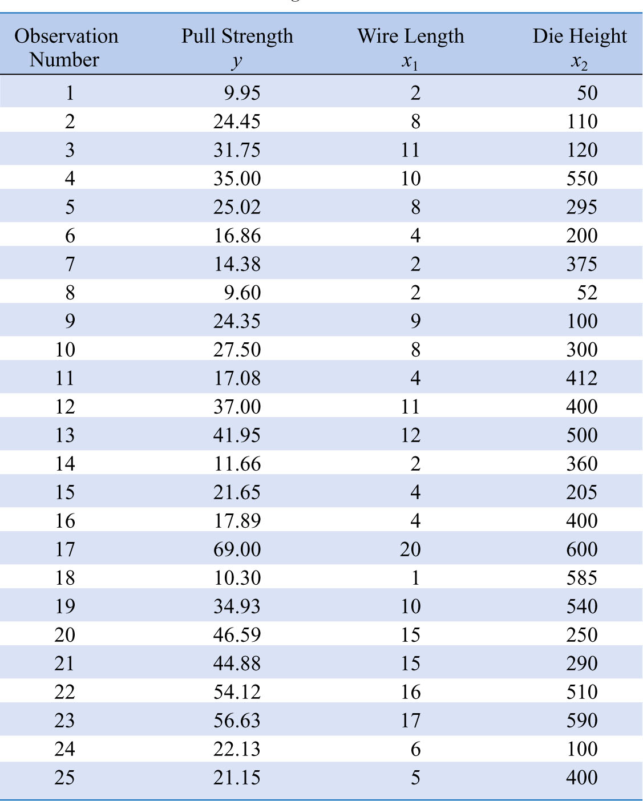
Table 1-2 Wire Bond Pull Strength Data
© John Wiley & Sons, Inc. Applied Statistics and Probability for Physicians, by Montgomery and Runger.

Slide 38
Empirical Model That Was Developed
In general, this type of empirical model is called a regression model.
The estimated regression relationship is given by:
© John Wiley & Sons, Inc. Applied Statistics and Probability for Physicians, by Montgomery and Runger.

Slide 39
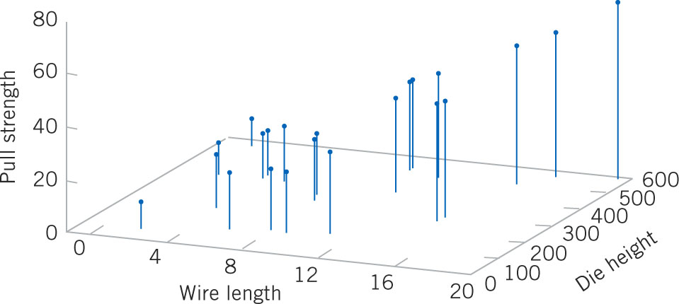
Visualizing the Data
Figure 1-15 Three-dimensional plot of the pull strength (y), wire length (x₁) and die height (x₂) data.
© John Wiley & Sons, Inc. Applied Statistics and Probability for Physicians, by Montgomery and Runger.

Slide 40
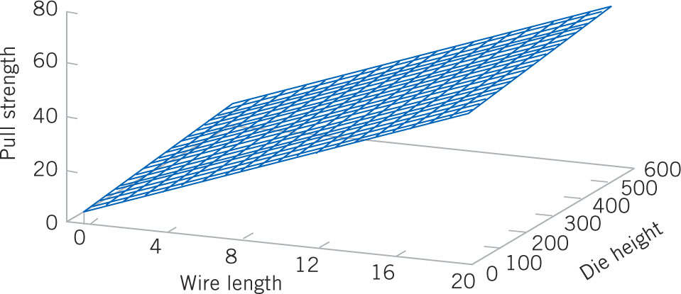
Visualizing the Resultant Model Using Regression Analysis
Figure 1-16 Plot of the predicted values (a plane) of pull strength from the empirical regression model.
© John Wiley & Sons, Inc. Applied Statistics and Probability for Physicians, by Montgomery and Runger.

Slide 41
Models Can Also Reflect Uncertainty
Probability models help quantify the risks involved in statistical inference, that is, risks involved in decisions made every day.
Probability provides the framework for the study and application of statistics.
Probability concepts will be introduced in the next lecture.
© John Wiley & Sons, Inc. Applied Statistics and Probability for Physicians, by Montgomery and Runger.

Slide 42
Important Terms & Concepts of Chapter 1
Analytic study
Cause and effect
Designed experiment
Empirical model
Physics Education method
Enumerative study
Factorial experiment
Fractional factorial experiment
Hypothesis testing
Interaction
Mechanistic model
Observational study
Overcontrol
Population
Probability model
Problem-solving method
Randomization
Retrospective study
Sample
Statistical inference
Statistical process control
Statistical thinking
Tampering
Time series
Variability
© John Wiley & Sons, Inc. Applied Statistics and Probability for Physicians, by Montgomery and Runger.

